Slide 1


Muse
AvidlyAbide

Slide 2


Muse
by Jacob Bøtter

Slide 3
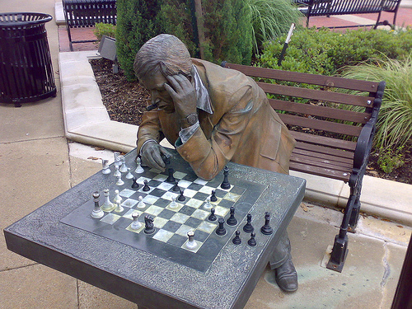

Muse
by tshein

Slide 4

    Muse – (v) / [myooz]: to become absorbed in thought; to turn something over in the mind
by Vic

Slide 5
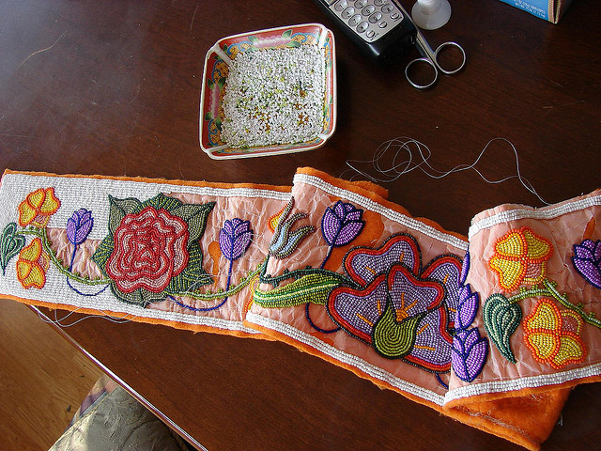

Meticulous
by echofosberg

Slide 6
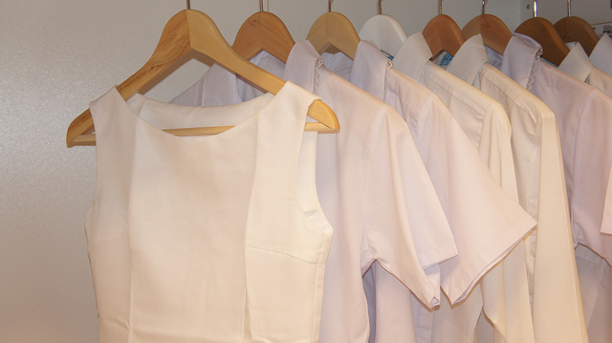
Meticulous
by epSos.de

Slide 7

Meticulous
by Tony Fischer Photography

Slide 8
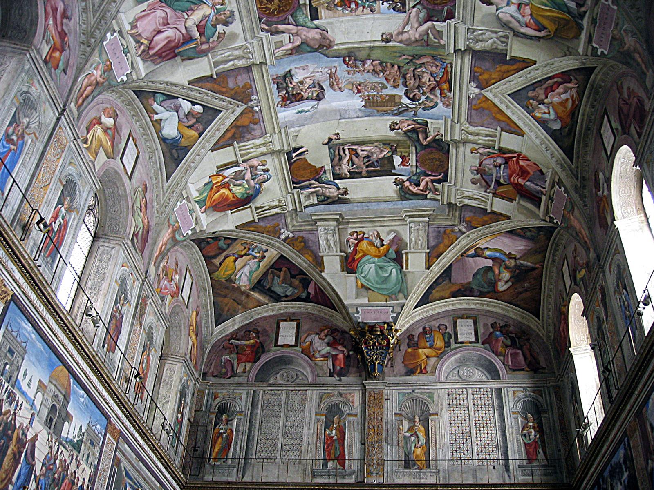
    Meticulous – (adj) / [muh-tik-yuh-luhs]: excessively careful; painstaking; scrupulous
by cking

Slide 9

Urbane
by ElizaPeyton

Slide 10
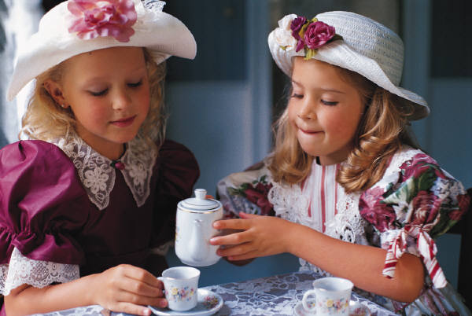
Urbane

Slide 11
Urbane

Slide 12
    Urbane – (adj) / [ur-beyn]: notably polite or polished in manner

Slide 13

Sagacity

Slide 14

Sagacity

Slide 15
Sagacity

Slide 16
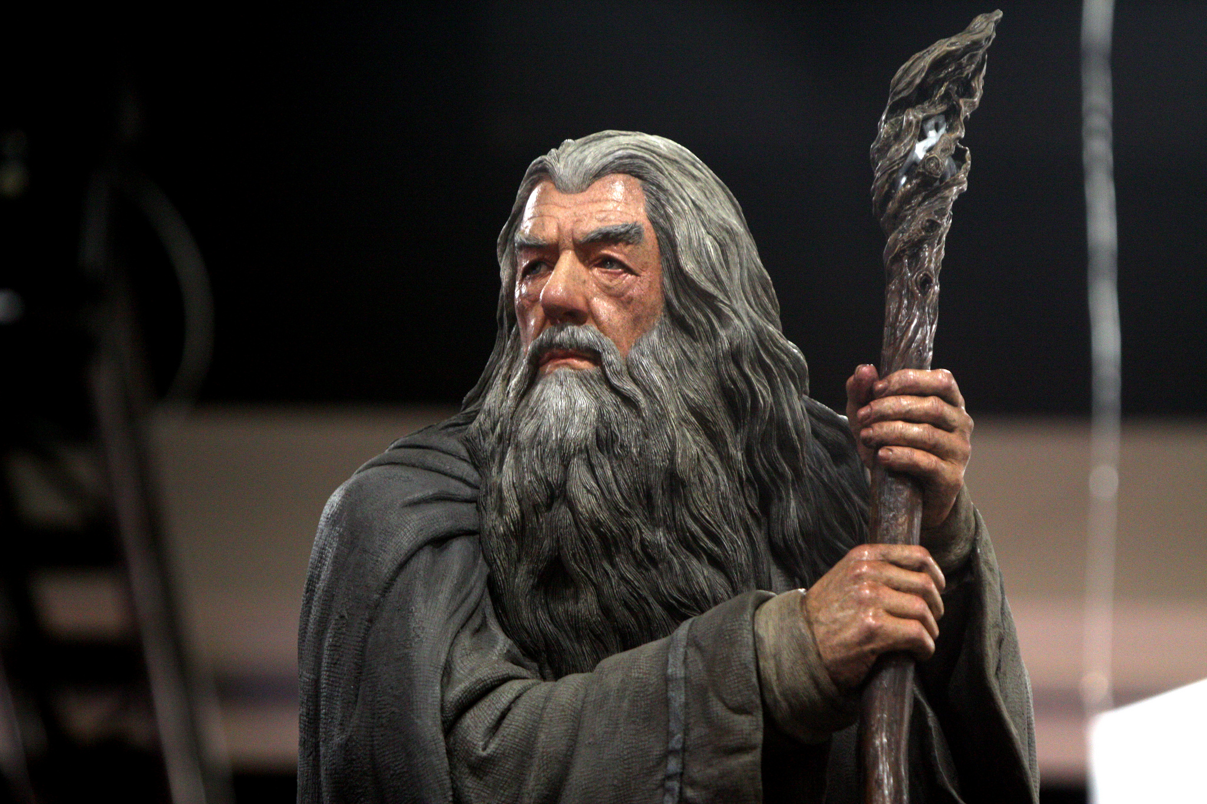
    Sagacity – (n) / [suh-gas-i-tee]: the quality of being keen in judgment
by Gage Skidmore

Slide 17

Edify
by emilio labrador

Slide 18

Edify
by www.audio-luci-store.it

Slide 19

Edify
by FutUndBeidl

Slide 20


    Edify – (v) / [ed-uh-fahy]: to instruct to improve, enlighten, or uplift

Slide 21
    Muse – (v) / [myooz]: to become absorbed in thought; to turn something over in the mind
by Vic

Slide 22
    Meticulous – (adj) / [muh-tik-yuh-luhs]: excessively careful; painstaking; scrupulous
by cking

Slide 23
    Urbane – (adj) / [ur-beyn]: notably polite or polished in manner

Slide 24
    Sagacity – (n) / [suh-gas-i-tee]: the quality of being keen in judgment
by Gage Skidmore

Slide 25
    Edify – (v) / [ed-uh-fahy]: to instruct to improve, enlighten, or uplift

