Slide 1
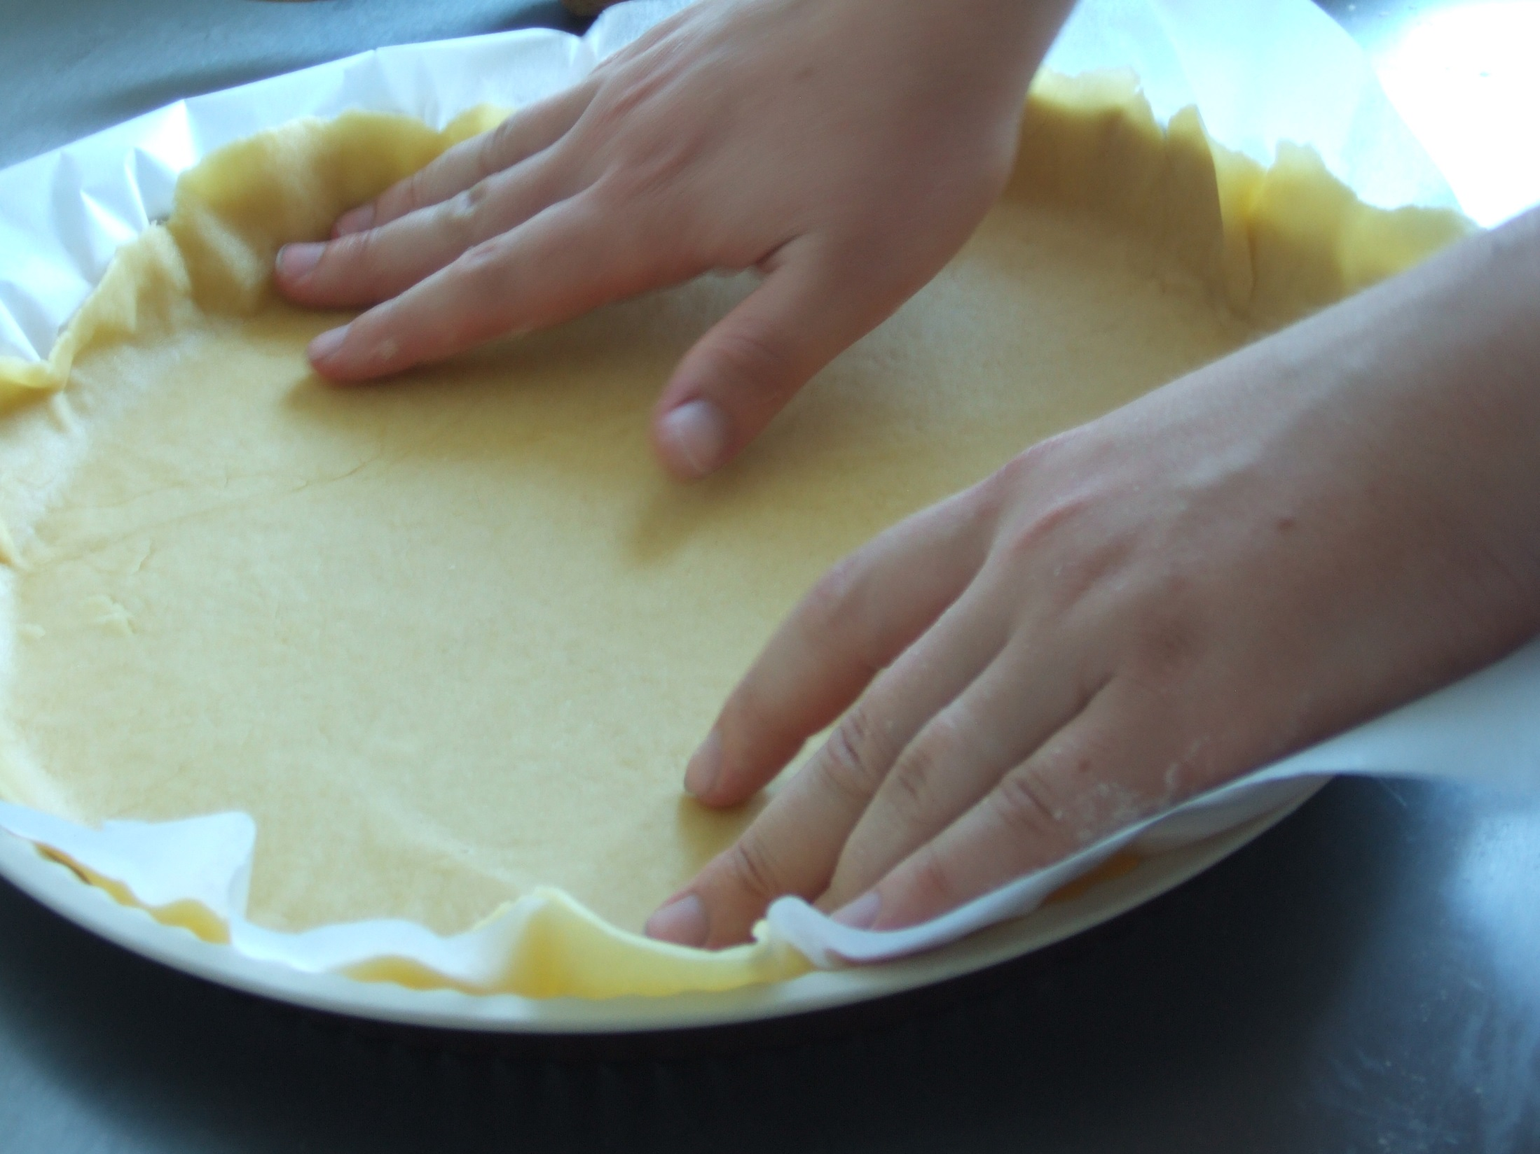

Malleable
by balise42

Slide 2
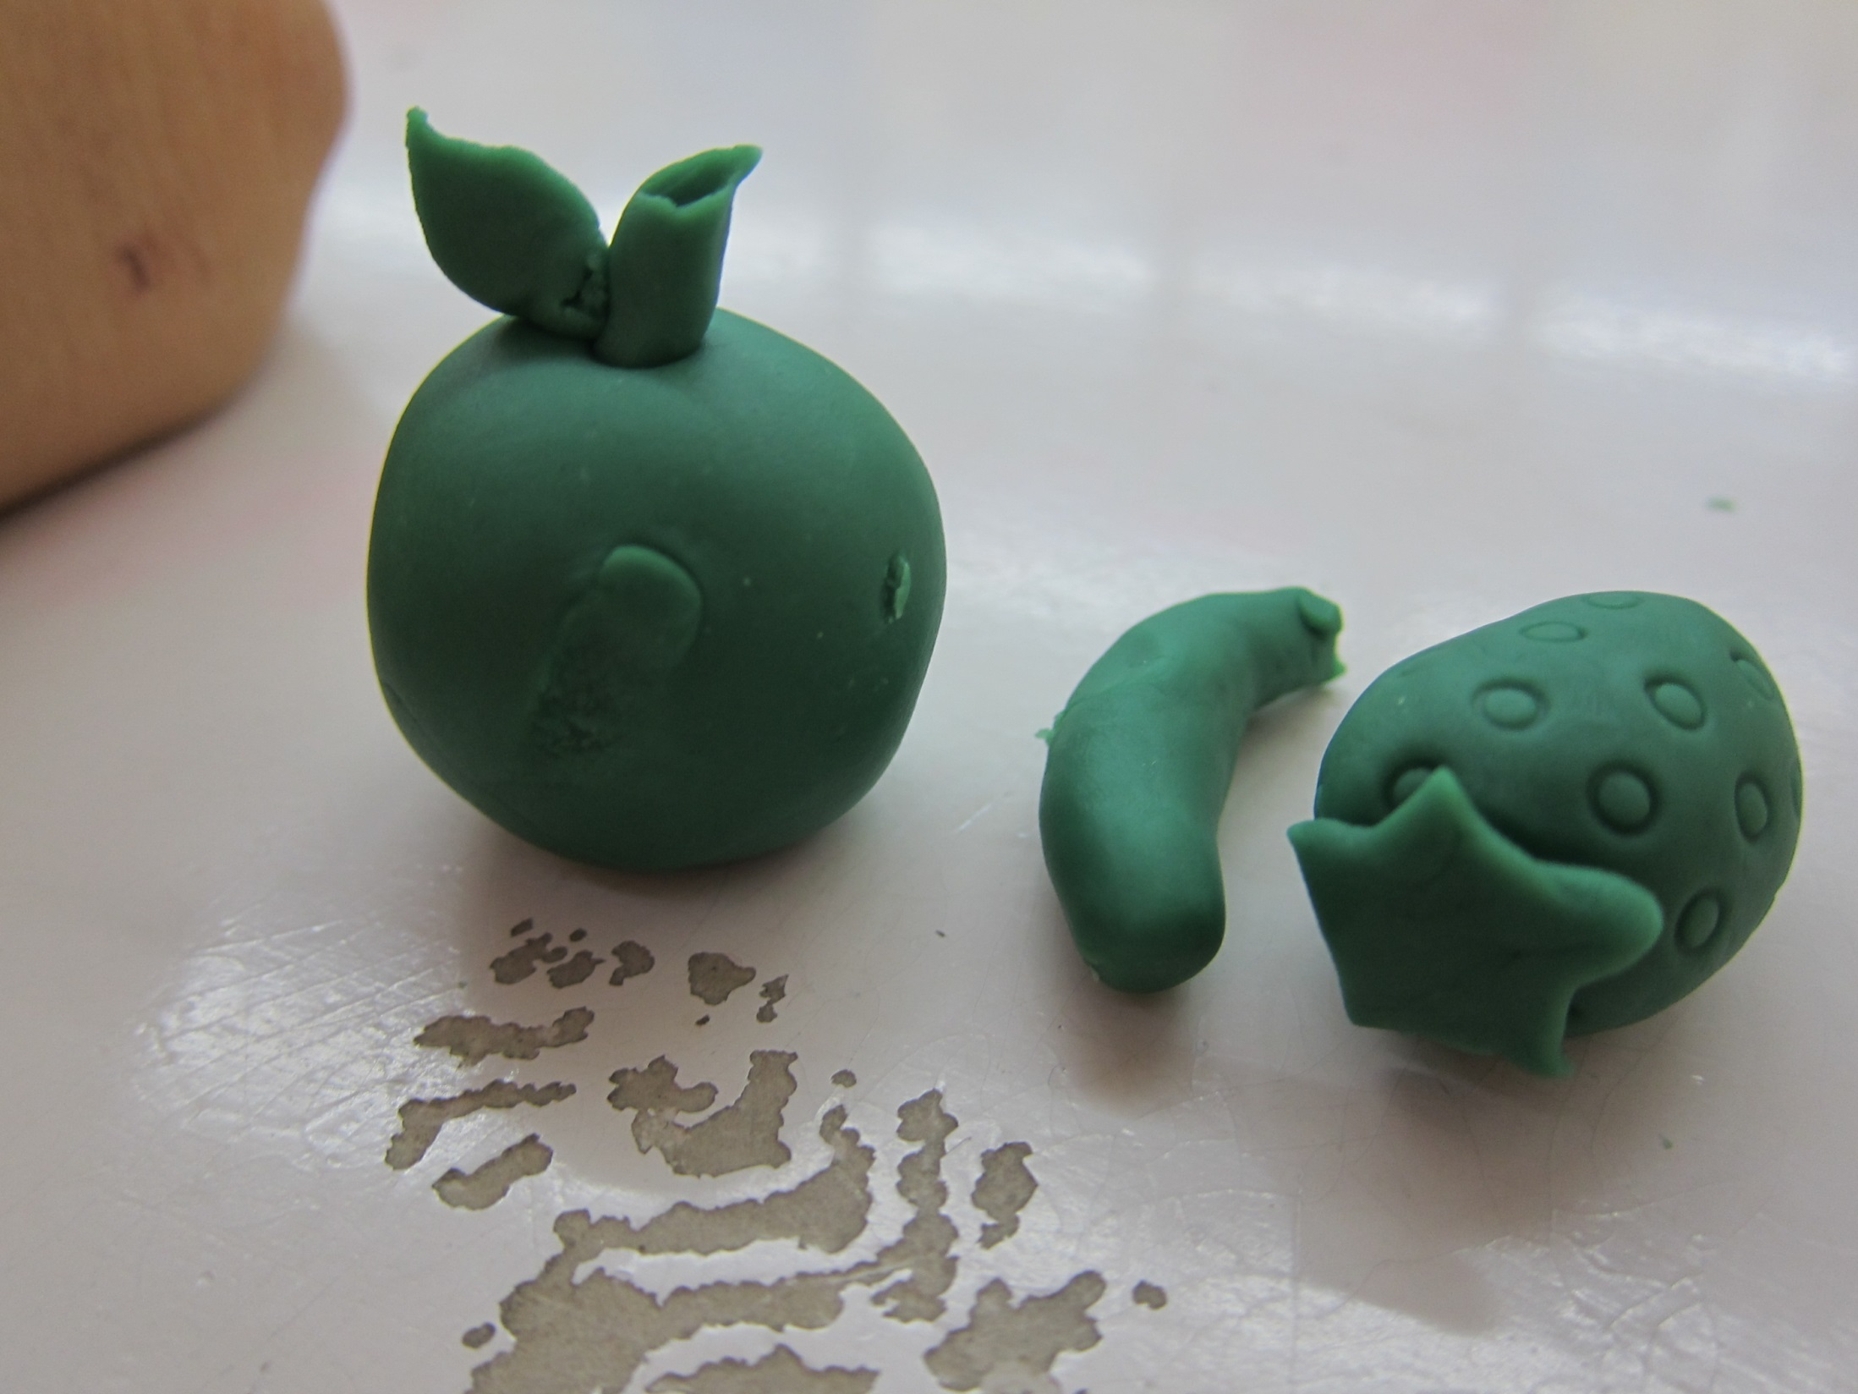
Malleable
by Micah Sittig

Slide 3
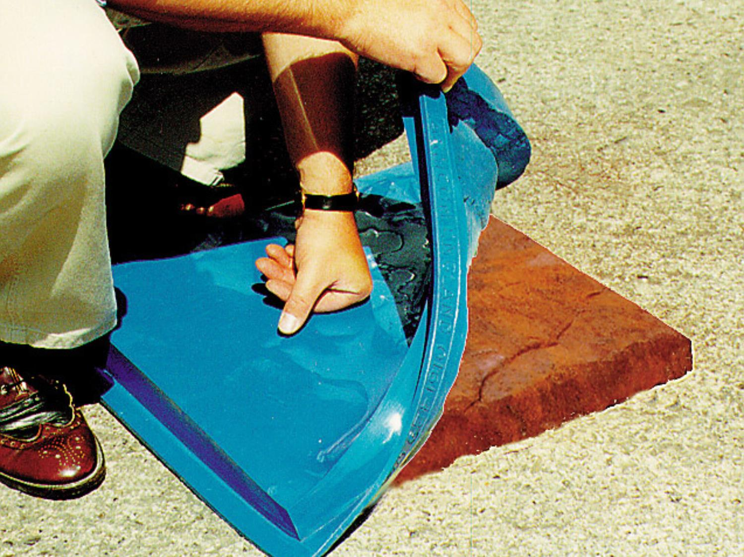
Malleable
by Armcon Precast

Slide 4
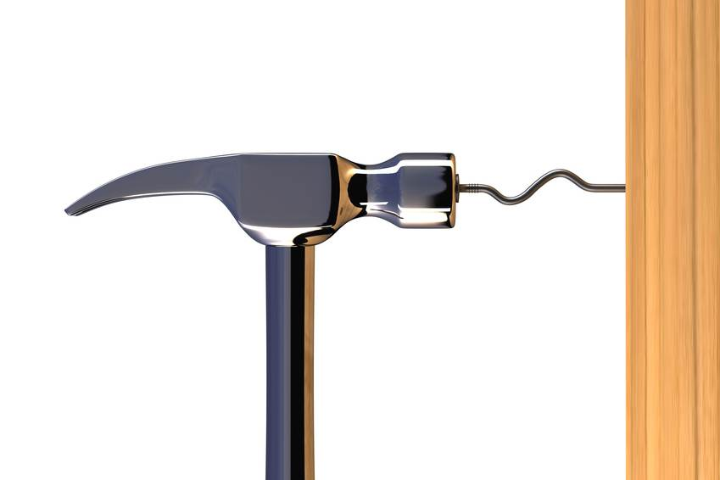
  Malleable – (adj) / [mal-ee-uh-buhl] capable of being extended or shaped by hammering or by pressure
Malleable

Slide 5
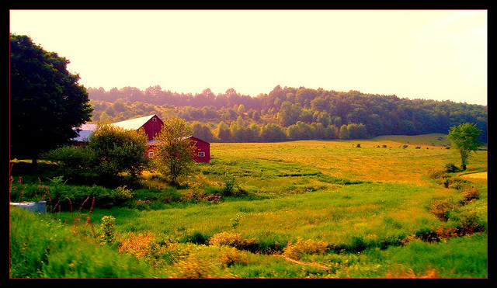

Bucolic
by Photofreak

Slide 6
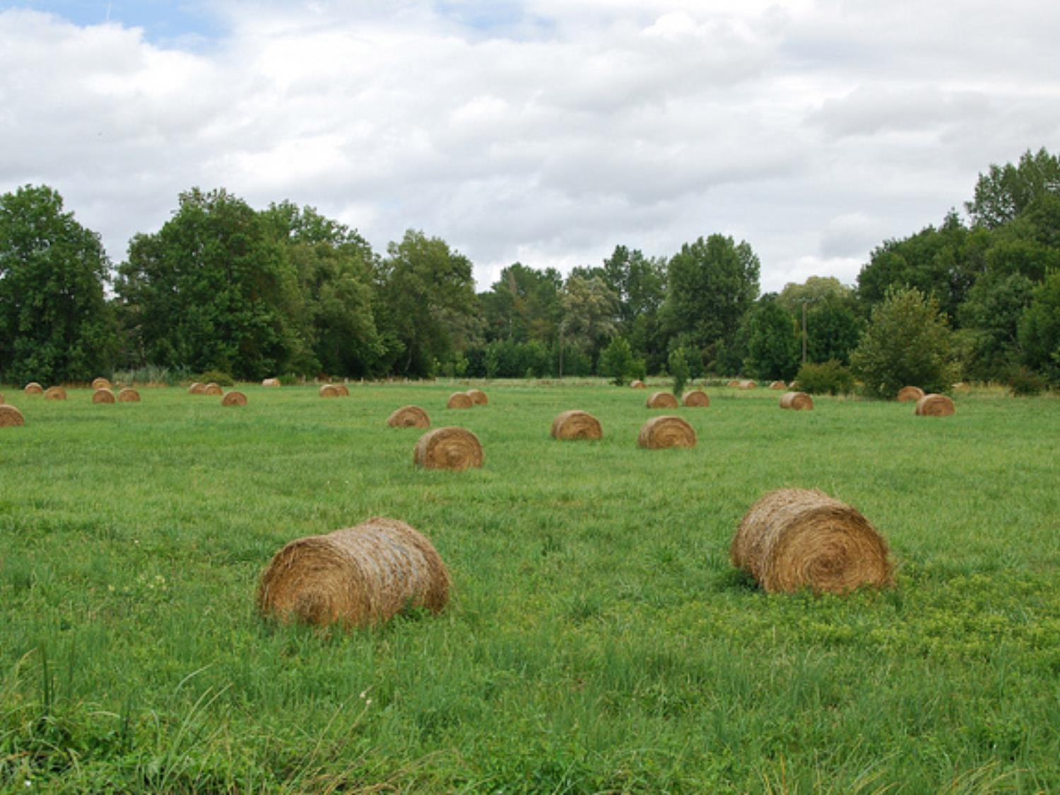

Bucolic
by Flikkesteph

Slide 7
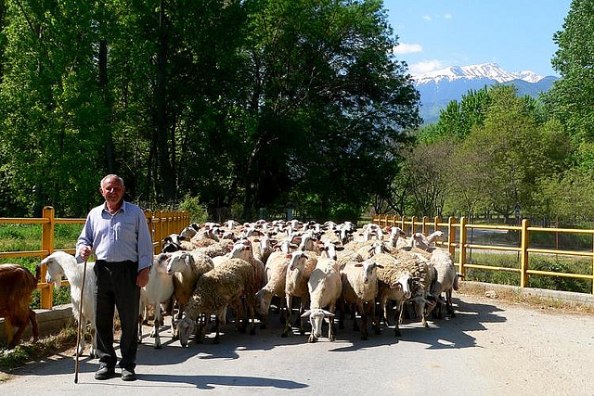

Bucolic
by Mike Bean

Slide 8
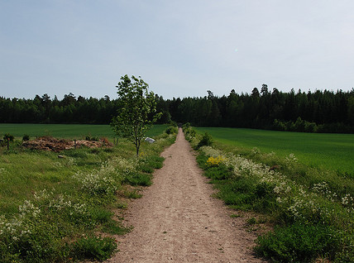
  Bucolic – (adj) / [byoo-kol-ik] of, pertaining to, or suggesting an idyllic rural life
by cstrom

Slide 9

Eloquent

Slide 10
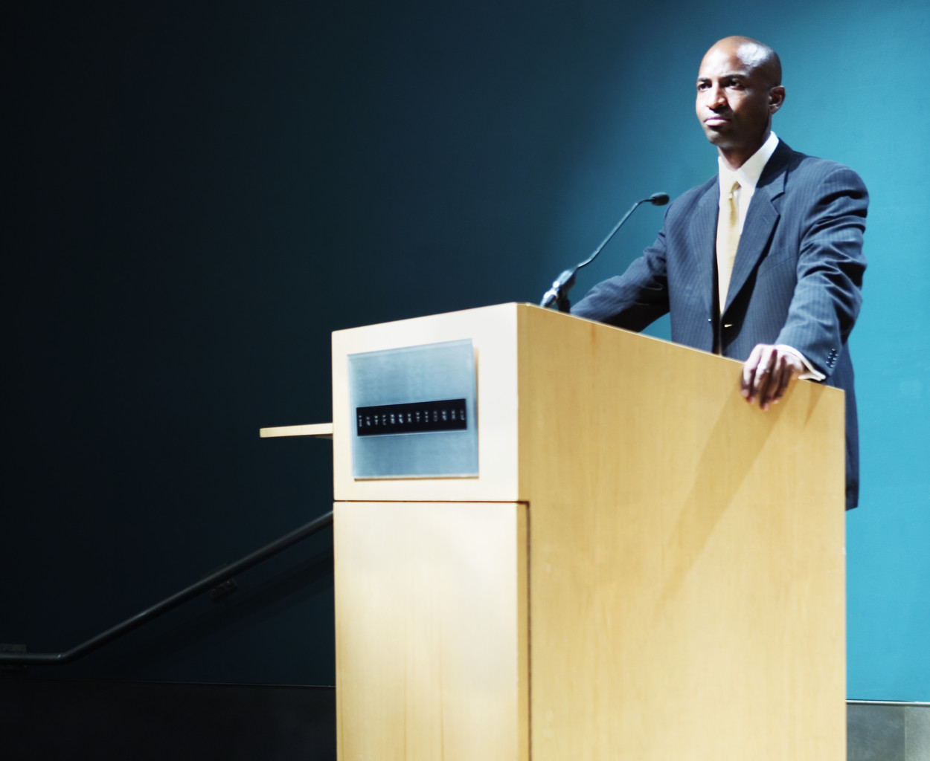
Eloquent

Slide 11
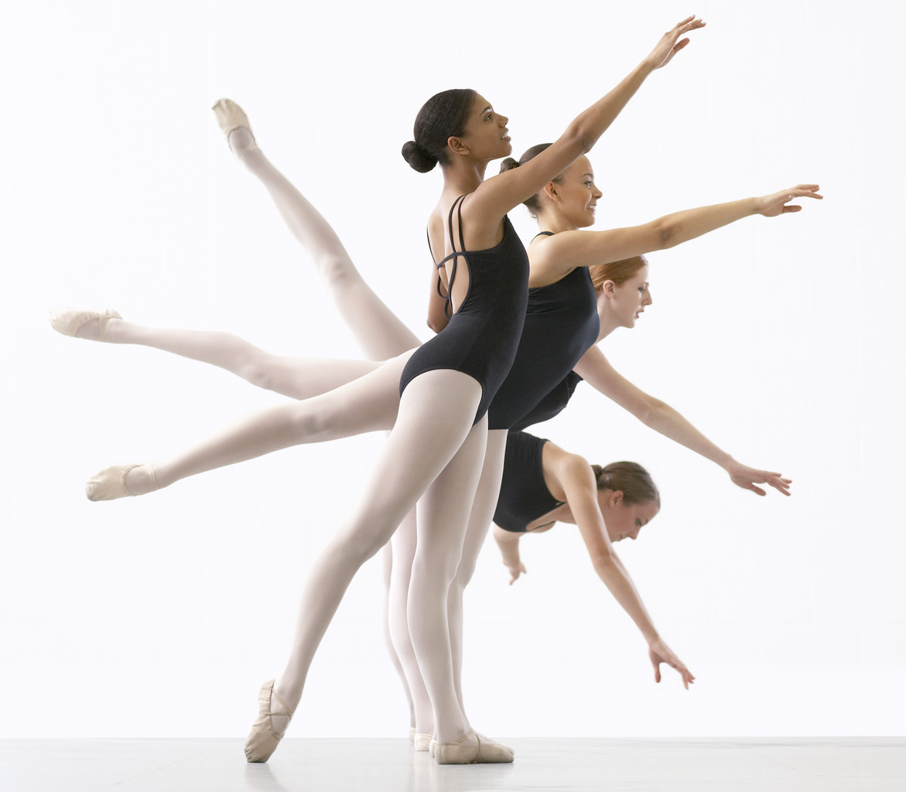
Eloquent

Slide 12
  Eloquent – (adj) / [el-uh-kwuhnt] having or exercising the power of fluent, forceful, and appropriate speech; movingly expressive

Slide 13
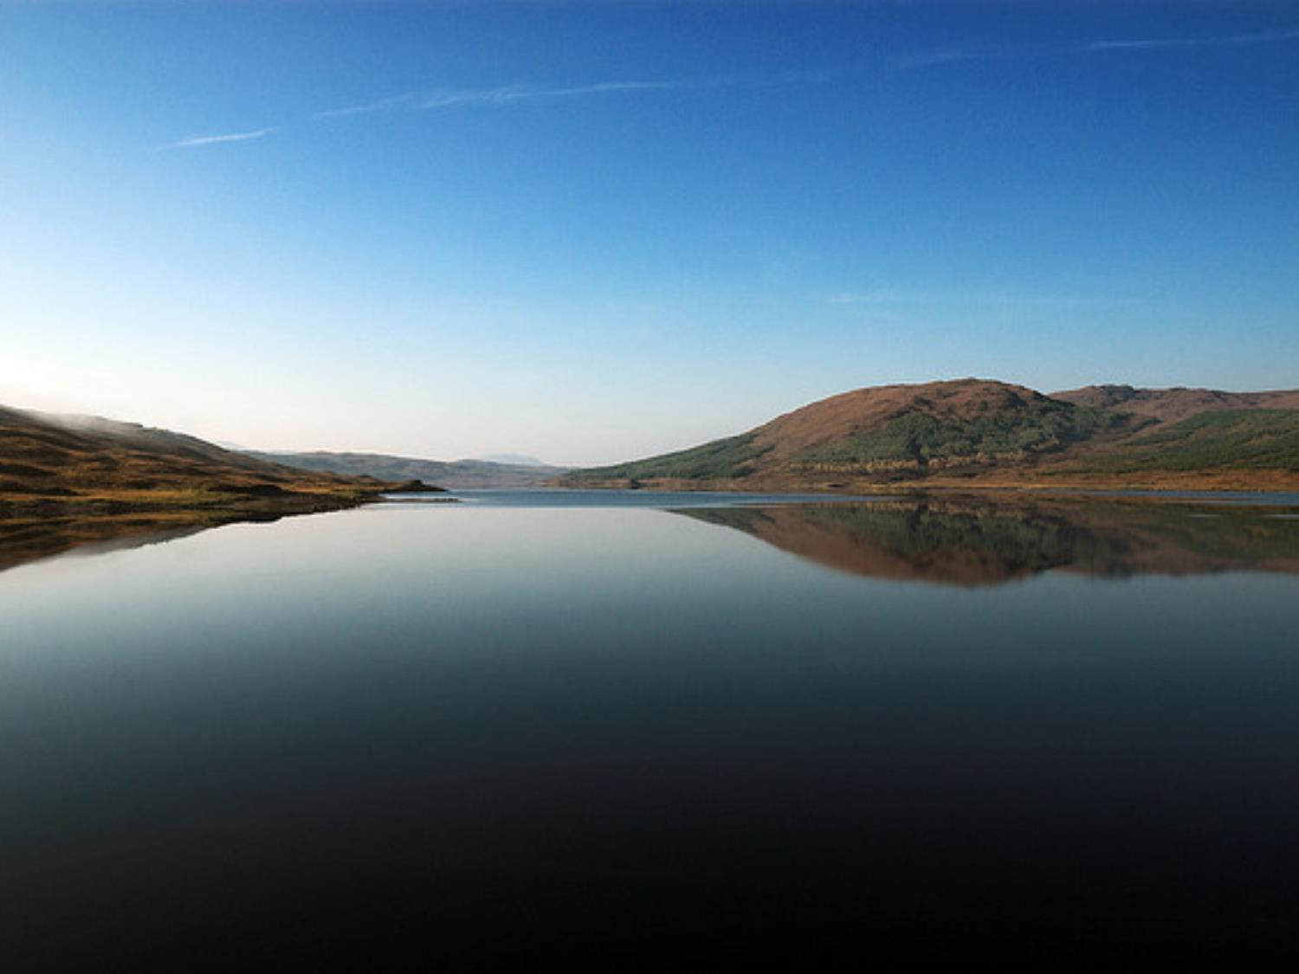
Halcyon
by atomicjeep

Slide 14
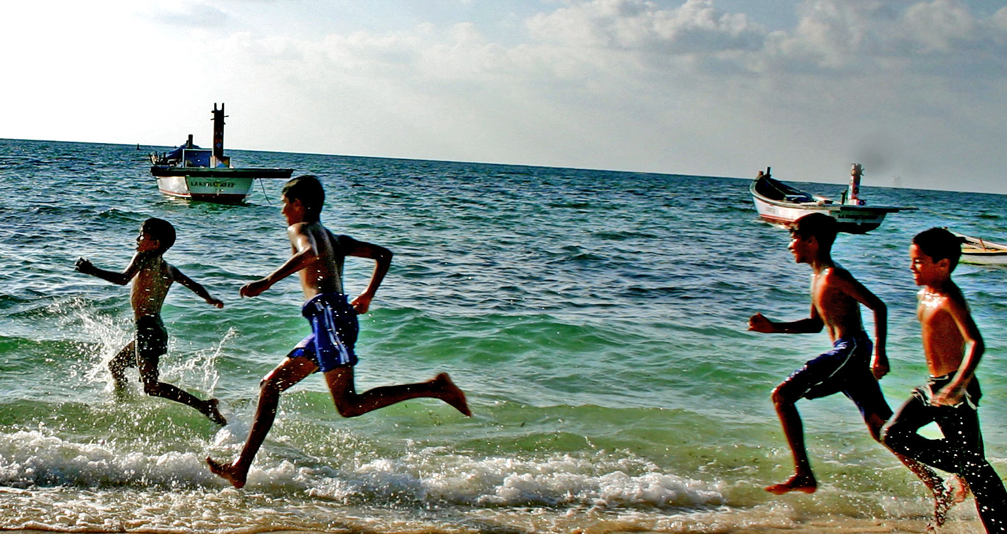
Halcyon
by icultist

Slide 15

Halcyon

Slide 16
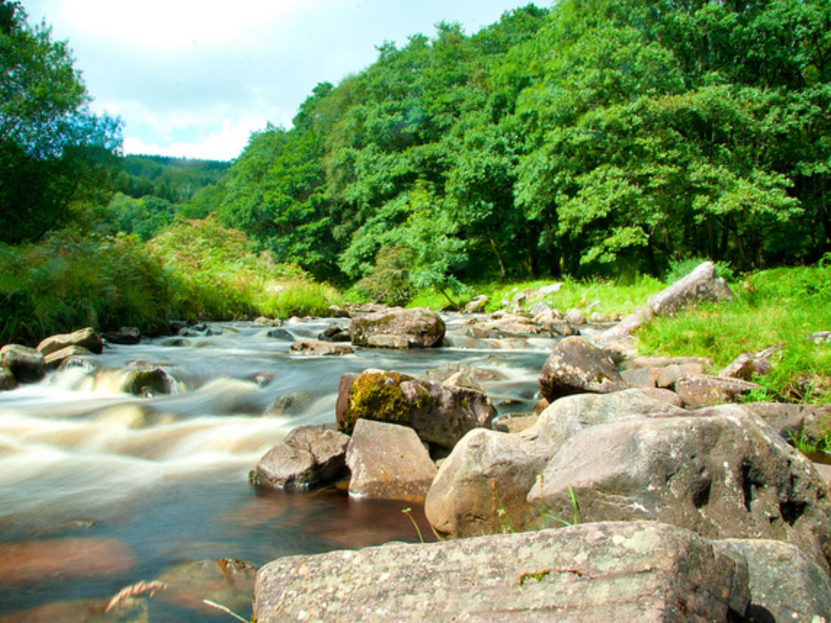
Halcyon – (adj) / [hal-see-uhn] calm; peaceful; tranquil; happy; joyful; carefree
by TWHITE87

Slide 17
  Malleable – (adj) / [mal-ee-uh-buhl] capable of being extended or shaped by hammering or by pressure from rollers
Malleable

Slide 18
  Bucolic – (adj) / [byoo-kol-ik] of, pertaining to, or suggesting an idyllic rural life
by cstrom

Slide 19
  Eloquent – (adj) / [el-uh-kwuhnt] having or exercising the power of fluent, forceful, and appropriate speech; movingly expressive

Slide 20
Halcyon – (adj) / [hal-see-uhn] calm; peaceful; tranquil; happy; joyful; carefree
by TWHITE87

