Slide 1
Miserly

Slide 2

Miserly

Slide 3
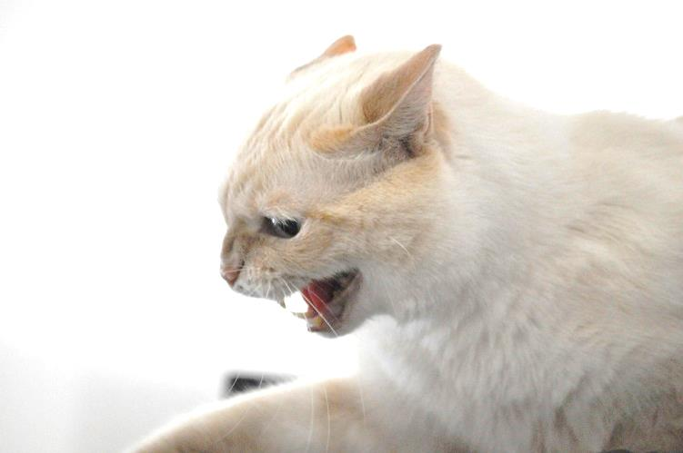

Miserly
by Brilhasti1

Slide 4
  Miserly – (adj) /
  [mahy-zer-lee]
  stingy; mean.

Slide 5
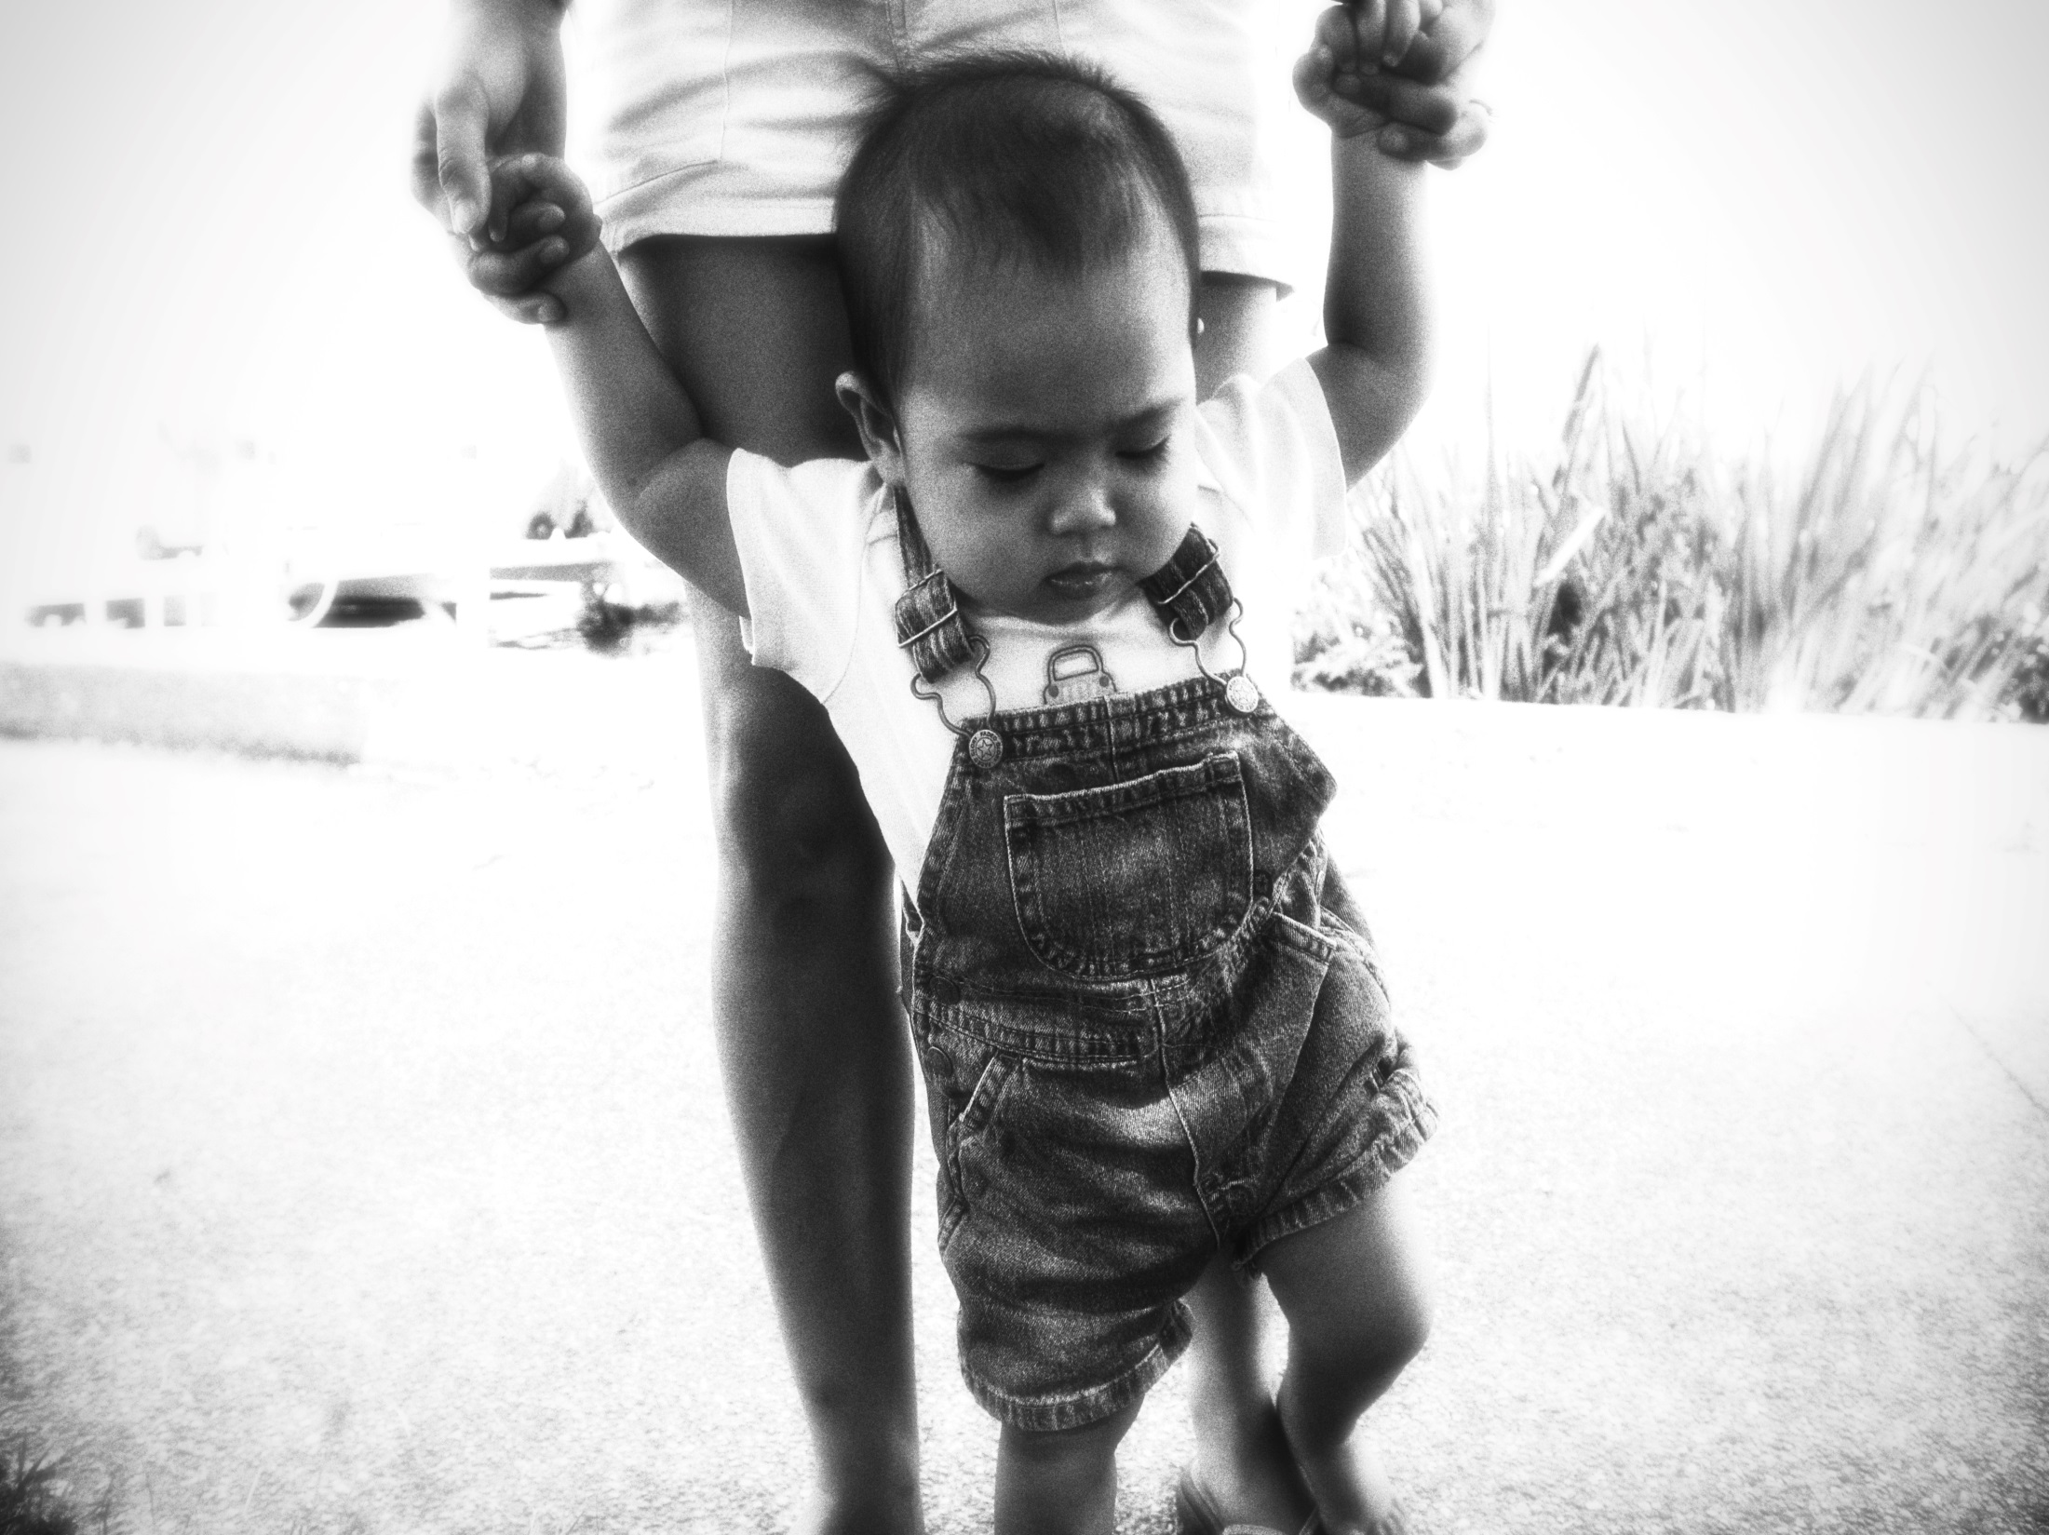
Bolster
by Tela Chhe

Slide 6
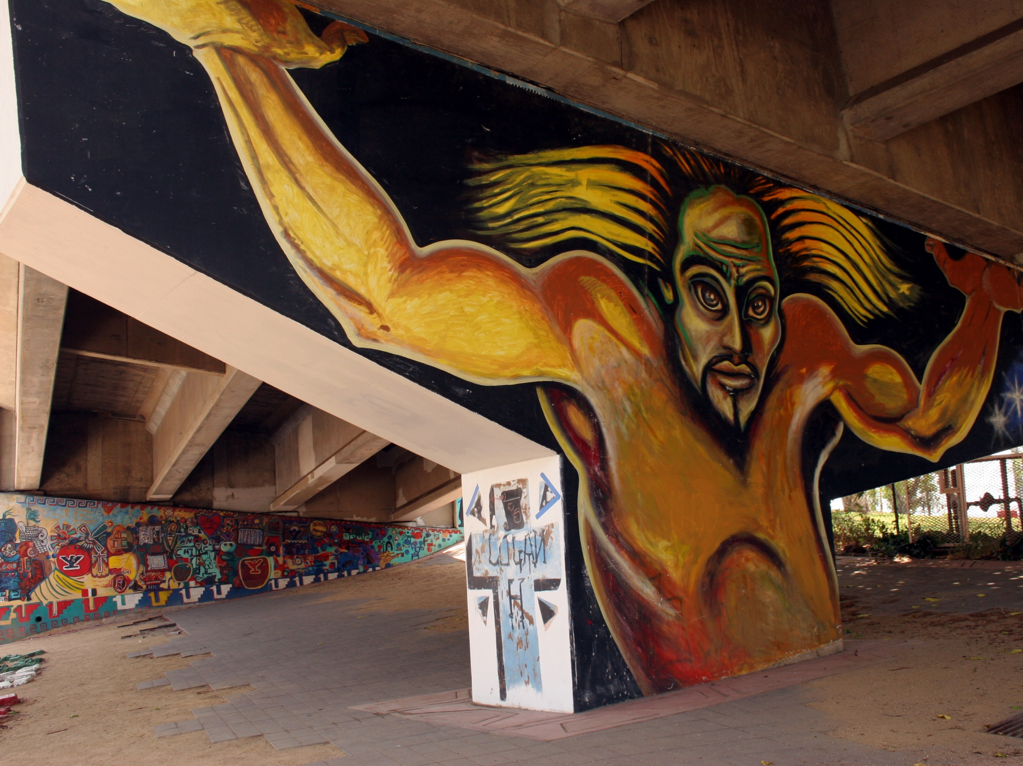
Bolster
by kellinahandbasket

Slide 7


Bolster
by woodleyeonderworks

Slide 8
  Bolster – (v) /
  [bohl-ster] support; reinforce; add.

Slide 9
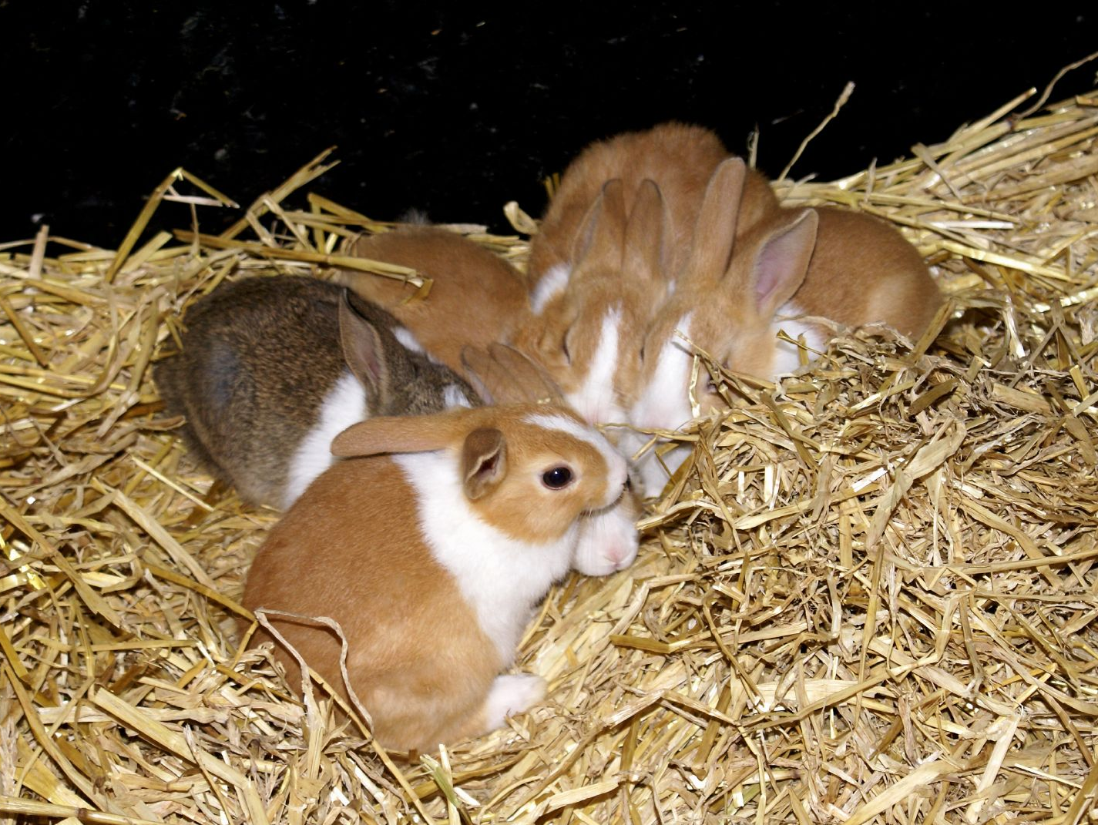
Prolific
by Martin Pettitt

Slide 10
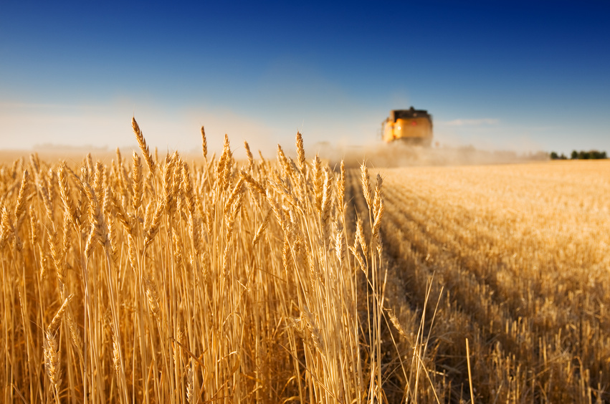
Prolific

Slide 11

Prolific

Slide 12
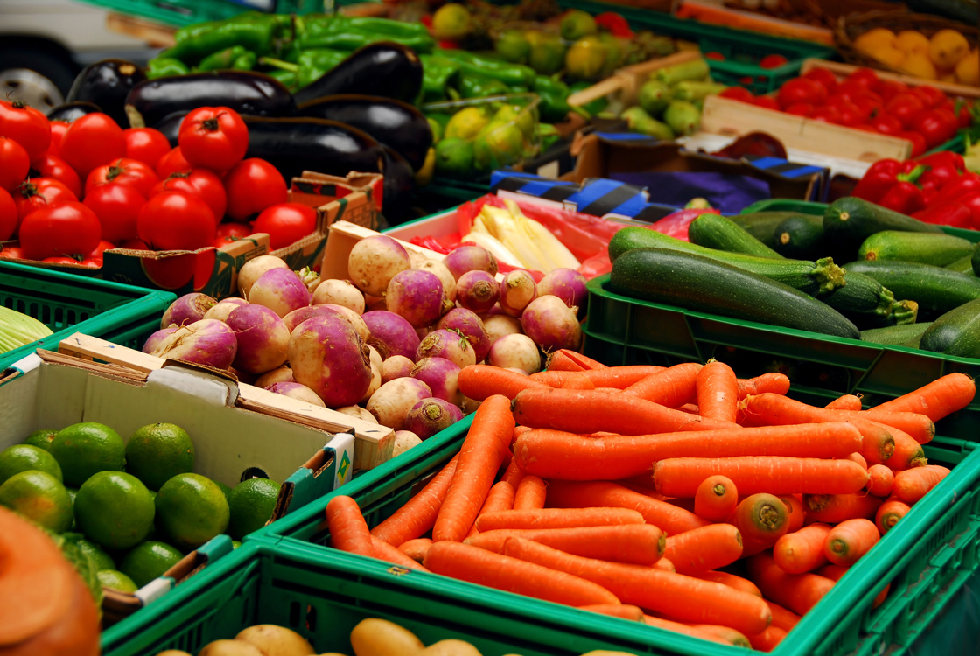
  Prolific – (adj) / [pruh-lif-ik] abundantly fruitful; producing in large quantities or with great frequency.

Slide 13

Terse
by Jean Pichot

Slide 14
Terse

Slide 15
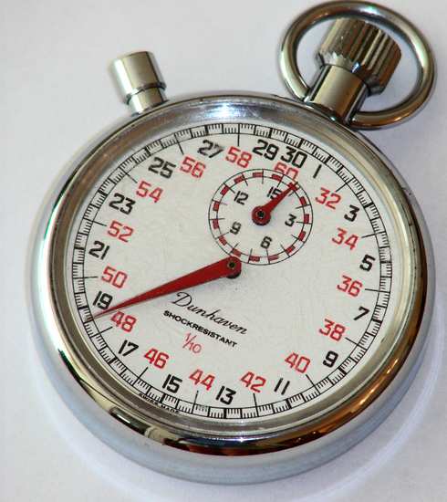
Terse

Slide 16

  Terse – (adj) / [turs] concise; pithy; brief.
by othree

Slide 17
  Miserly – (adj) /
  [mahy-zer-lee]
  stingy; mean.

Slide 18
  Bolster – (v) /
  [bohl-ster] support; reinforce; add.

Slide 19
  Prolific – (adj) / [pruh-lif-ik] abundantly fruitful; producing in large quantities or with great frequency.

Slide 20
  Terse – (adj) / [turs] concise; pithy; brief.
by othree

