Slide 1
Aspire

Slide 2

Aspire

Slide 3
Aspire

Slide 4


  Aspire – (v) / [uh-spahy^{uh}r] seek to attain; long for.
by George M. Groutas

Slide 5

Esoteric

Slide 6

Esoteric

Slide 7

Esoteric

Slide 8
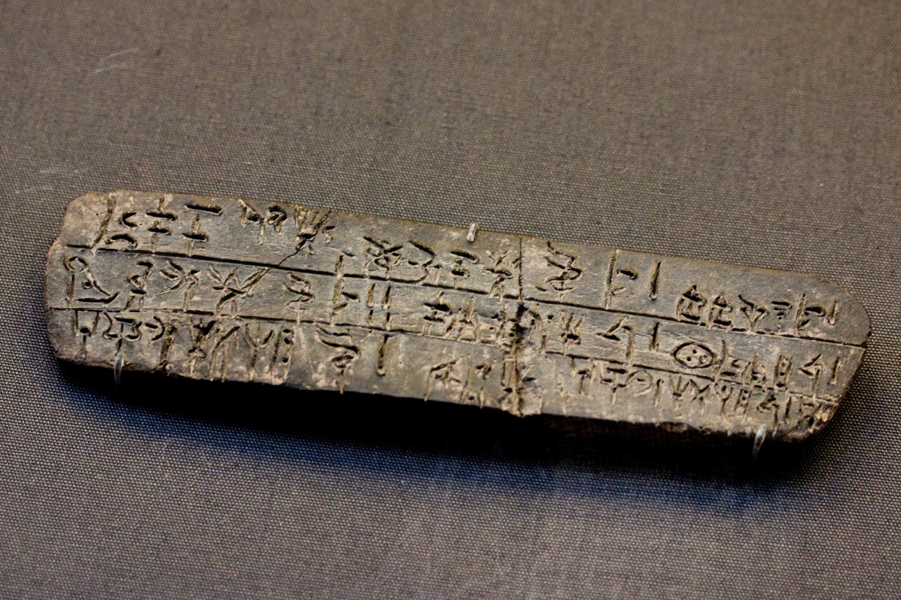

  Esoteric – (adj) / [es-uh-ter-ik] hard to understand; known only to the chosen few
by vintagedept

Slide 9

Vacillate

Slide 10
Vacillate

Slide 11
Vacillate

Slide 12
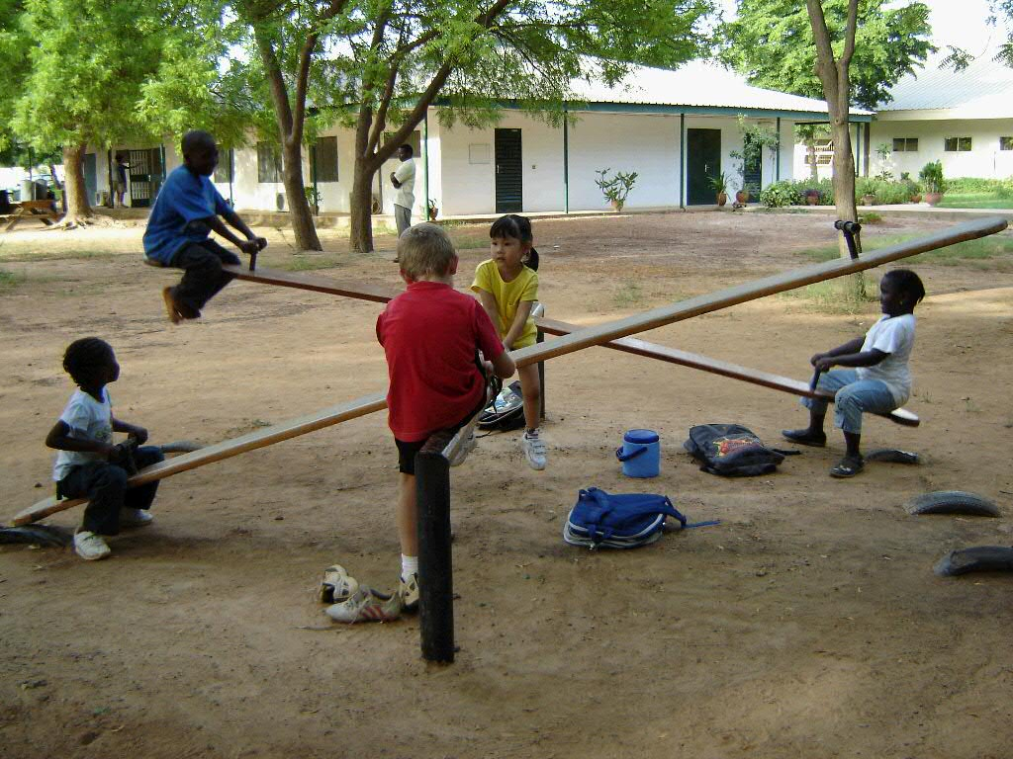

  Vacillate – (v) / [vas-uh-leyt] waver; fluctuate.
by 4Cheungs

Slide 13
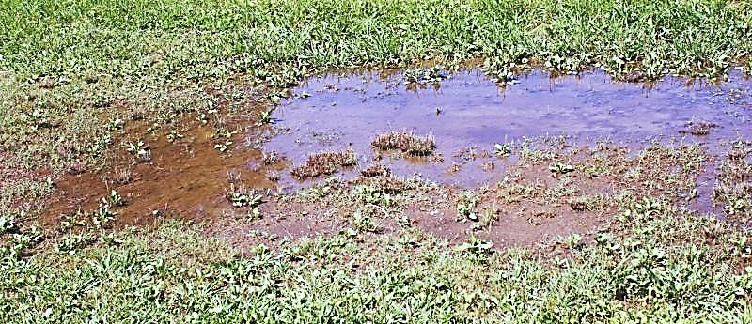

Stagnant
by nachan

Slide 14
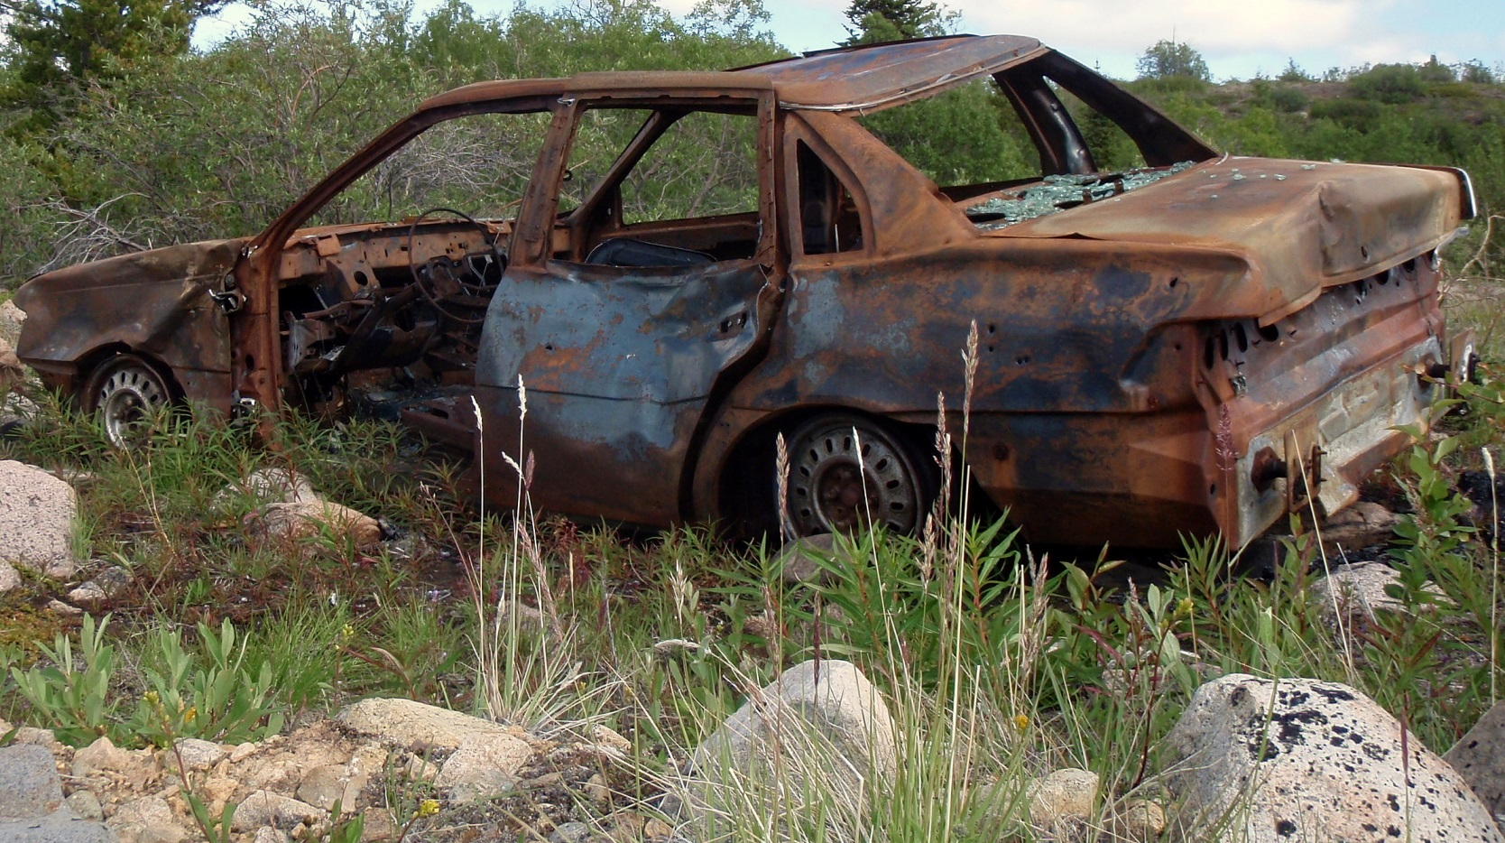
Stagnant
by Anthony DeLorenzo

Slide 15

Stagnant

Slide 16

  Stagnant – (adj) / [stag-nuhnt] motionless; stale; dull
by cindy47452

Slide 17
  Aspire – (v) / [uh-spahy^{uh}r] seek to attain; long for.
by George M. Groutas

Slide 18
  Esoteric – (adj) / [es-uh-ter-ik] hard to understand; known only to the chosen few
by vintagedept

Slide 19
  Vacillate – (v) / [vas-uh-leyt] waver; fluctuate.
by 4Cheungs

Slide 20
  Stagnant – (adj) / [stag-nuhnt] motionless; stale; dull
by cindy47452

