Slide 1
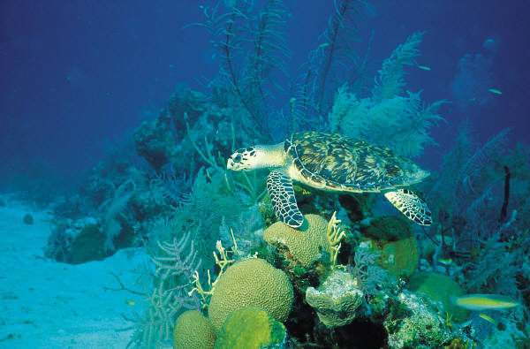
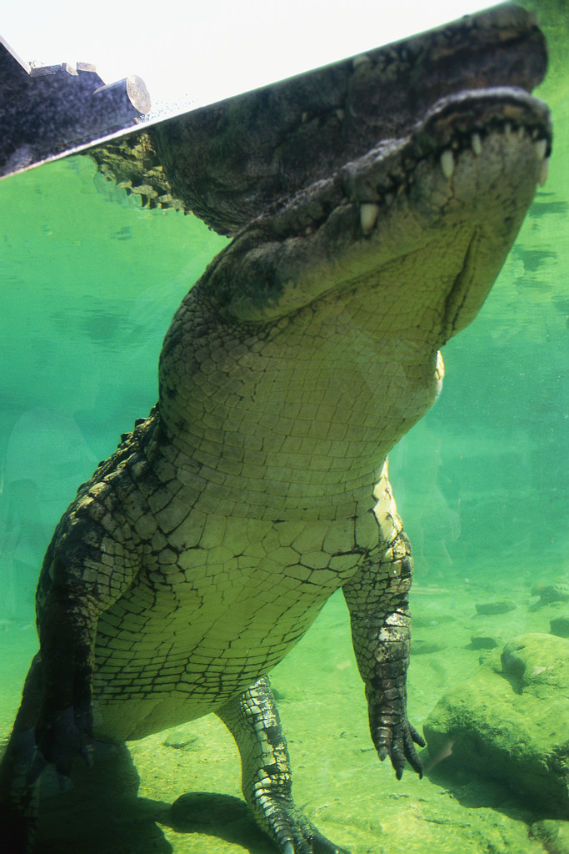
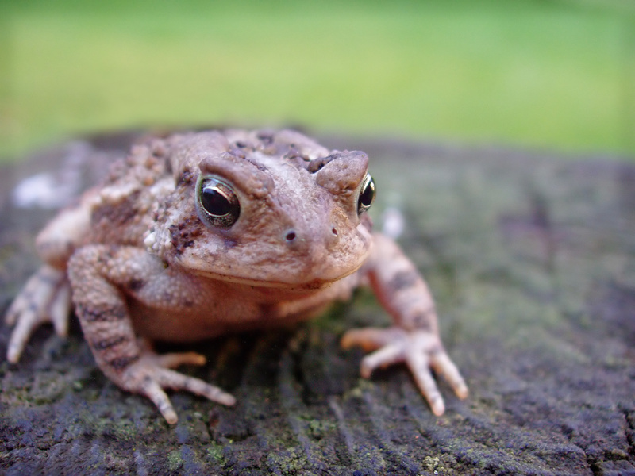
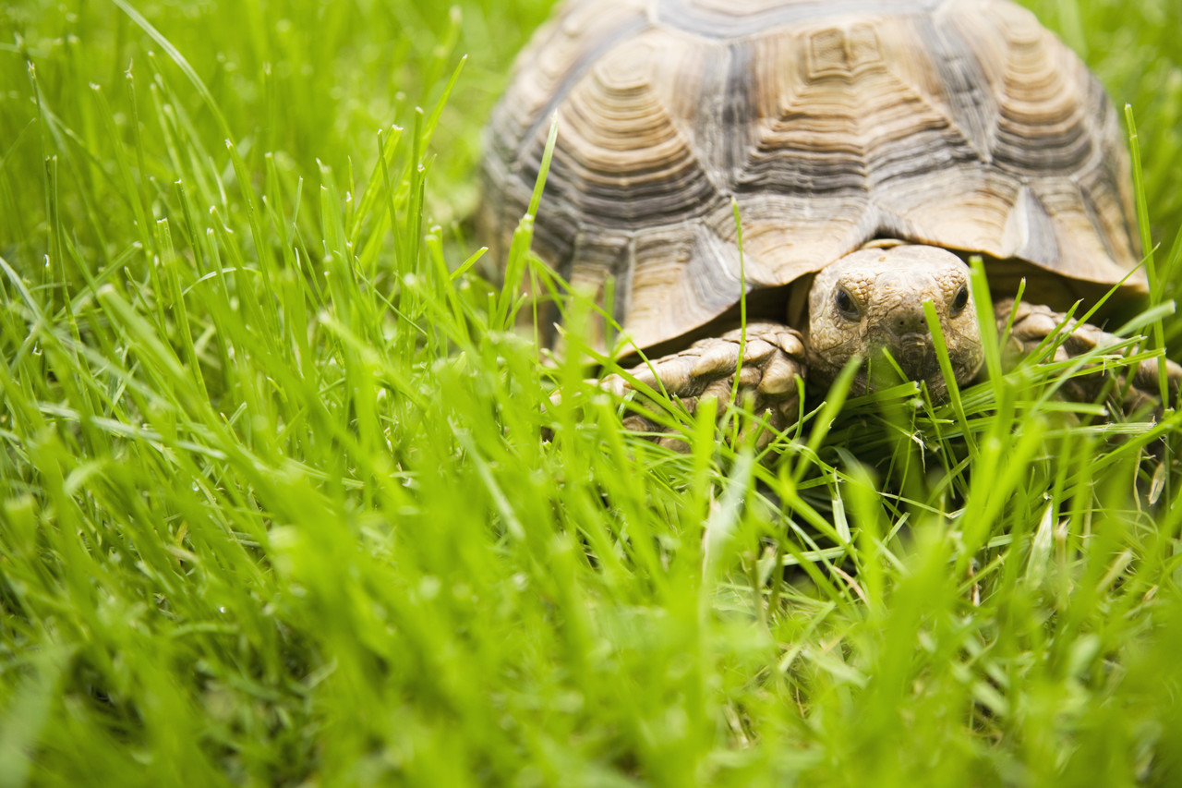
Amphibious

Slide 2

Ambivalence

Slide 3
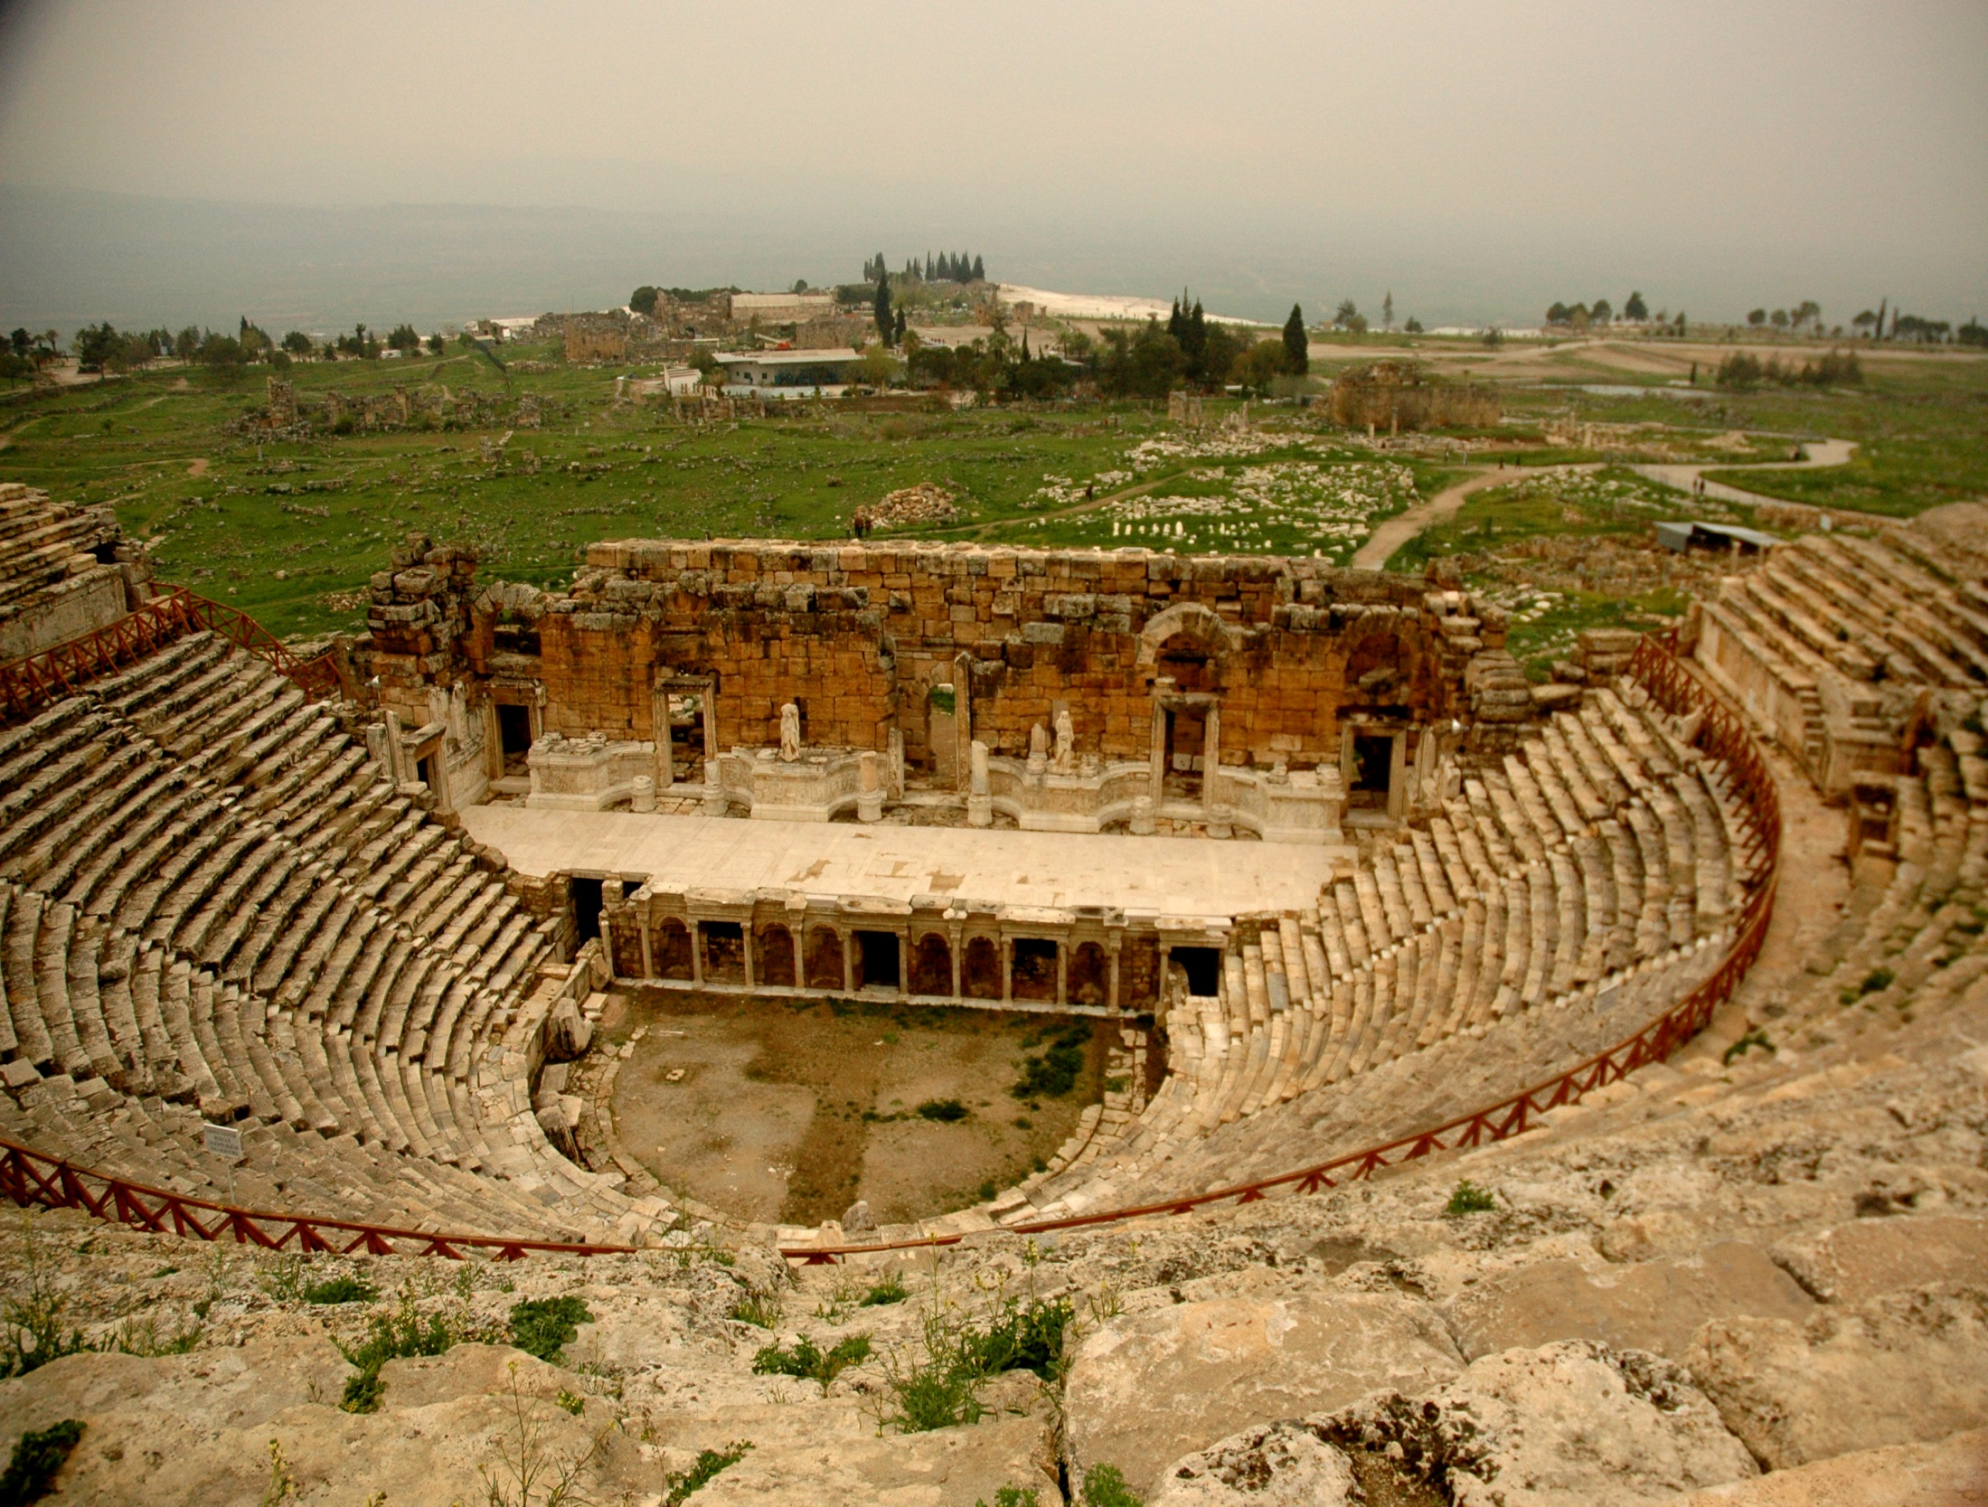

Amphitheatre
by Camera on autopilot

Slide 4
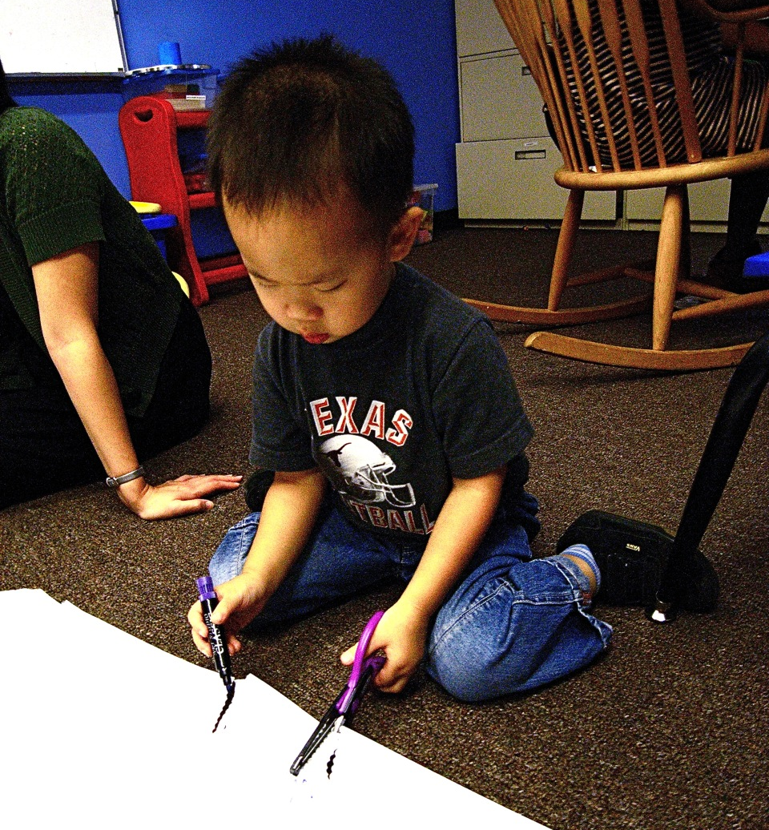
  Ambidextrous
  Ambi/Amphi – both, on both sides, around
by hamron

Slide 5

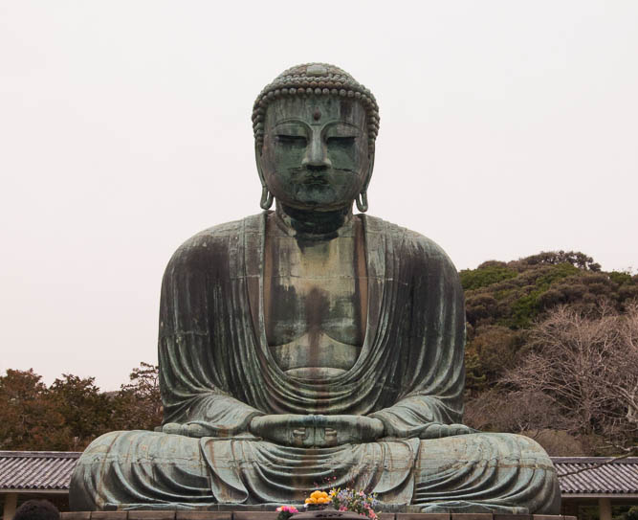

Credence
by frugal dattier

Slide 6


Press Credentials
by Jannie-Jan

Slide 7
Credulous

Slide 8

  Cred = believe
by DragonRal

Slide 9

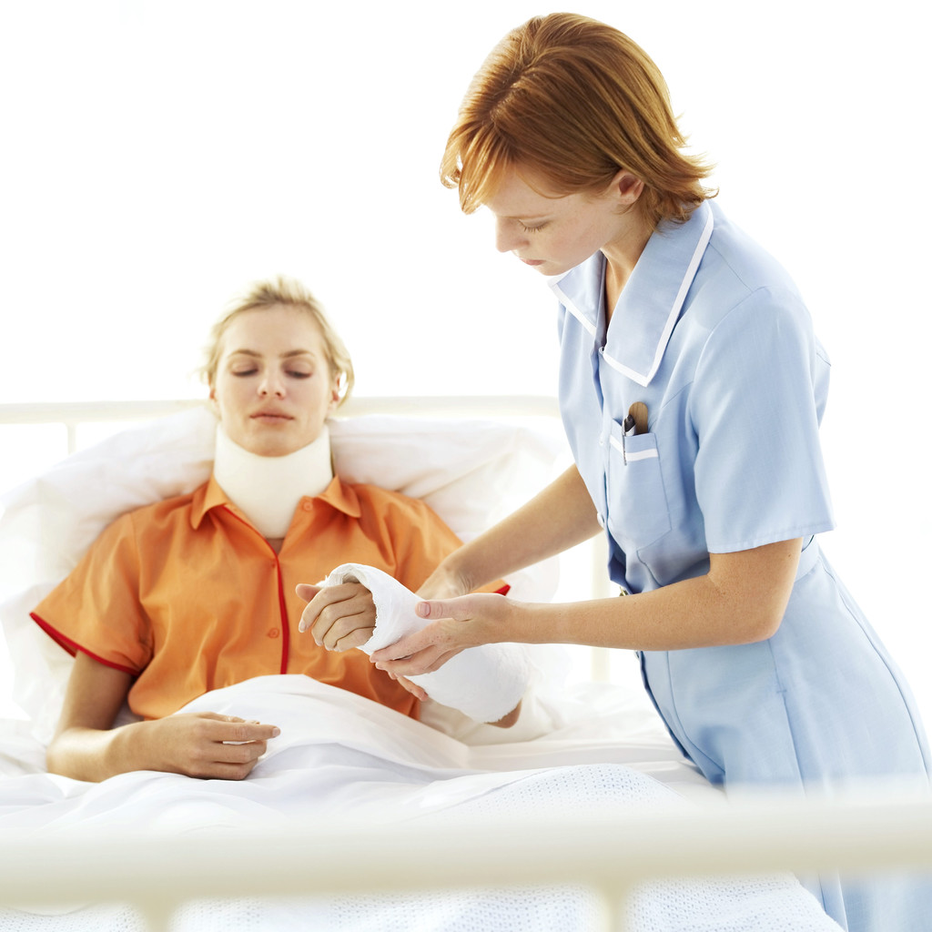
Empathy

Slide 10
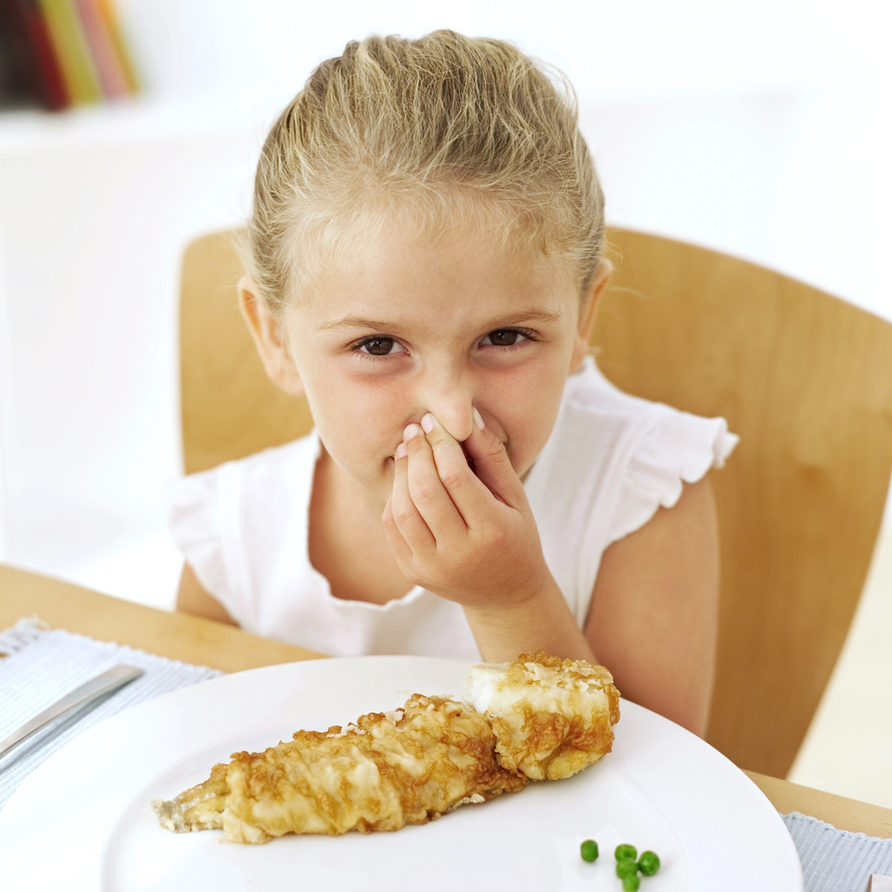
Antipathy

Slide 11
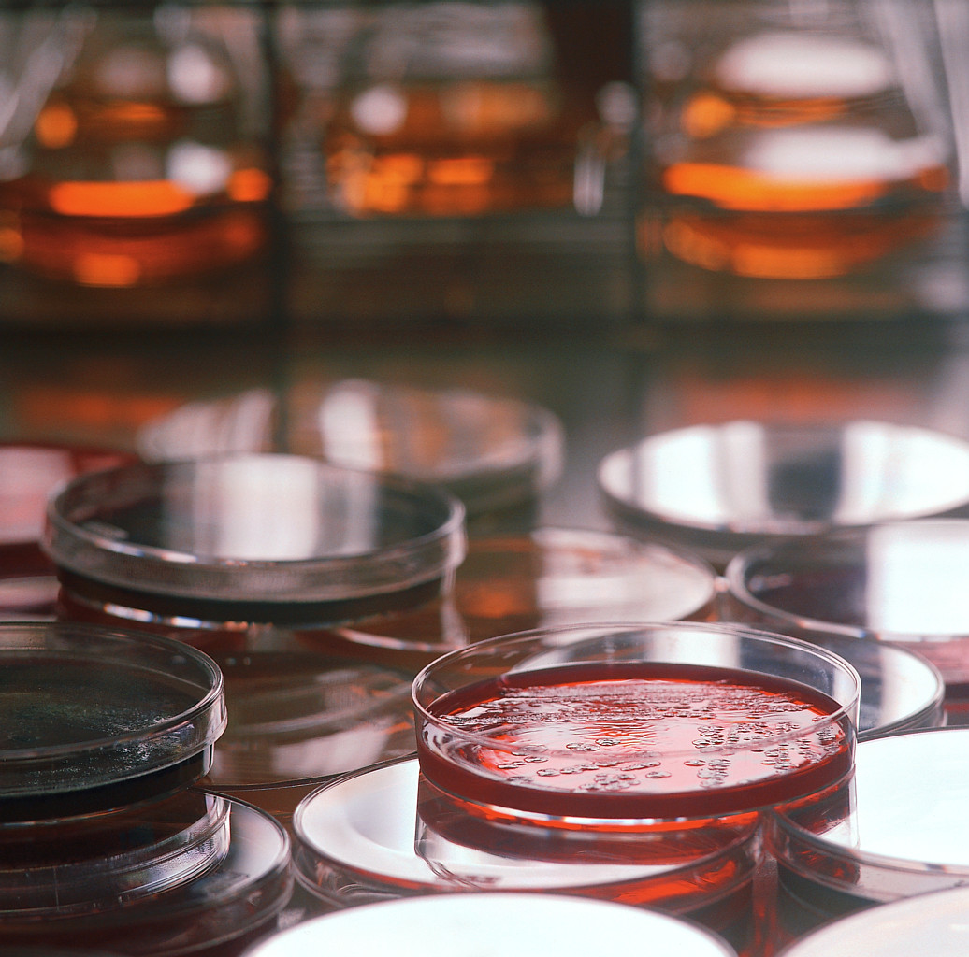
Pathology

Slide 12

  Path = feeling, emotion

Slide 13
Sedentary

Slide 14
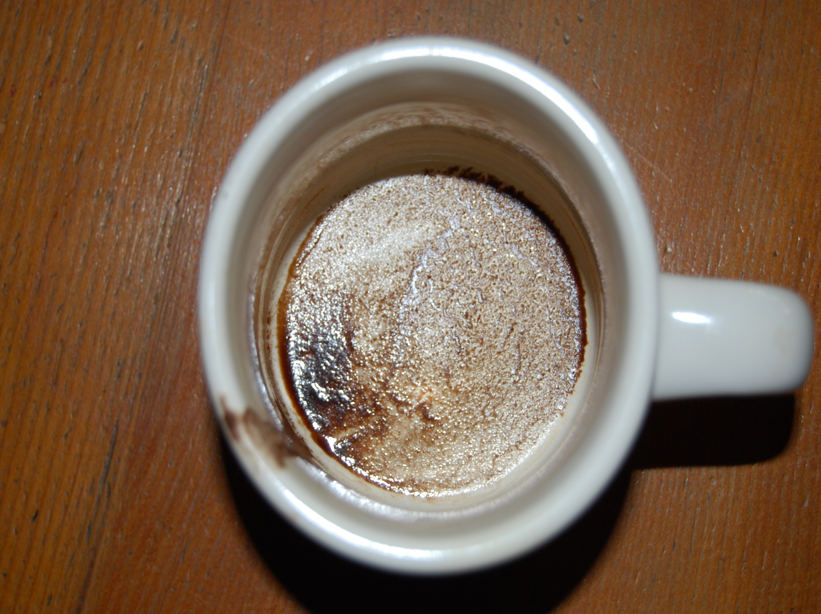

Sediment
by matt.davis

Slide 15

Sedate

Slide 16
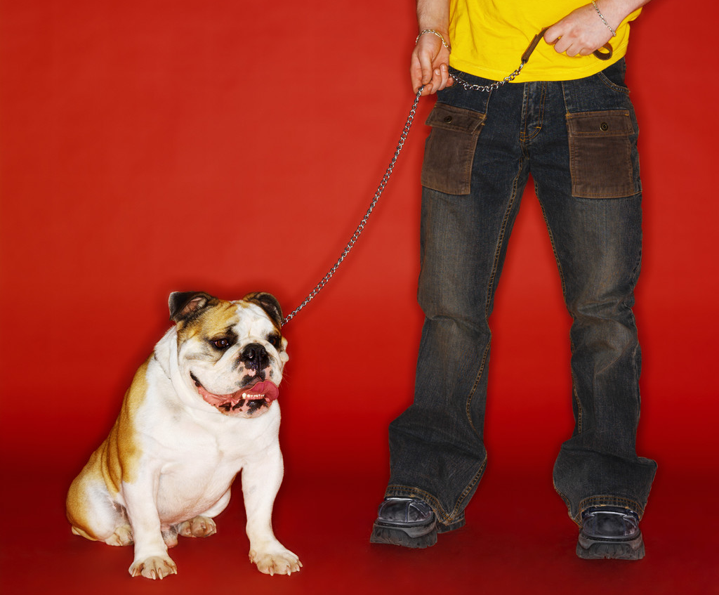
Sed = sit

Slide 17
  Ambidextrous
  Ambi/Amphi – both, on both sides, around
by hamron

Slide 18
  Cred = believe
by DragonRal

Slide 19
  Path = feeling, emotion

Slide 20
Sed = sit

