Slide 1
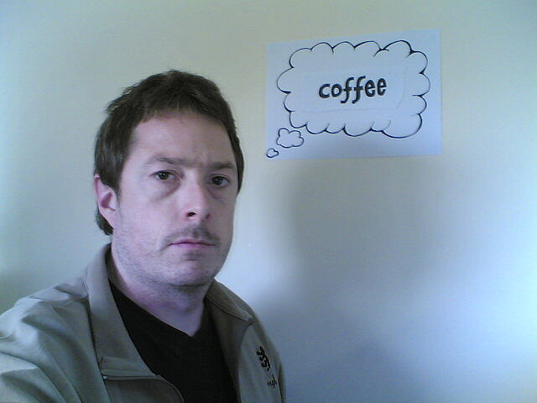

Articulate
by Dplanet::

Slide 2
Articulate
When ideas fail, words come in handy
-Goethe

Slide 3
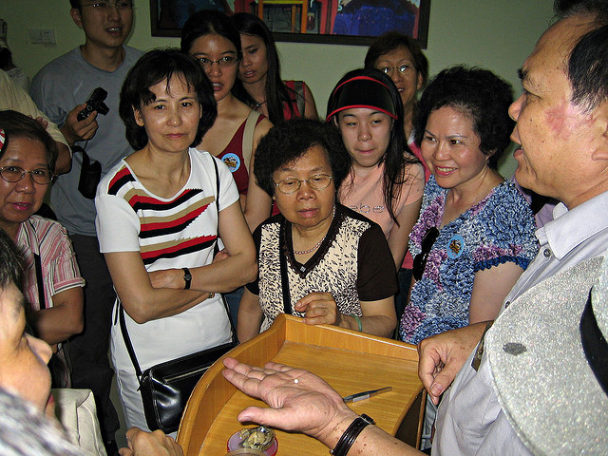
Articulate
by maveric2003

Slide 4
  Articulate – (adj) [ahr-tik-yuh-lit] effective; distinct; using language easily and fluently

Slide 5
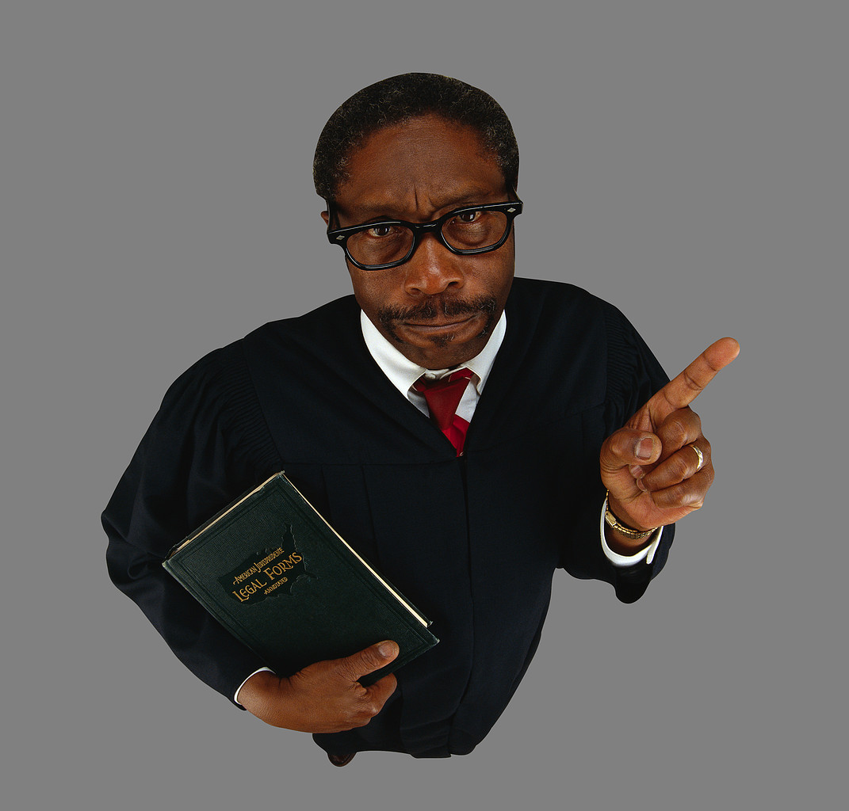
Dogmatic

Slide 6
Dogmatic

Slide 7
Dogmatic

Slide 8
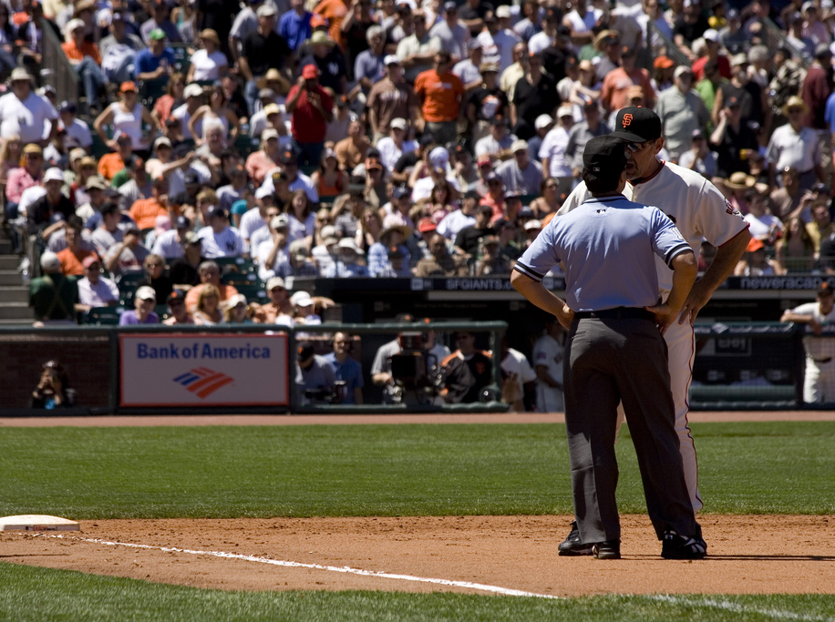
  Dogmatic – (adj) /[dawg-mat-ik] opinionated; arbitrary; doctrinal
by dennis

Slide 9
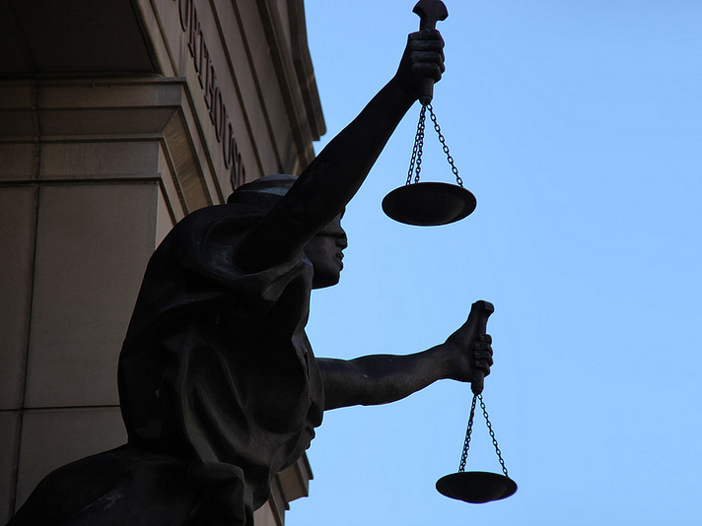
Justify
by Tim Evanson

Slide 10
Justify

Slide 11
Justify

Slide 12
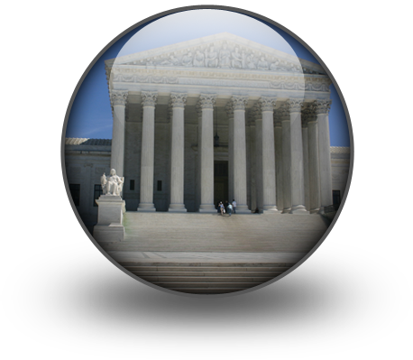
  Justify – (v) /[juhs-tuh-fahy] to show to be just or right; to defend

Slide 13
Refute

Slide 14
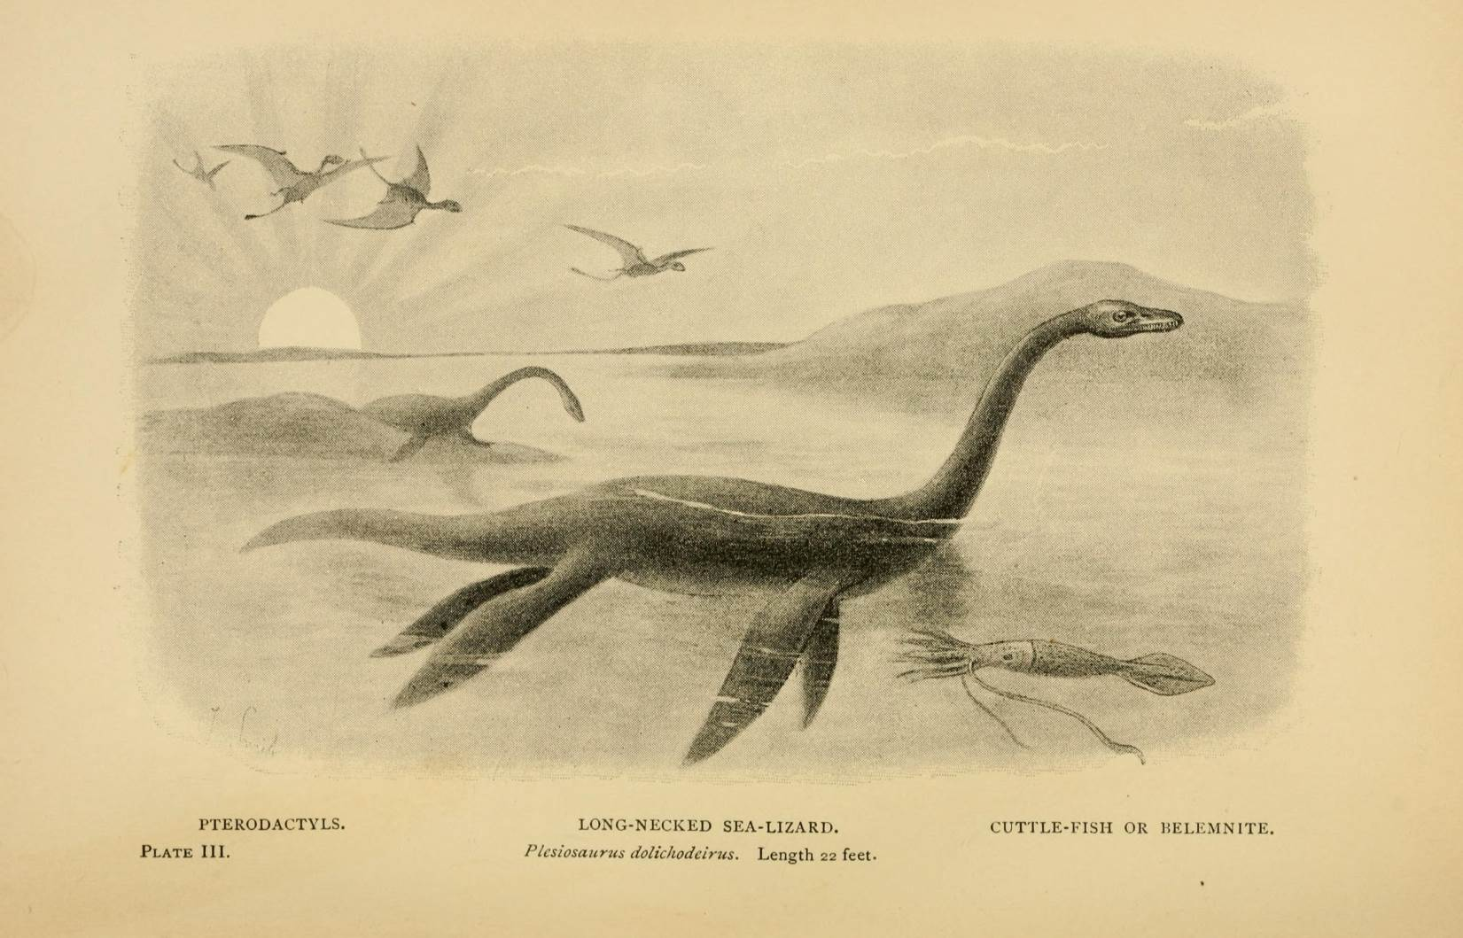
Refute
by BioDivLibrary

Slide 15
Refute

Slide 16
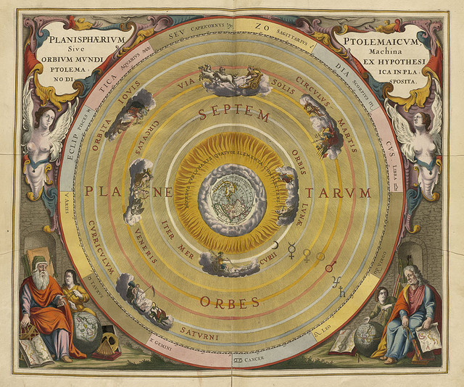

  Refute – (v) [ri-fyoot] disprove.
By Norman B Leventhal Map Center at the BPL

