Slide 1
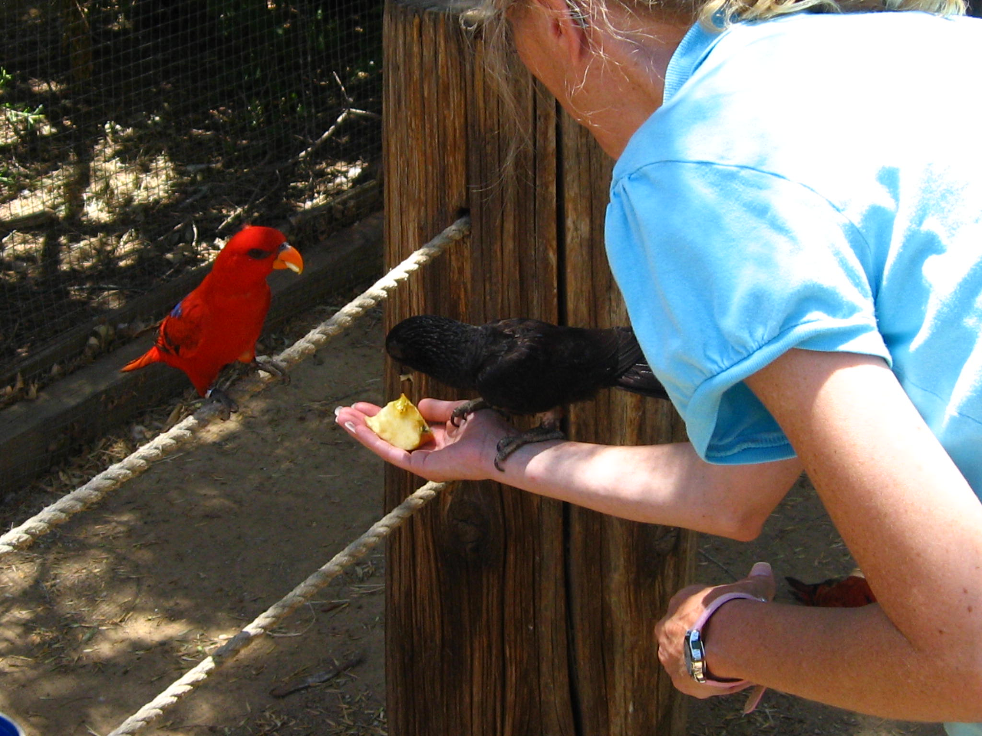

Cajole
by Candie_N (Welcome Spring)

Slide 2
Cajole

Slide 3
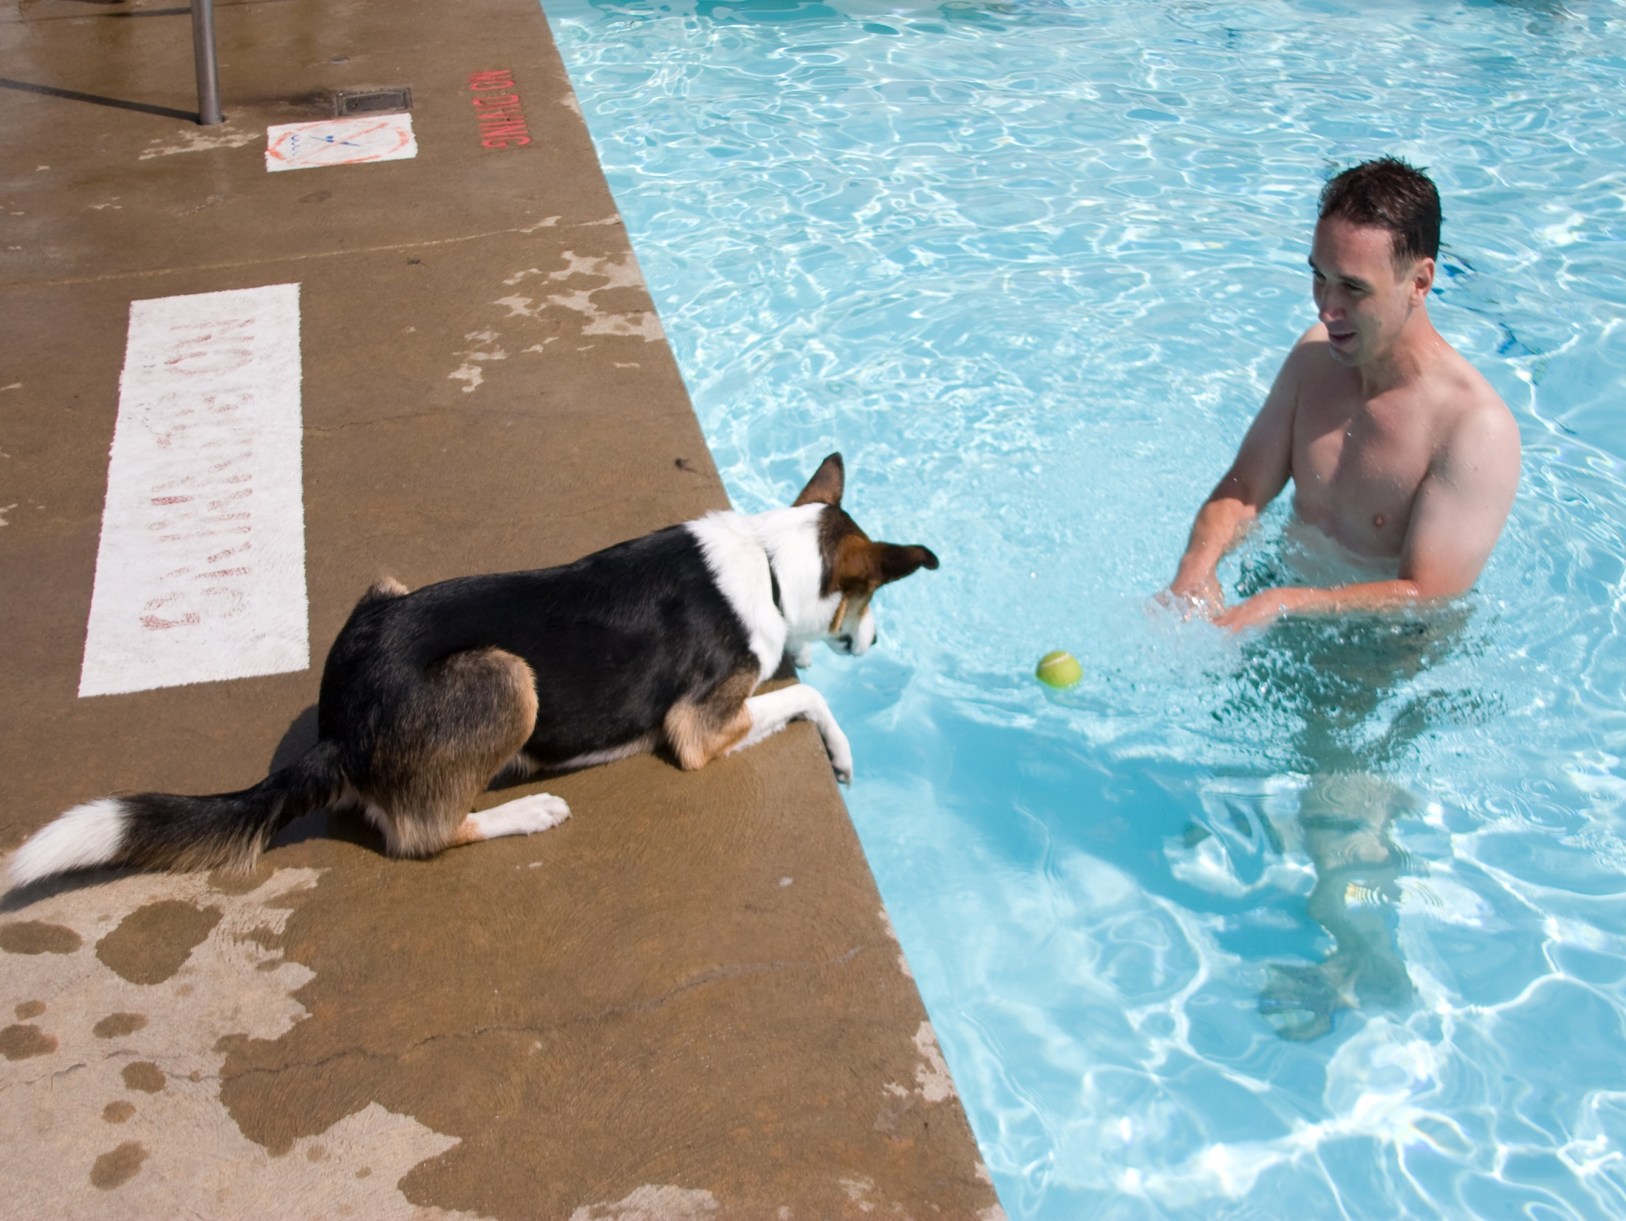

Cajole
by bgreenlee

Slide 4
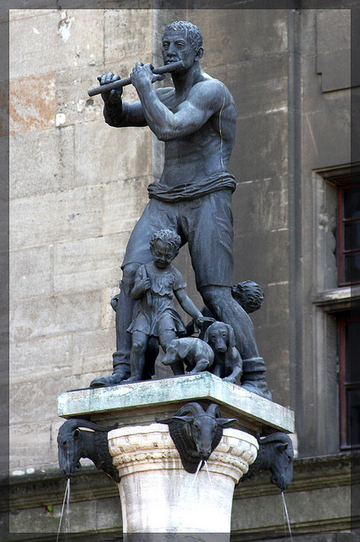

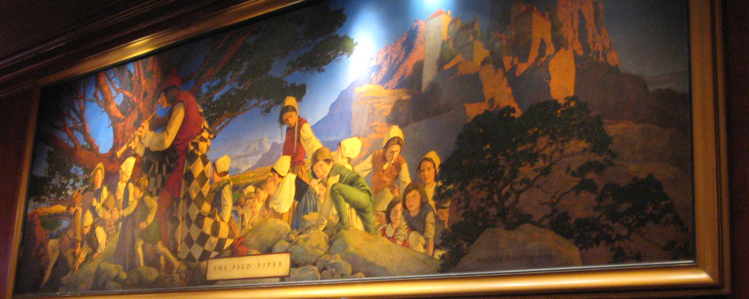
  Cajole – (v) /[kuh-johl] coax; wheedle.
by tinyfroglet
by moonlightbulb

Slide 5
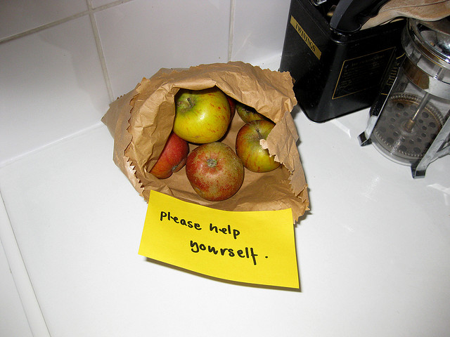
Corroborate
by withassociates

Slide 6
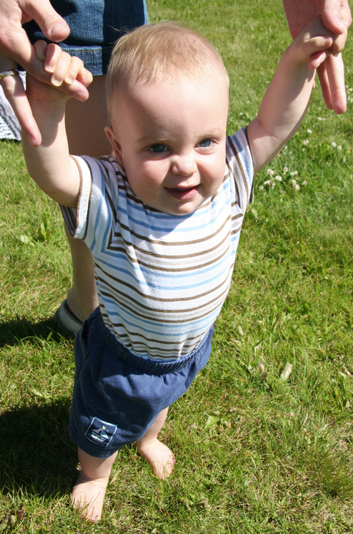
Corroborate

Slide 7
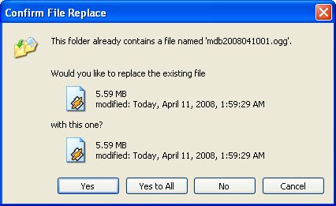
Corroborate
by darcas

Slide 8

  Corroborate – (v) [kuh-rob-uh-reyt]
  confirm, support.

Slide 9


Dissent

Slide 10
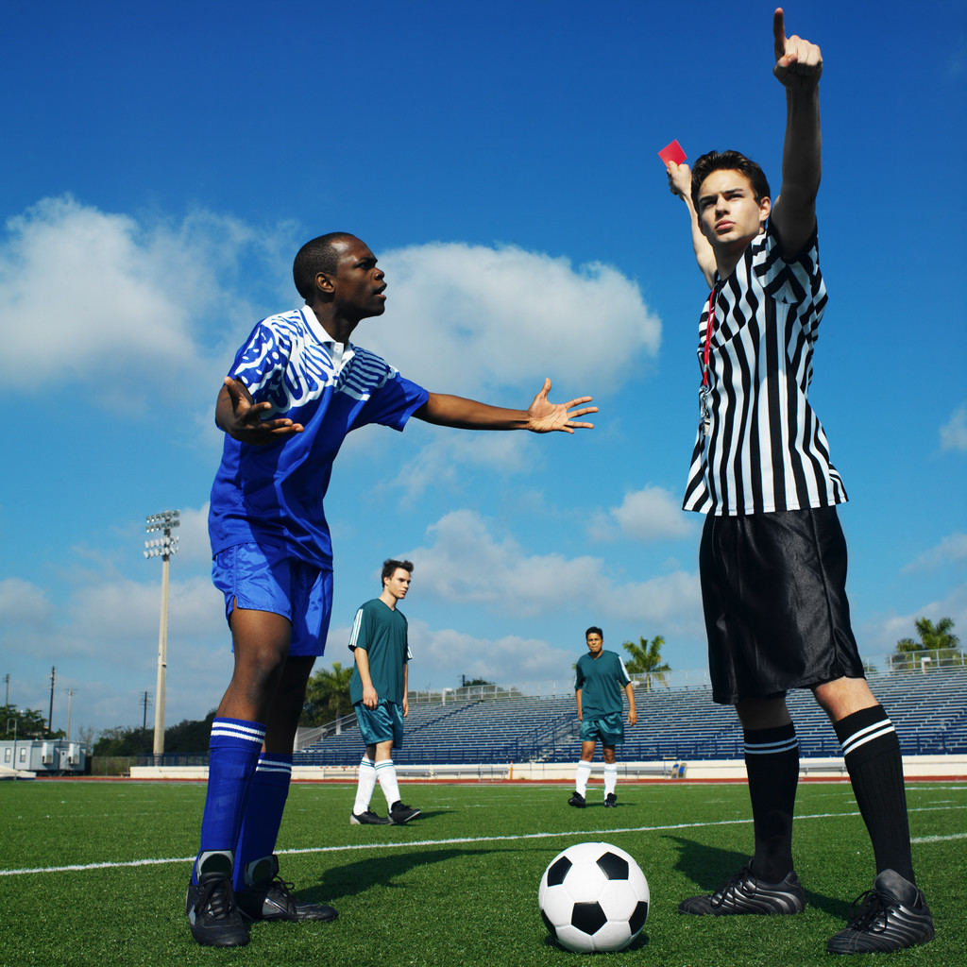
Dissent

Slide 11
Dissent

Slide 12

  Dissent – (v) [dih-sent] disagree

Slide 13
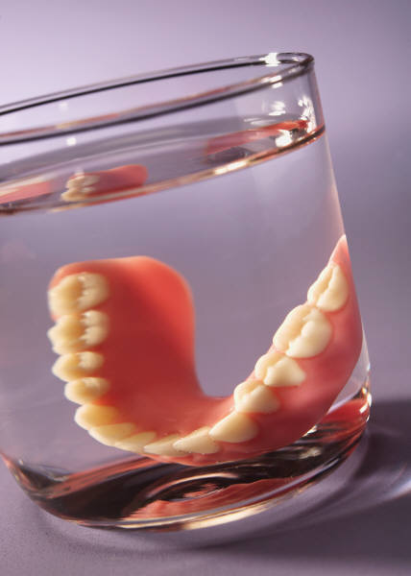
Spurious

Slide 14
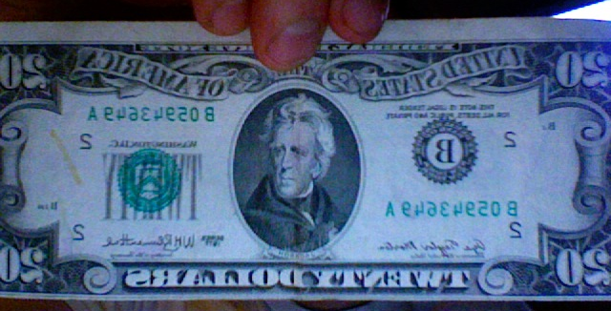
Spurious
by lazzarello

Slide 15

Spurious
by AZRainman

Slide 16
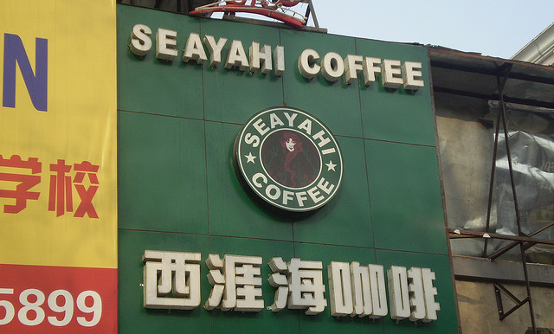
  Spurious – (adj) [spyoor-ee-uhs] false; counterfeit; forged; illogical.
by Renato Ganoza

