Slide 1


Anarchy
by soundman1024

Slide 2
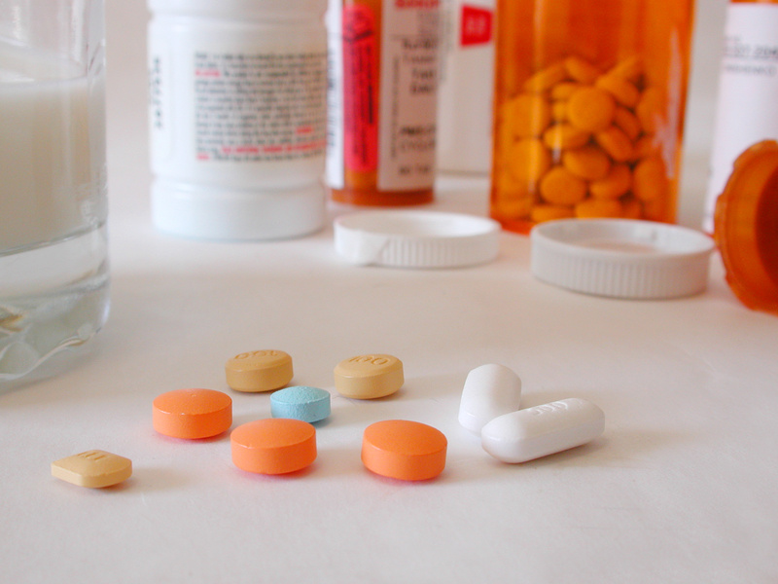
Antibiotics

Slide 3
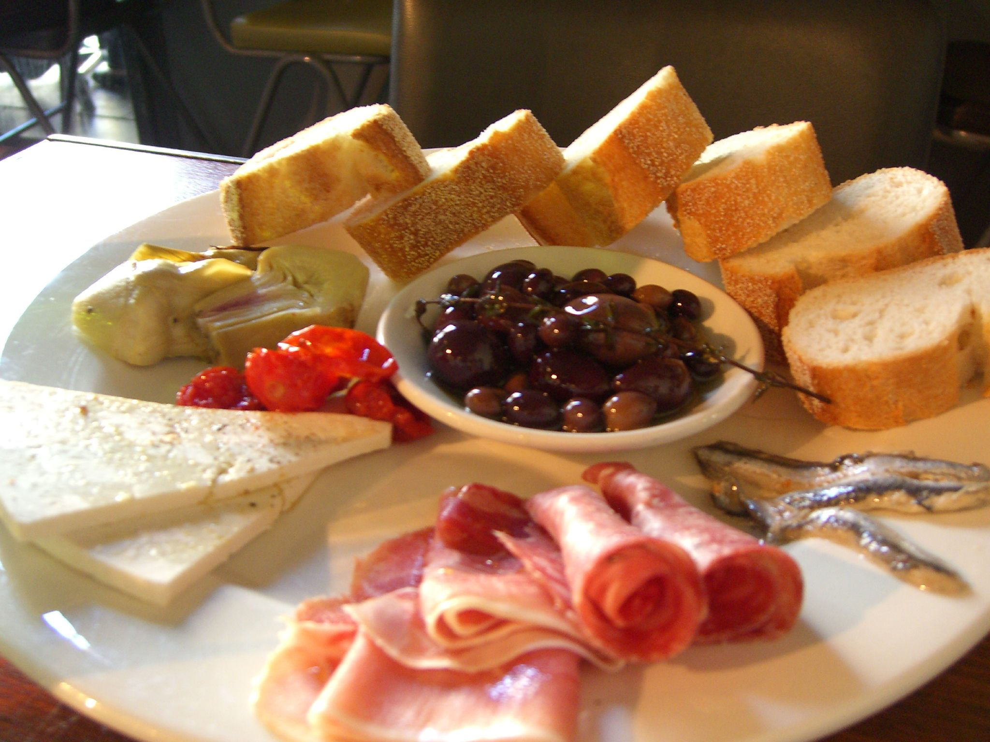

Antipasto
by avlxyz

Slide 4
  An, ani, anti = against, opposite.

Slide 5
Discount

Slide 6
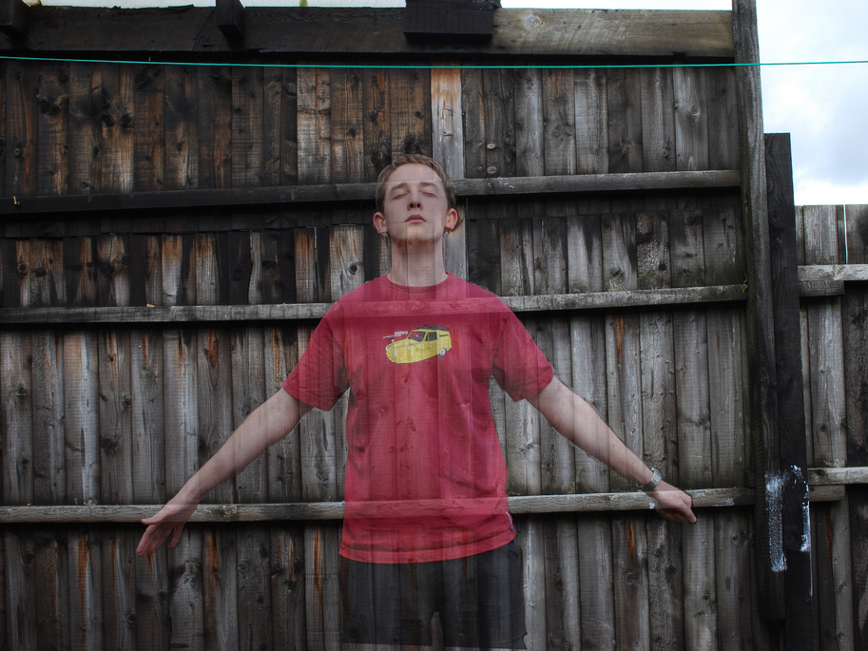

Disappear
by stuartpilbrow

Slide 7
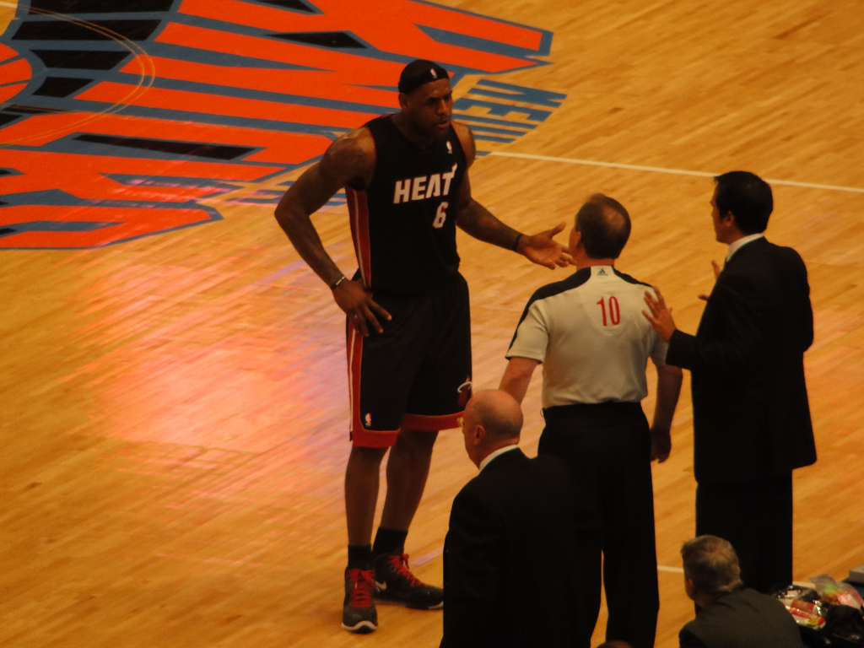
Disagree
by SportsAngle.com

Slide 8
  Dis = take away,
  deprive, not.

Slide 9
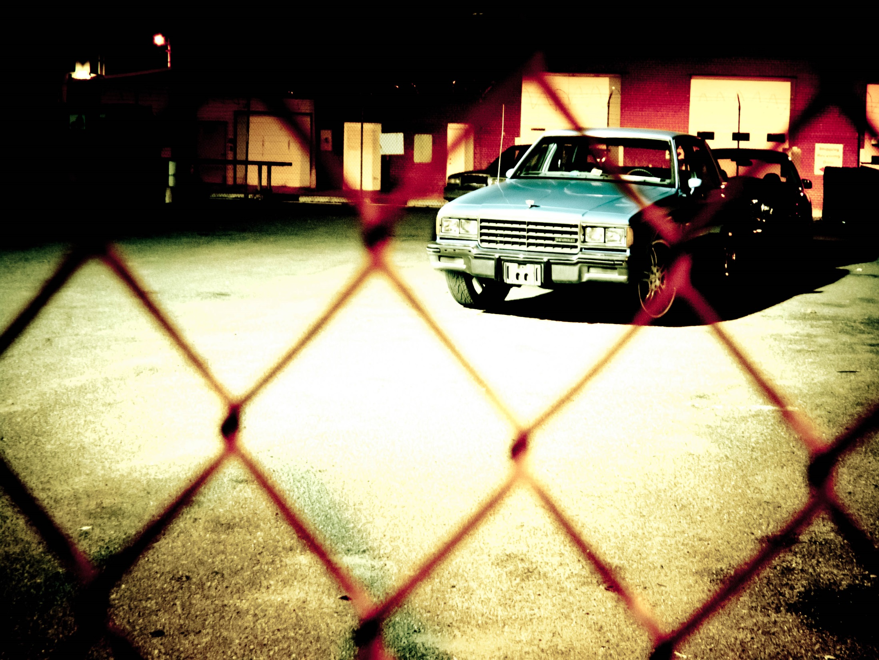
Impound
by Stphngrhm

Slide 10

Inflate

Slide 11
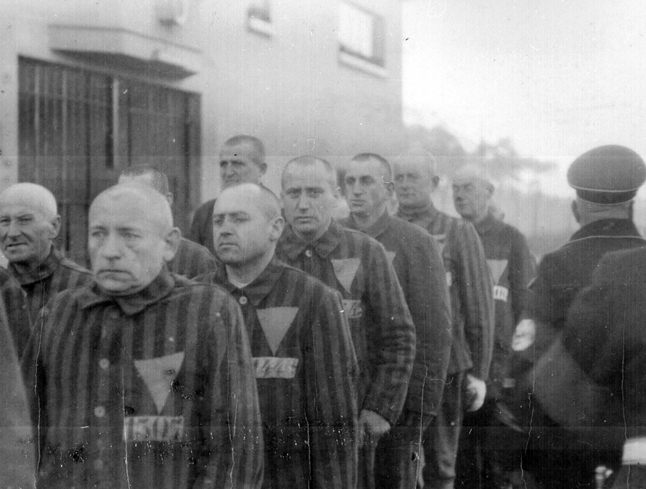
Incarcerated
by Marion Doss

Slide 12

  Im/in = not, without.

Slide 13
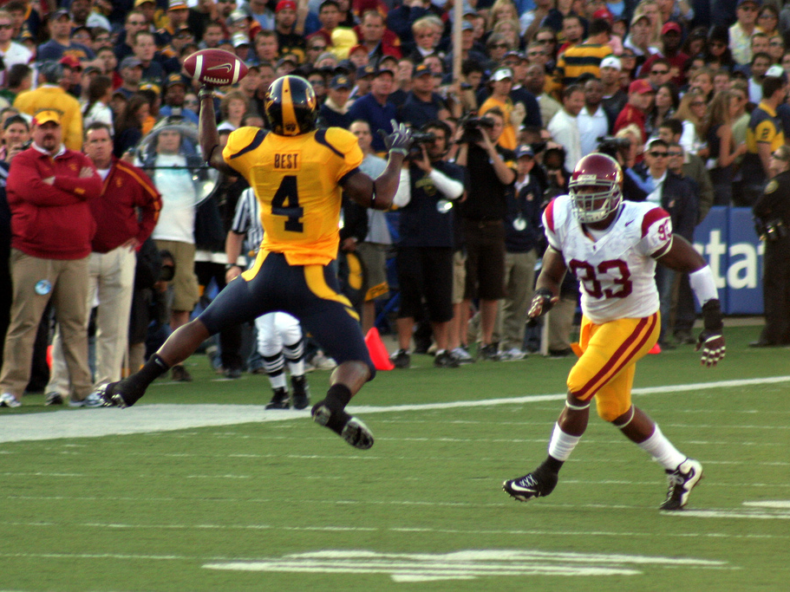
Receive
by Monica’s Dad

Slide 14

Research

Slide 15
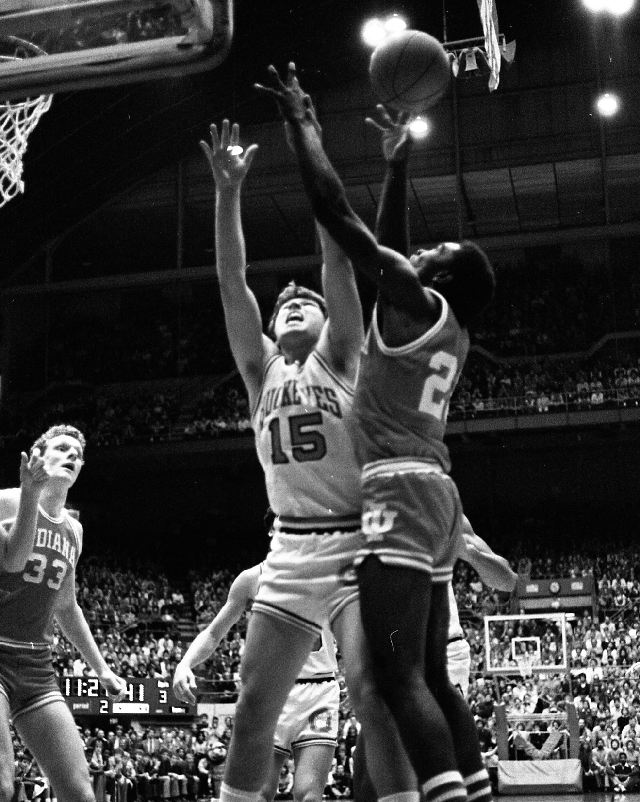
Rebound
by Elessar

Slide 16
  Re = again, back, backward.

