Slide 1
Astute

Slide 2
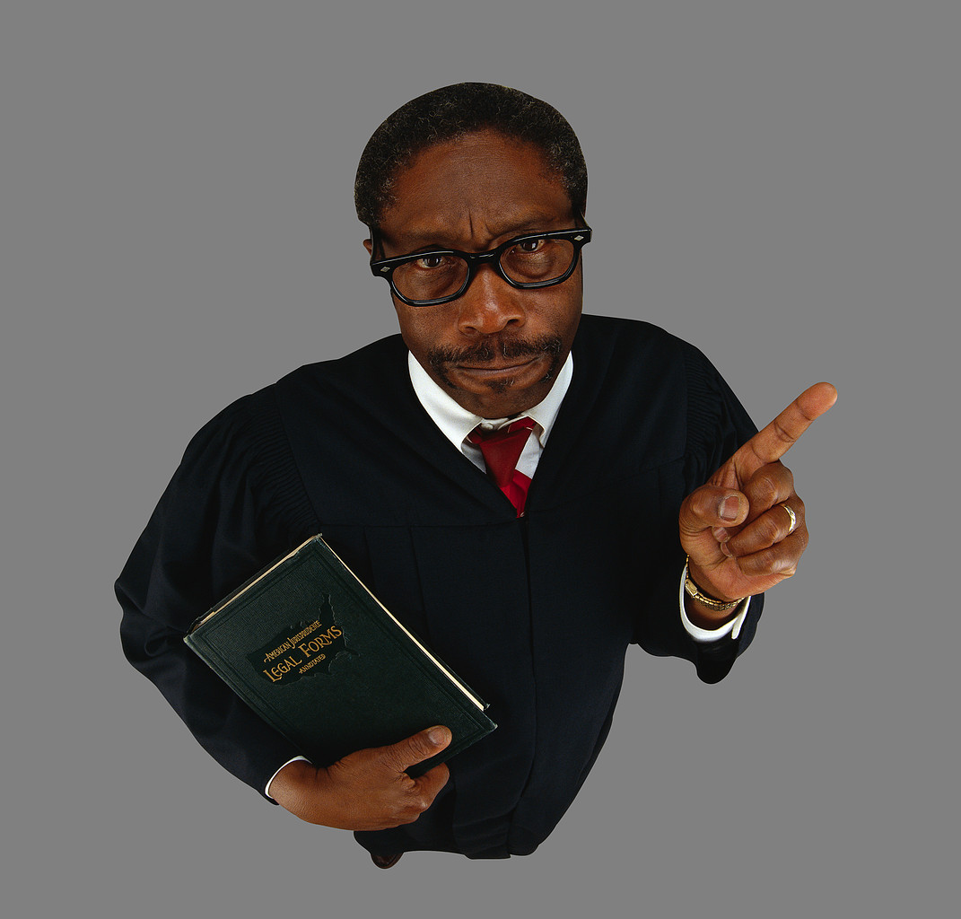
Astute

Slide 3
Astute

Slide 4
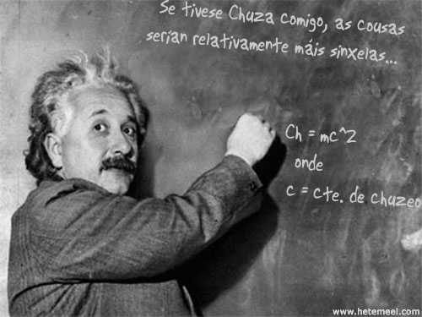

Astute – (adj) [uh-stoot] wise; shrewd; keen
by dorfun

Slide 5
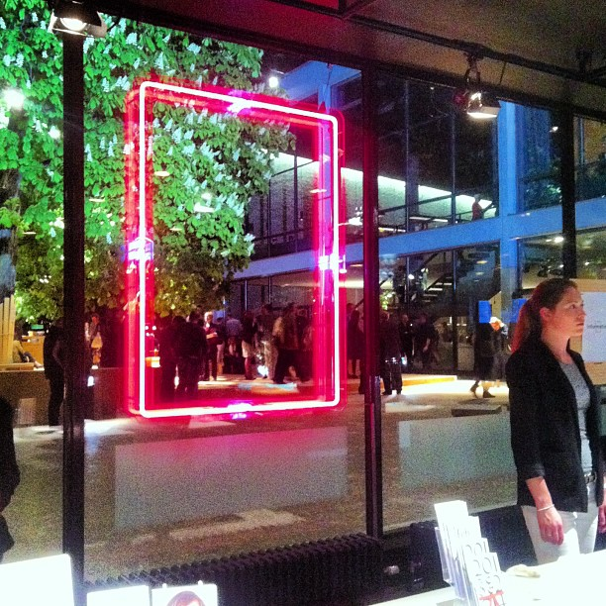
Extraneous
by illustir

Slide 6
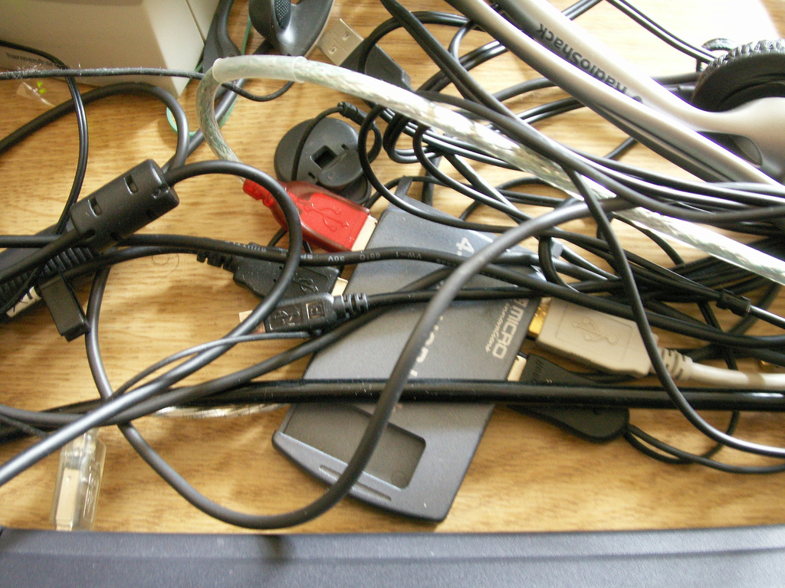

Extraneous
by Daquella manera

Slide 7
Extraneous

Slide 8
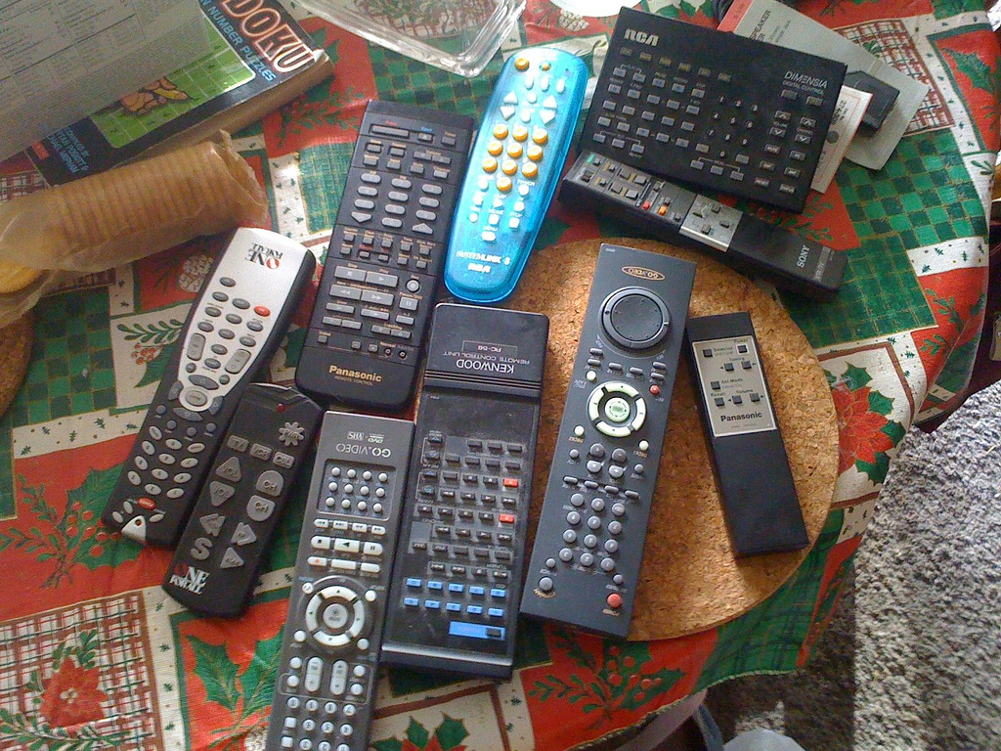
Extraneous – (adj) [ik-strey-nee-uhs] not essential; superfluous
by AvidlyAbide
by Vic

Slide 9
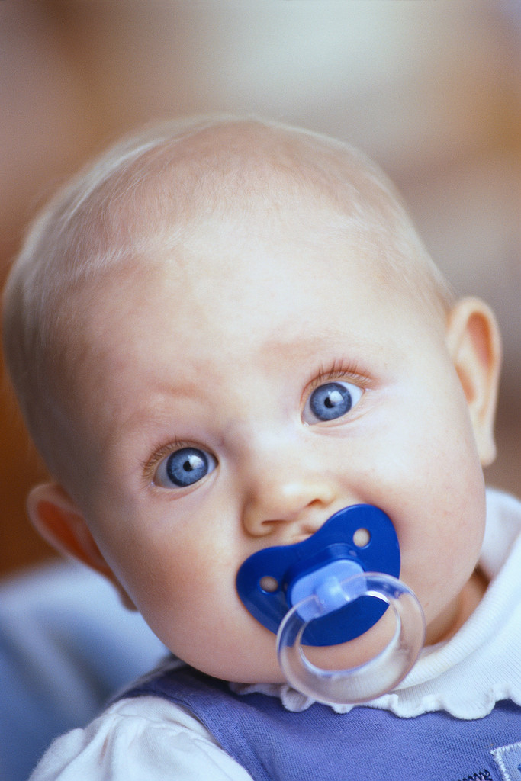
Placate

Slide 10
Placate

Slide 11
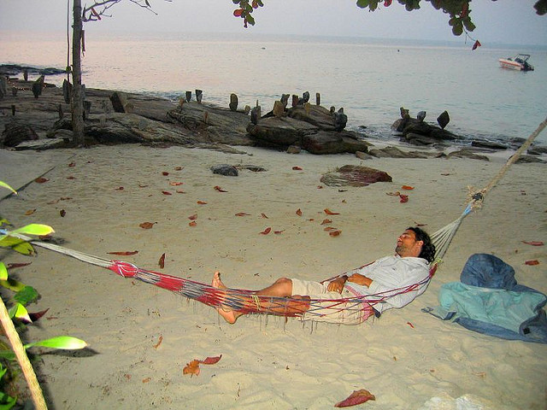
Placate
by Viajar24h.com
by Vic

Slide 12
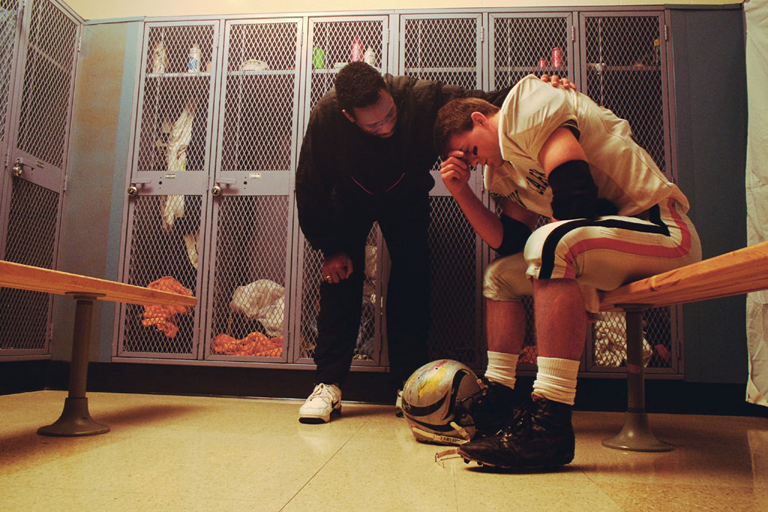
Placate – (v) [pley-keyt] pacify; conciliate

Slide 13

Vindicate

Slide 14
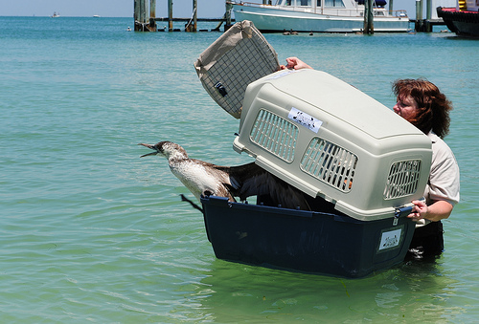
Vindicate
by USFWS Headquarters

Slide 15
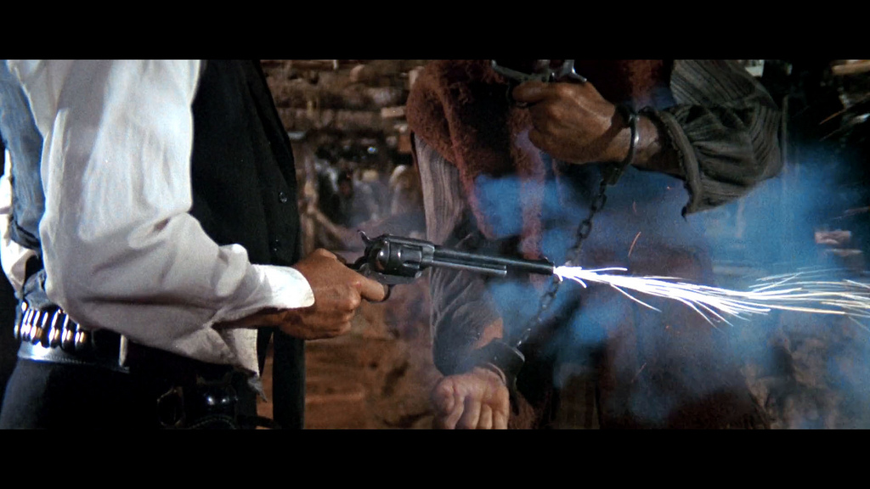
Vindicate
by quapan

Slide 16
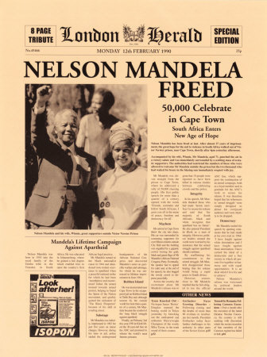
Vindicate - (v)
[vin-di-keyt] clear from blame; exonerate, justify or support

