Slide 1

Ambivalence

Slide 2
Ambivalence

Slide 3
Ambivalence

Slide 4
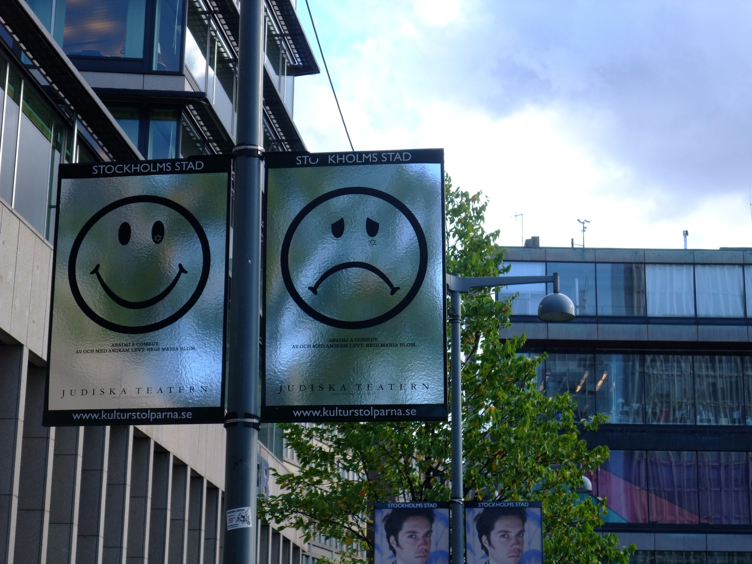

Ambivalence (n) [am-biv-uh-luhns] the state of having contradictory or conflicting emotional attitudes
by James Cridland

Slide 5

Appraise

Slide 6

Appraise

Slide 7
Appraise

Slide 8
Appraise – (v) [uh-preyz] to estimate the monetary value of; determine the worth of; assess. to estimate the nature, quality, importance

Slide 9
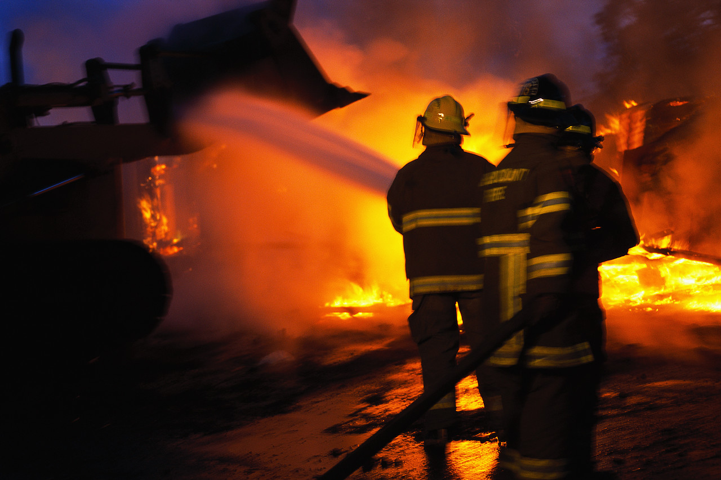
Conflagration

Slide 10
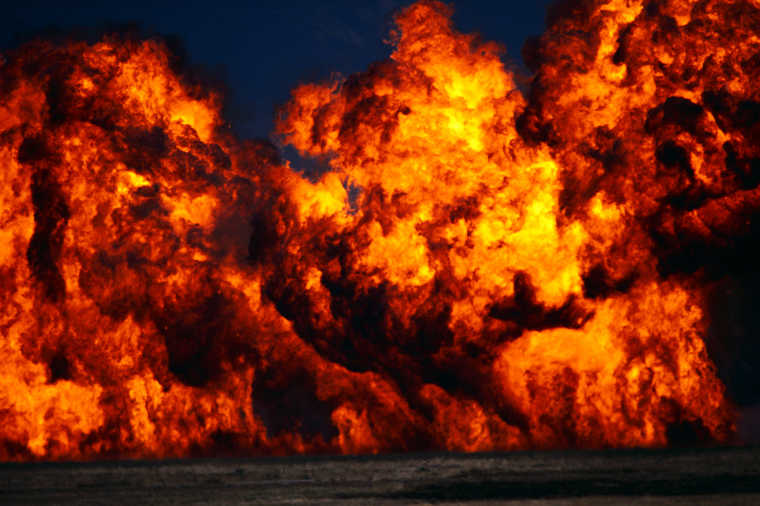
Conflagration

Slide 11
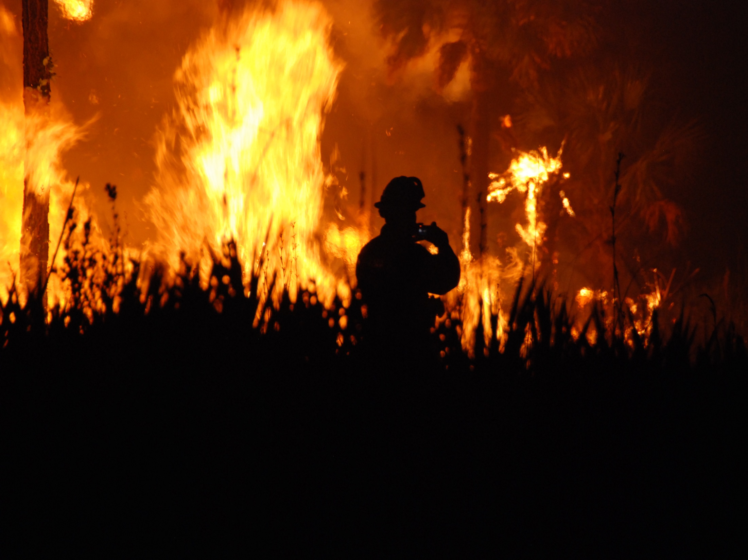

Conflagration
by USFWS/Southeast

Slide 12

Conflagration - (n) [kon-fluh-grey-shuhn]
great fire
by matthewvenn

Slide 13
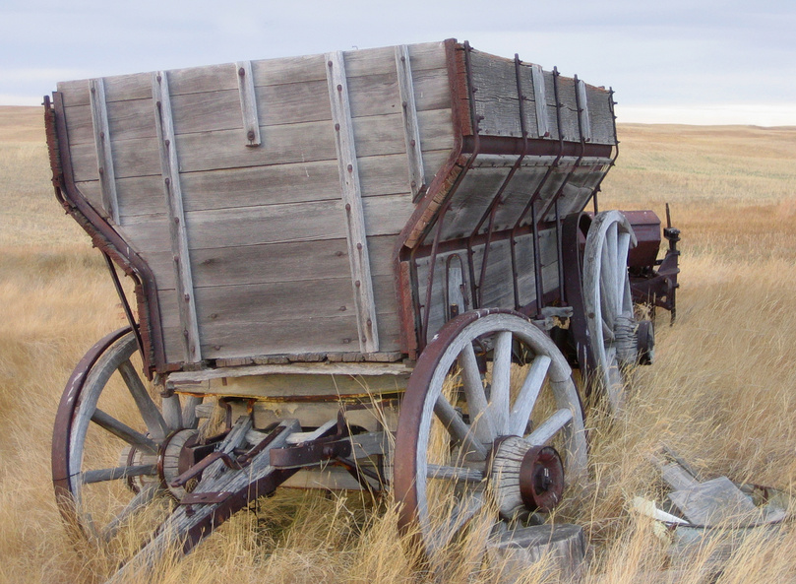
Provincial

Slide 14

Provincial
by AvidlyAbide
by Vic

Slide 15

Provincial

Slide 16

Provincial – (adj) [pruh-vin-shuhl] limited in outlook; unsophisticated
by AvidlyAbide
by Vic

