Slide 1
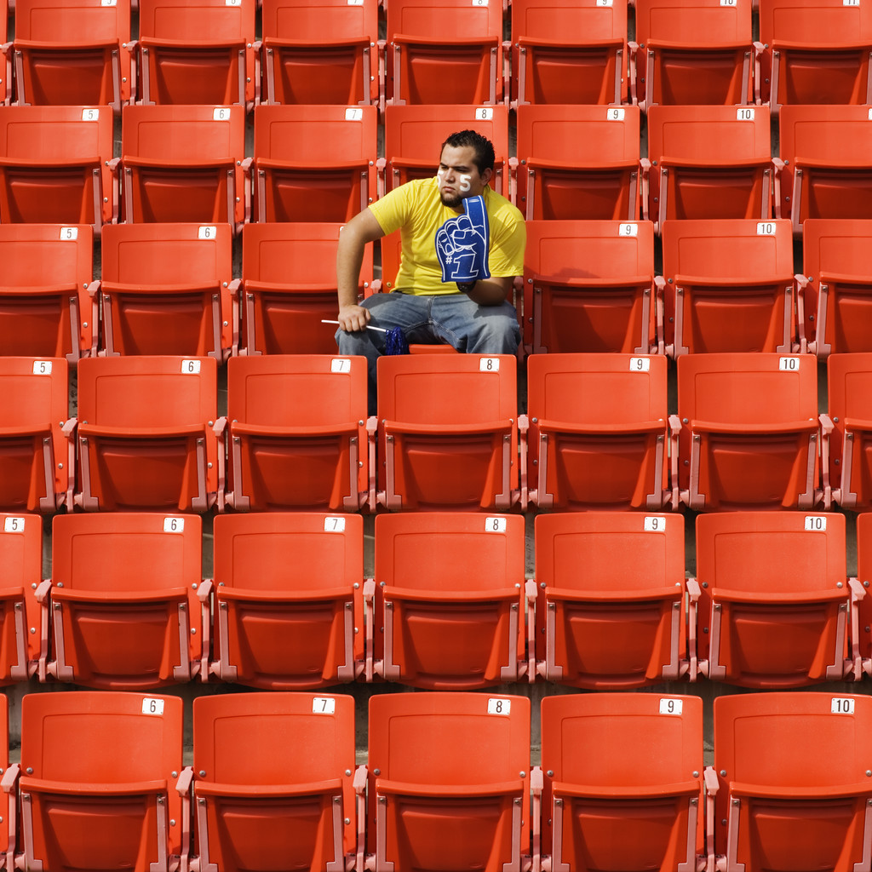
Aloof

Slide 2
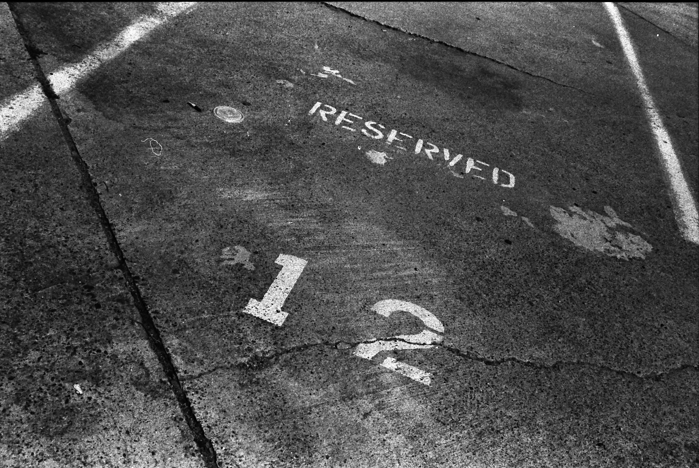

Aloof
by Steve Snodgrass

Slide 3
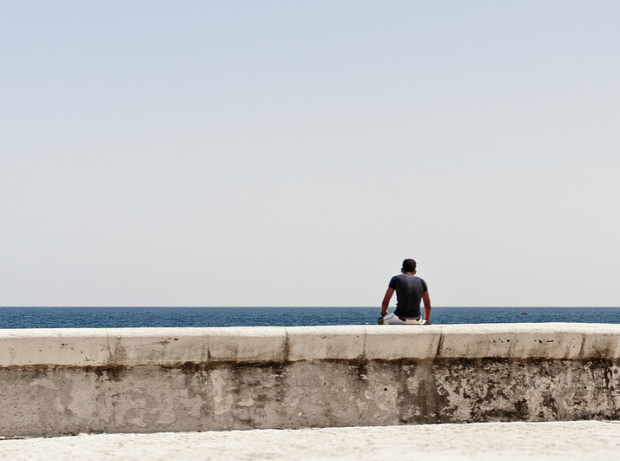
Aloof
by vxla

Slide 4
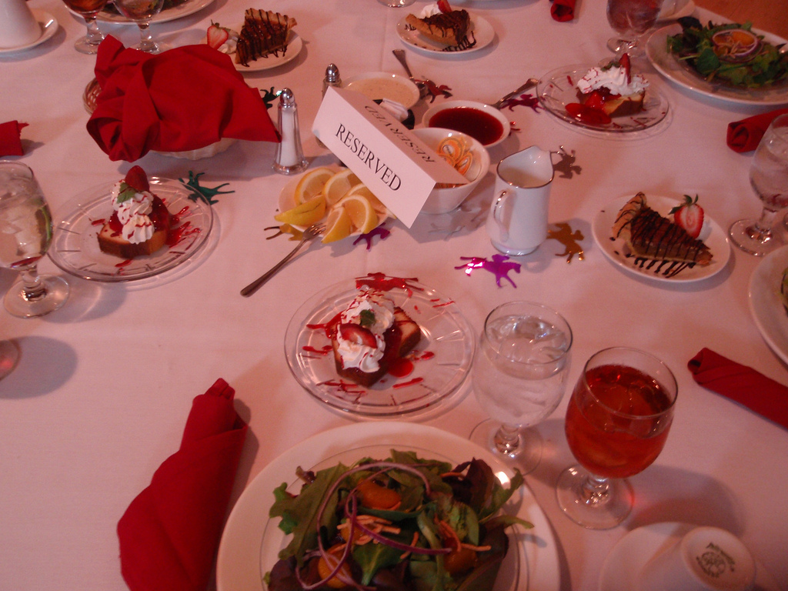
Aloof – (adj) [uh-loof] apart; reserved
by Joelk75

Slide 5
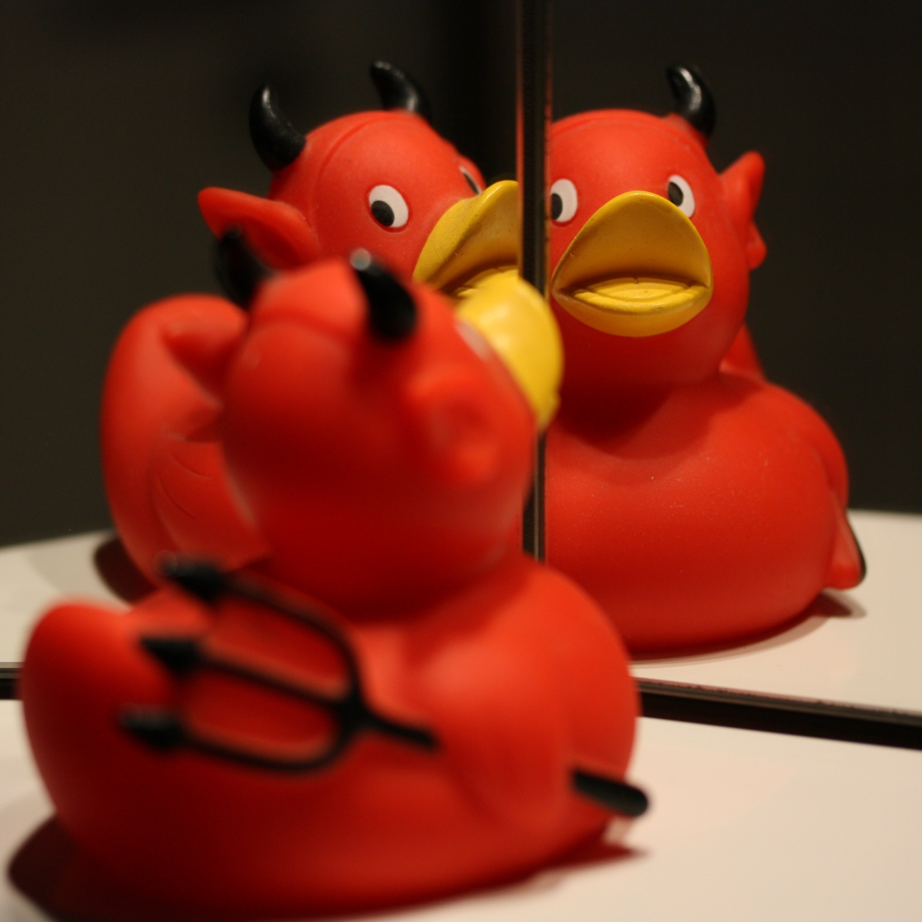
Depravity
by saturn ♄

Slide 6
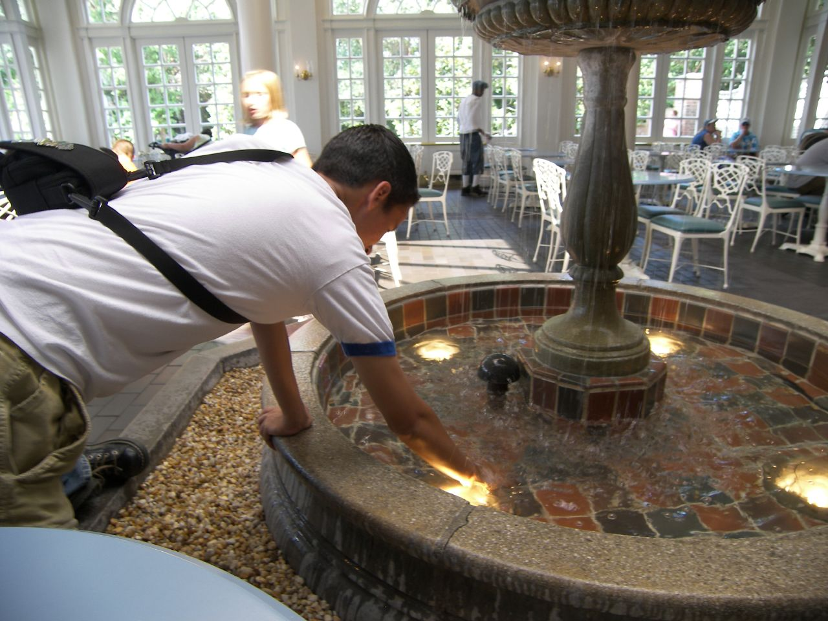
Depravity
by james ellsworth

Slide 7
Depravity

Slide 8
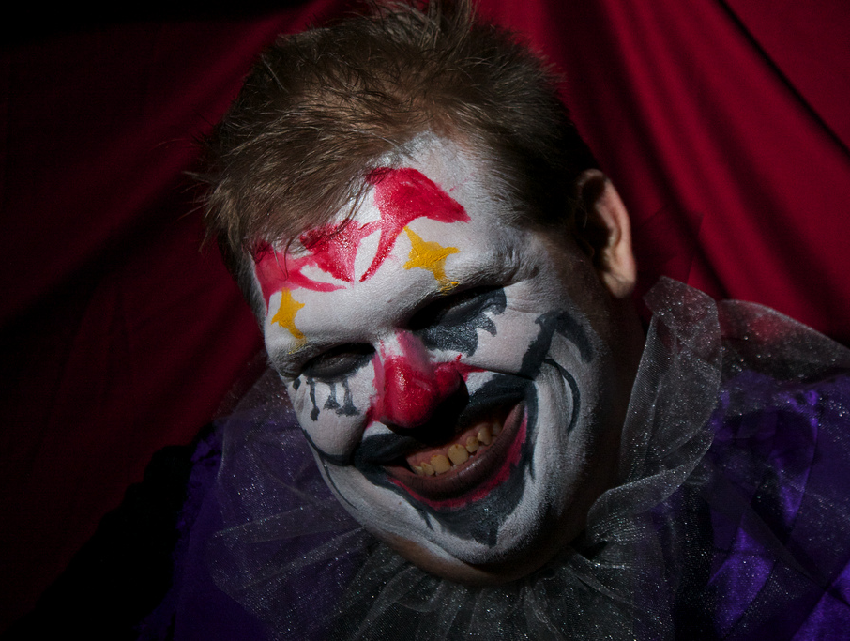

Depravity – (n) [dih-prav-i-tee] extreme corruption; wickedness
by Silver Tusk

Slide 9
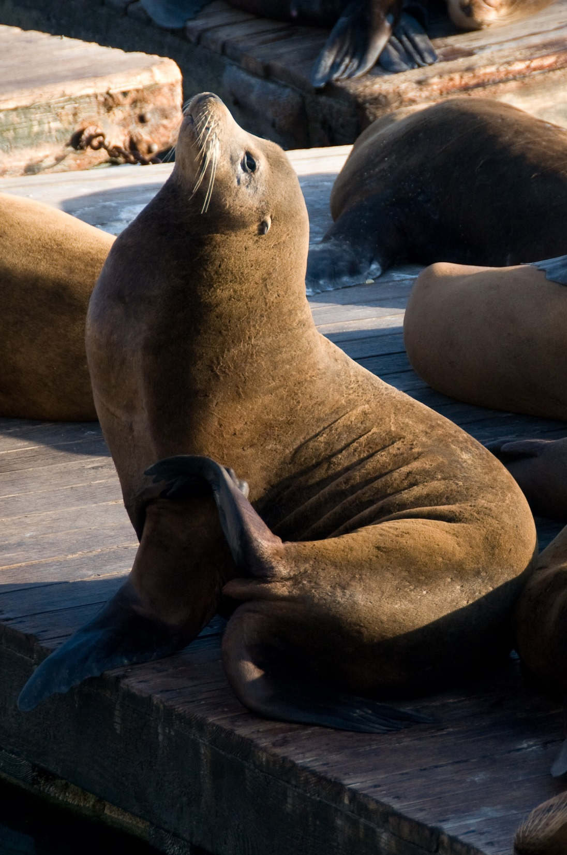
Haughtiness
by ArtBrom

Slide 10
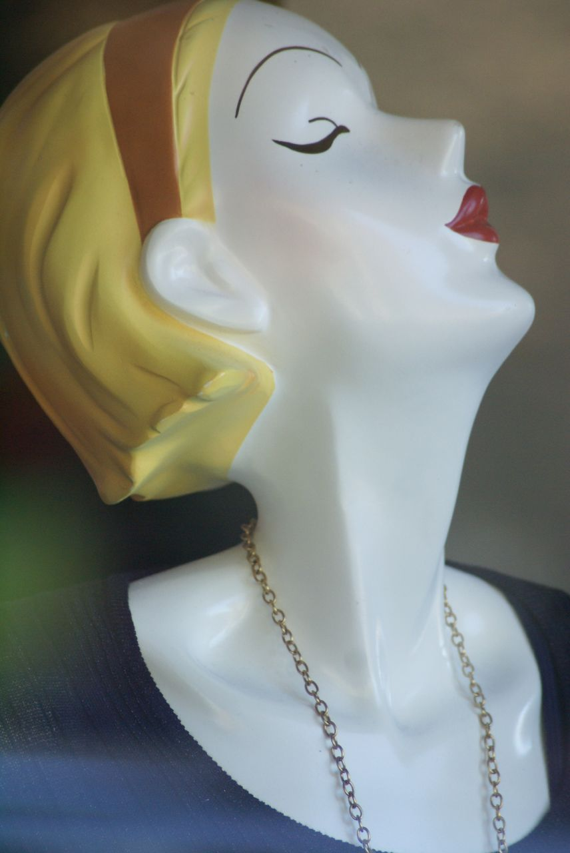
Haughtiness
by Valerie Everett

Slide 11

Haughtiness
by he(art)geek

Slide 12
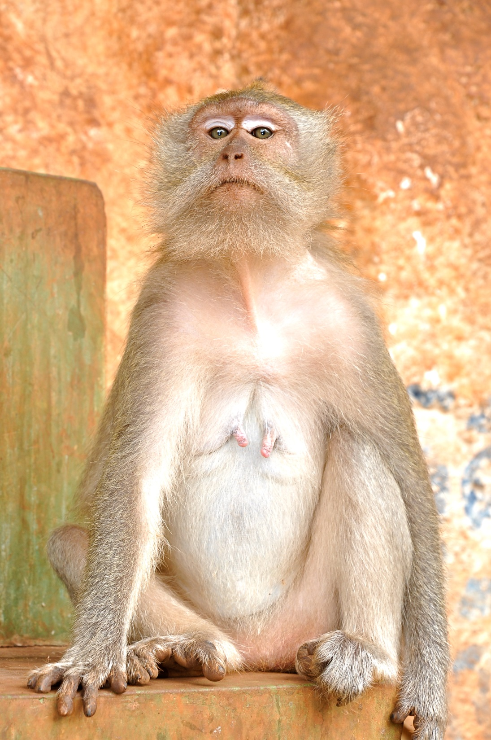
Haughtiness – (n) [haw-tee] pride; arrogance
by Brandon LLW

Slide 13
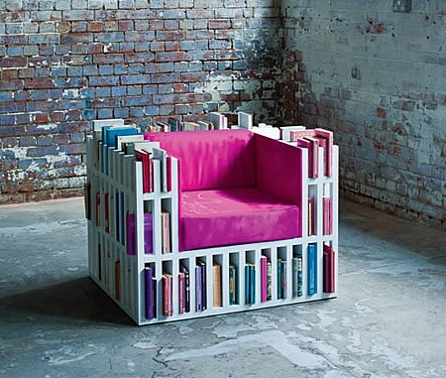
Pragmatic
by Wickerfurniture

Slide 14
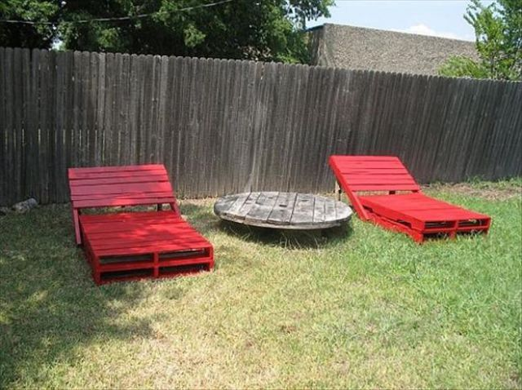
Pragmatic
by xaxor.com

Slide 15
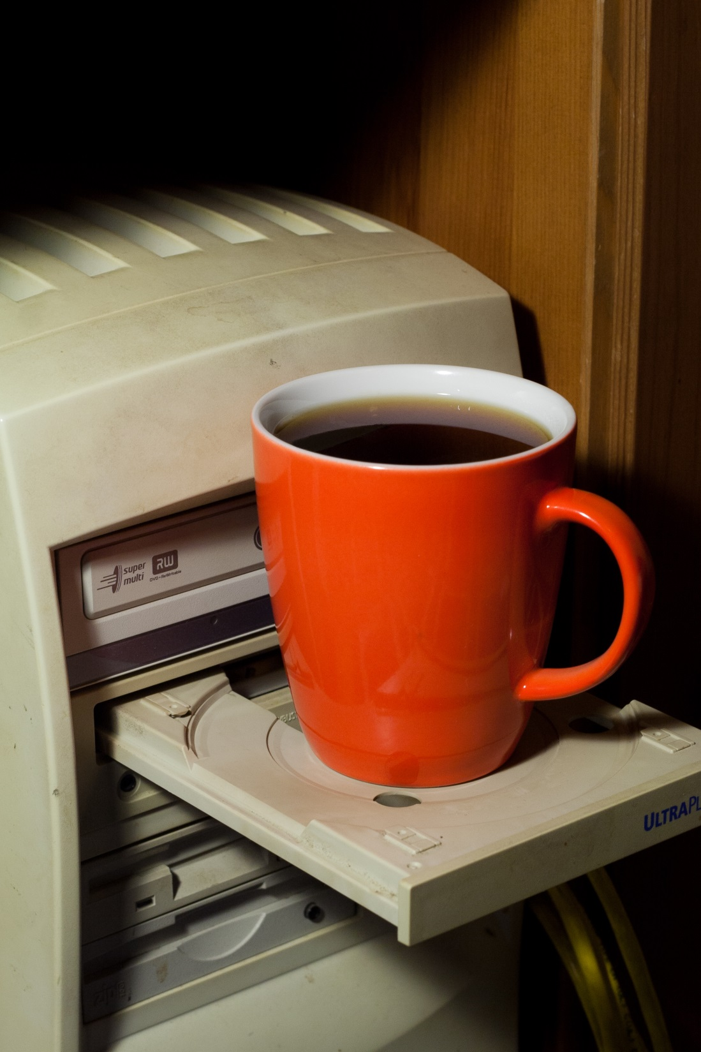
Pragmatic
by he-sk

Slide 16
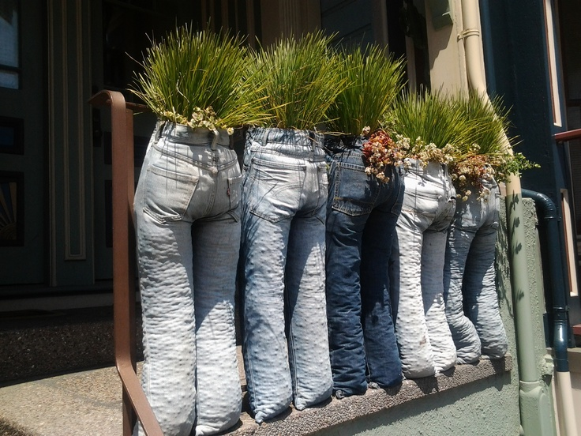
Pragmatic – (adj) [prag-mat-ik] practical; concerned with the practical worth or impact of something
by Flora & Fauna

