Slide 1
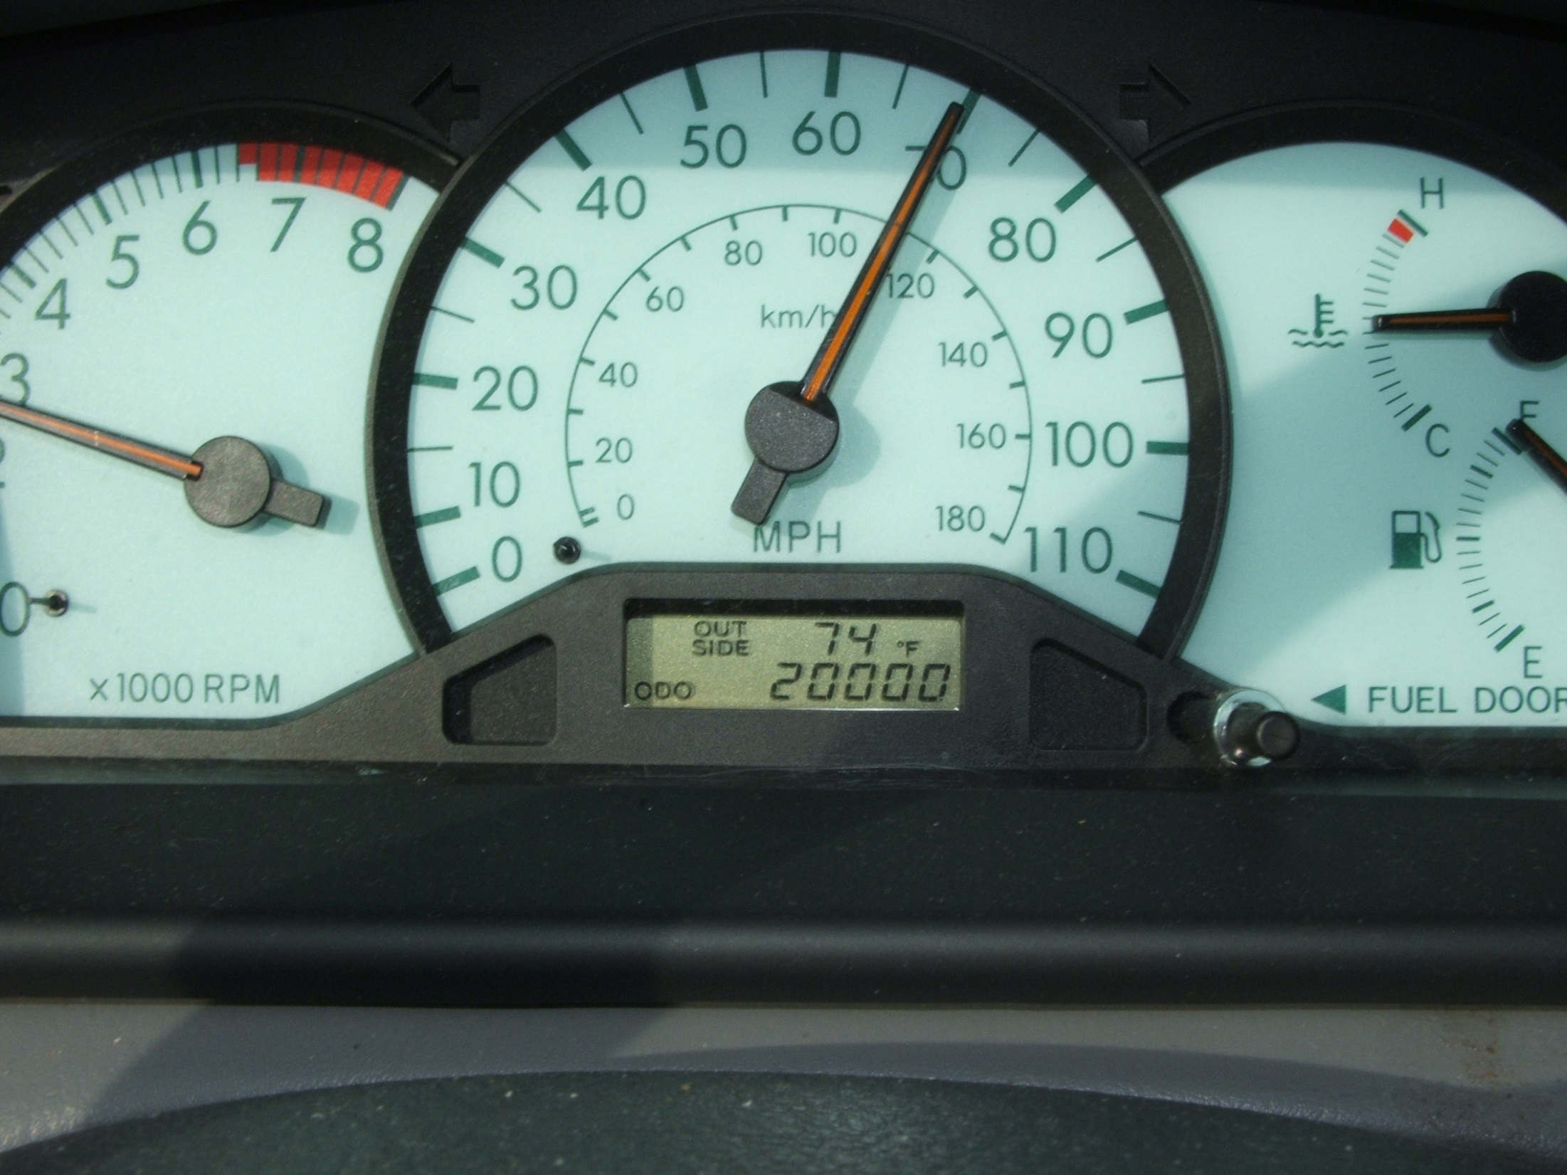
Accelerate
by KellyK

Slide 2
Acknowledge
by JefferyTurner

Slide 3
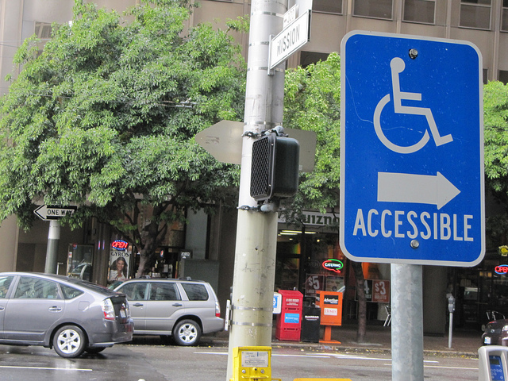
Accessible
by m.gifford
by Vic

Slide 4
Ac = to, toward, near
by Architopher

Slide 5
Exit
by arthit
by Vic

Slide 6
Examine
by CollegeDegrees360

Slide 7
Exercise

Slide 8
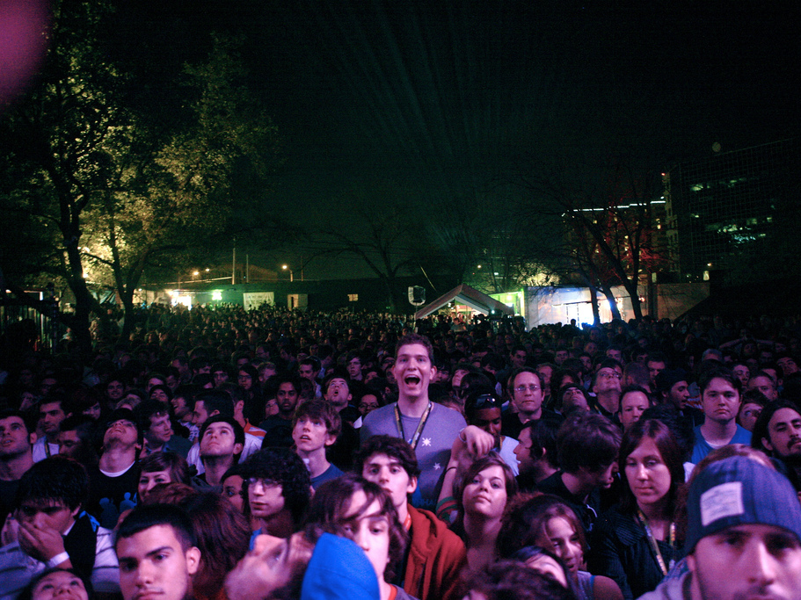
Ex = from, out
by Kris Krug

Slide 9
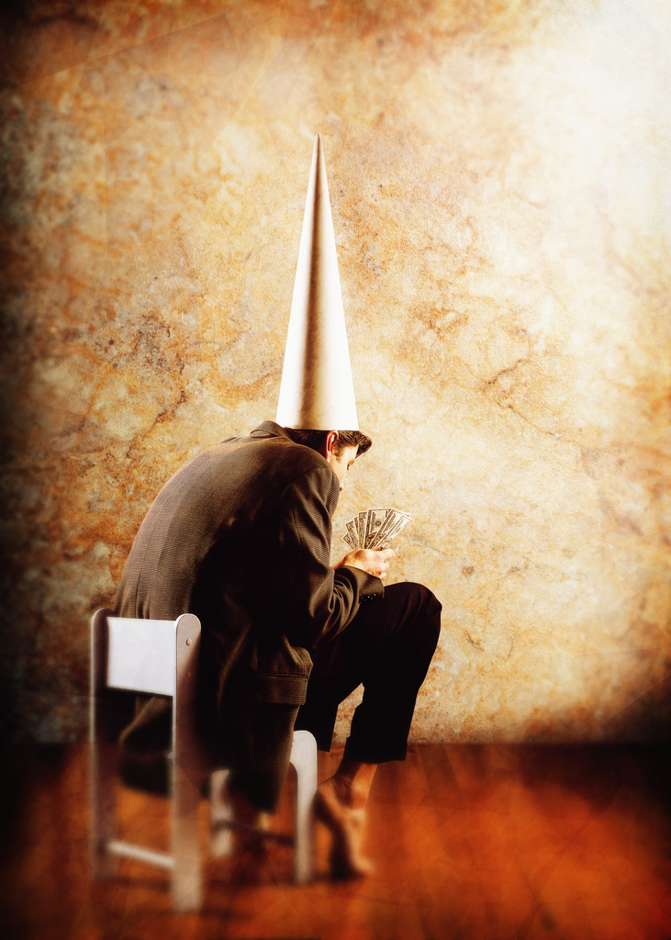
Idiocy

Slide 10
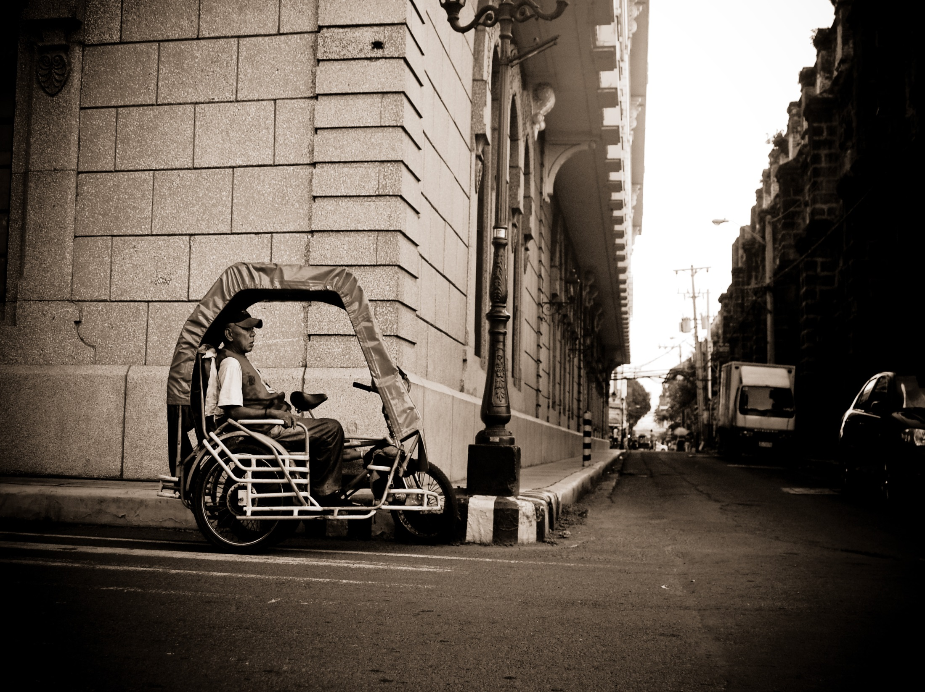
Idiosyncrasy
by fechi fajardo

Slide 11
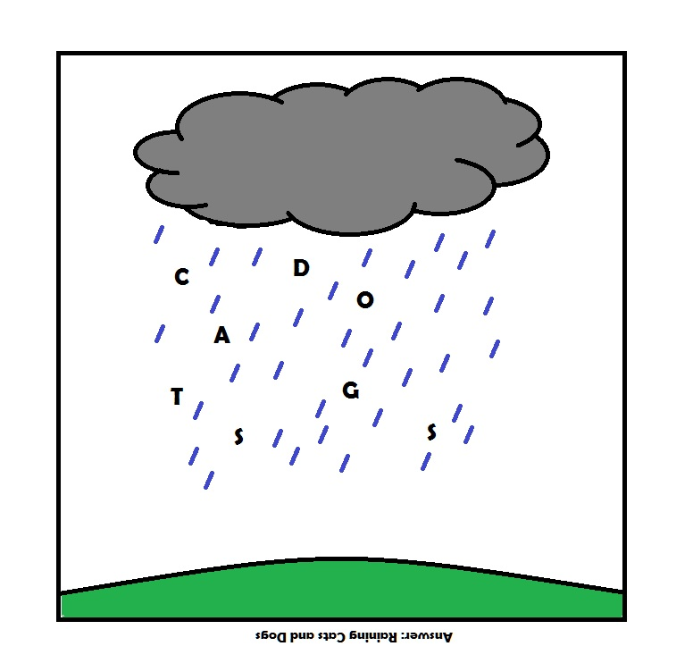
Idiomatic
by Bingmanson

Slide 12
Idio = peculiar, personal, distinct
by micadew

Slide 13
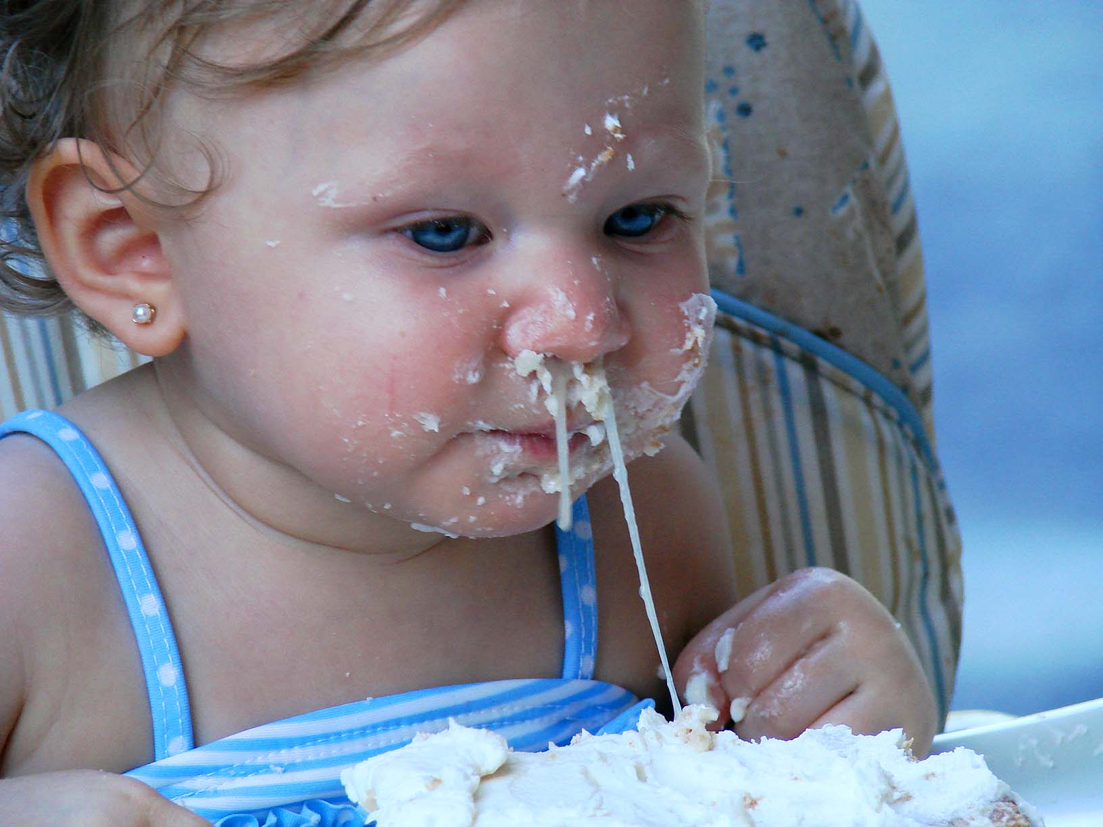
Repugnant
by LadyDragonflyCC - >;<

Slide 14
Pugnacious

Slide 15
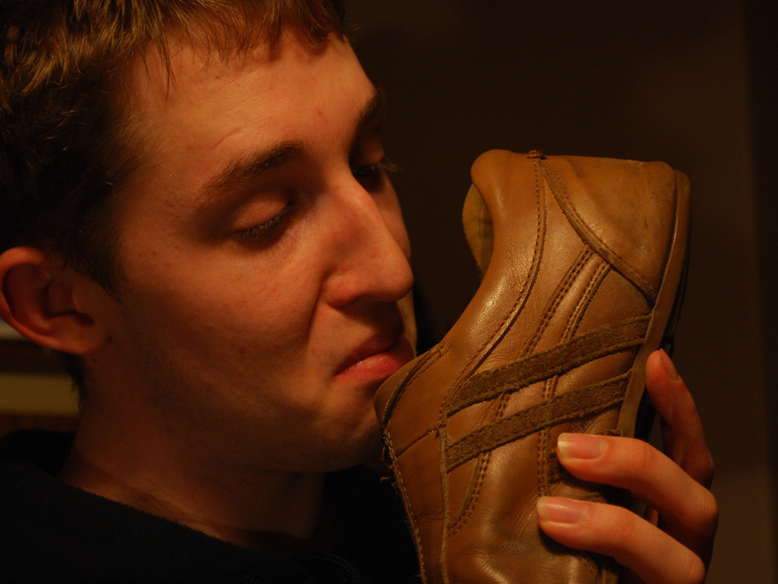
Pungent
by stuartpilbrow

Slide 16
Pugn/Pung = to fight

