Slide 1
Audio

Slide 2
Applaud

Slide 3
Aurora
by A. Sparrow

Slide 4
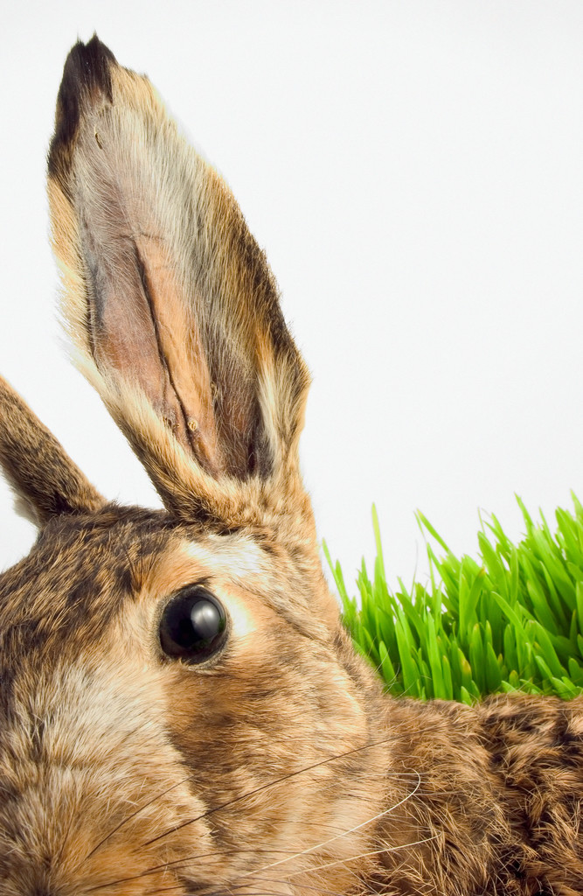
Aud, aur = to hear

Slide 5
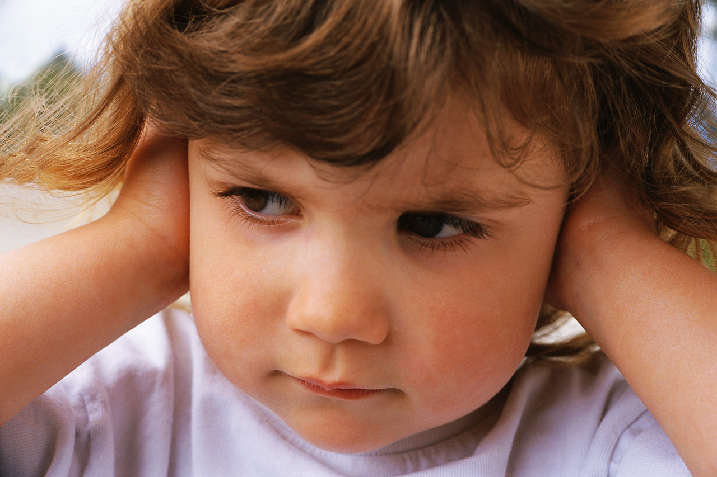
Cacophony

Slide 6
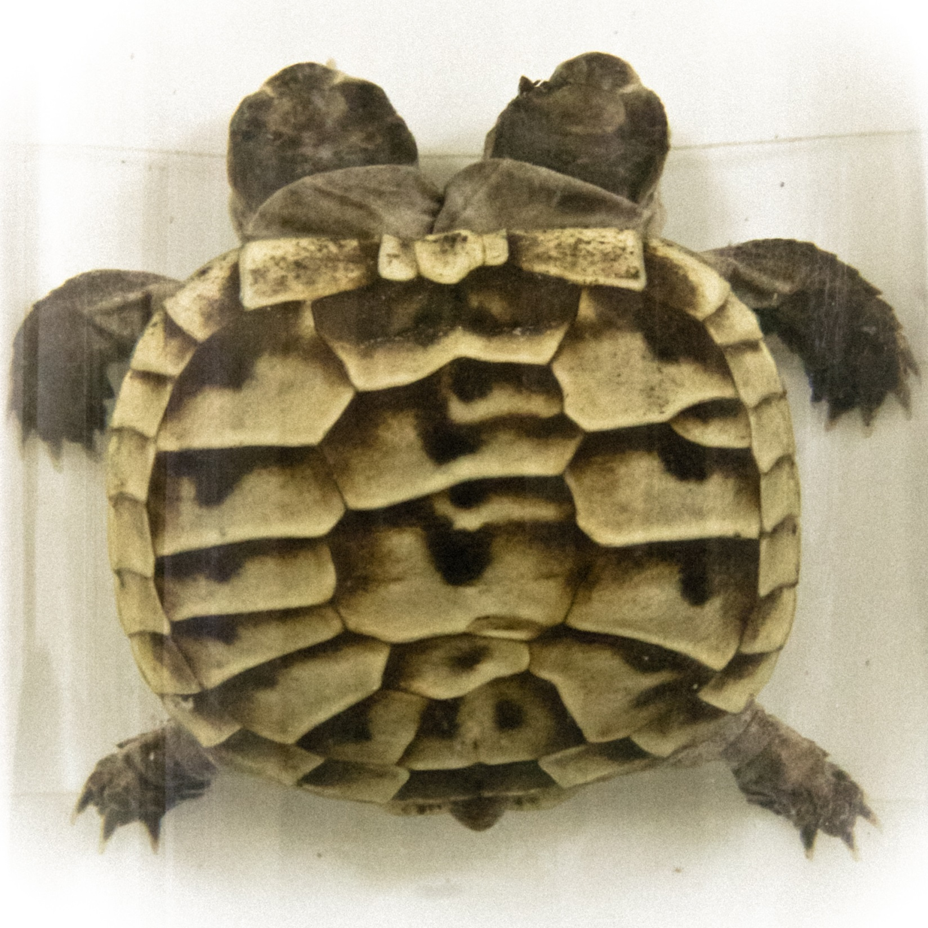
Dysfunction
by Orin Zebest

Slide 7
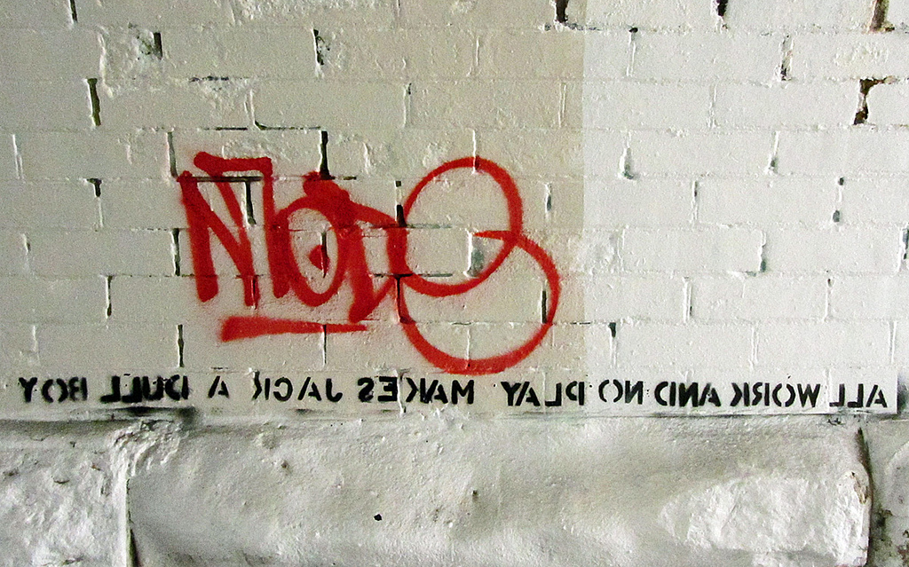
Dyslexic
by Newton grafitti

Slide 8
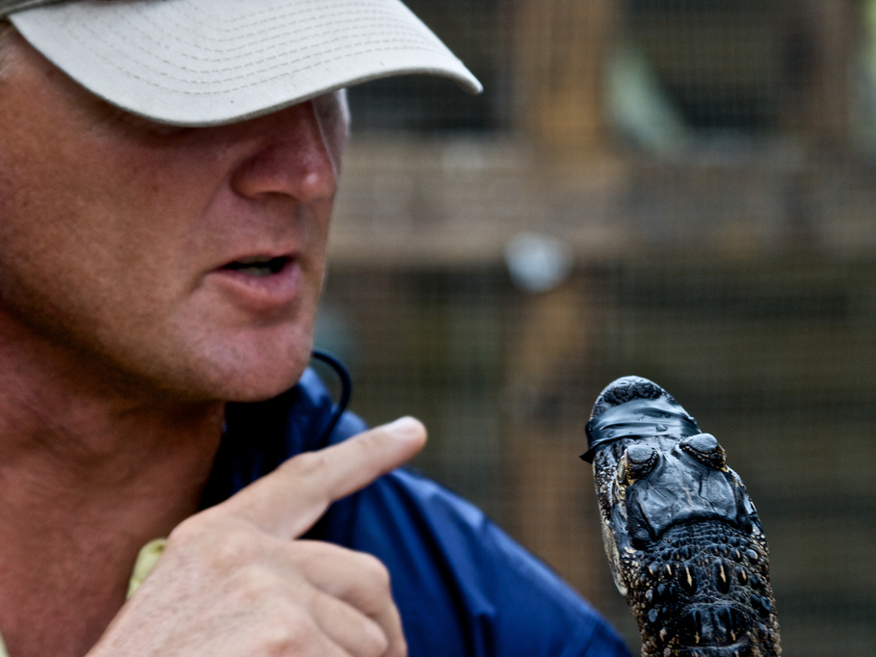
Caco-, dys- = bad, abnormal.
by NathanF

Slide 9
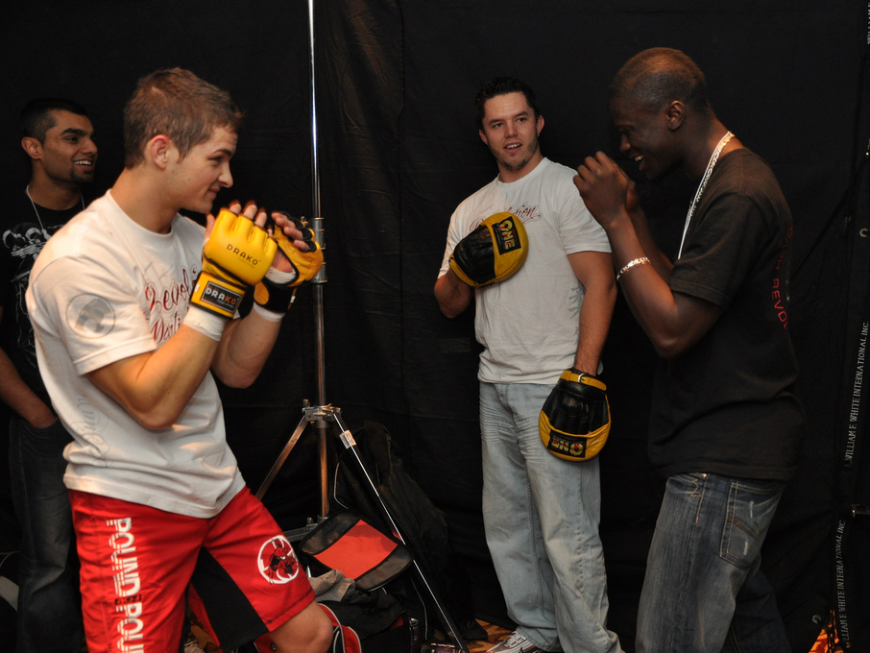
Bellicose
by MartialArtsNomad.com

Slide 10
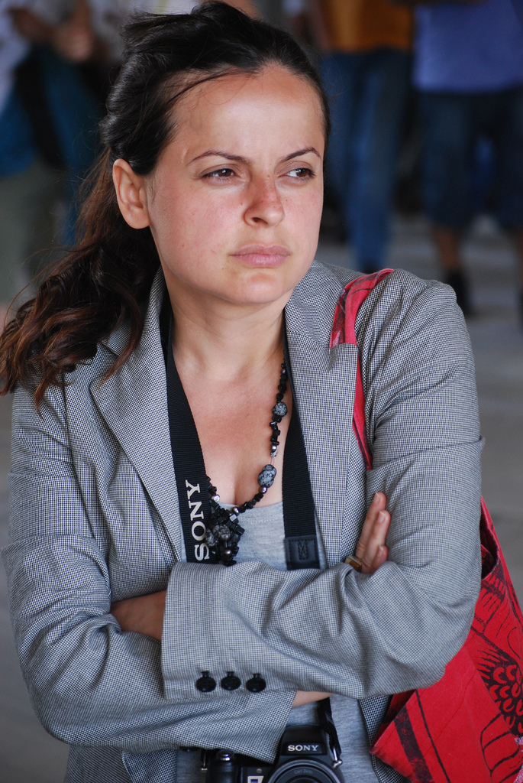
Belligerent
by allistair

Slide 11
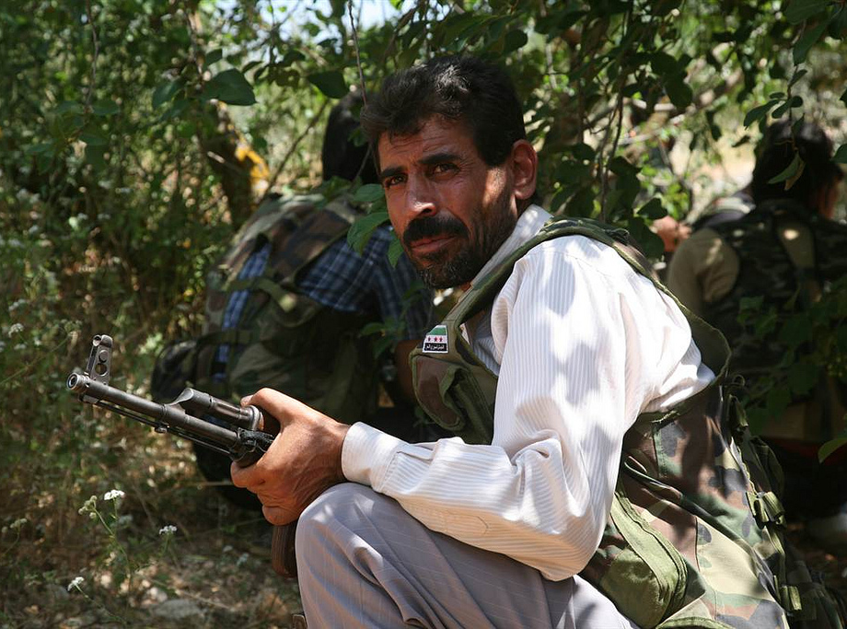
Rebellion
by FreedomHouse

Slide 12
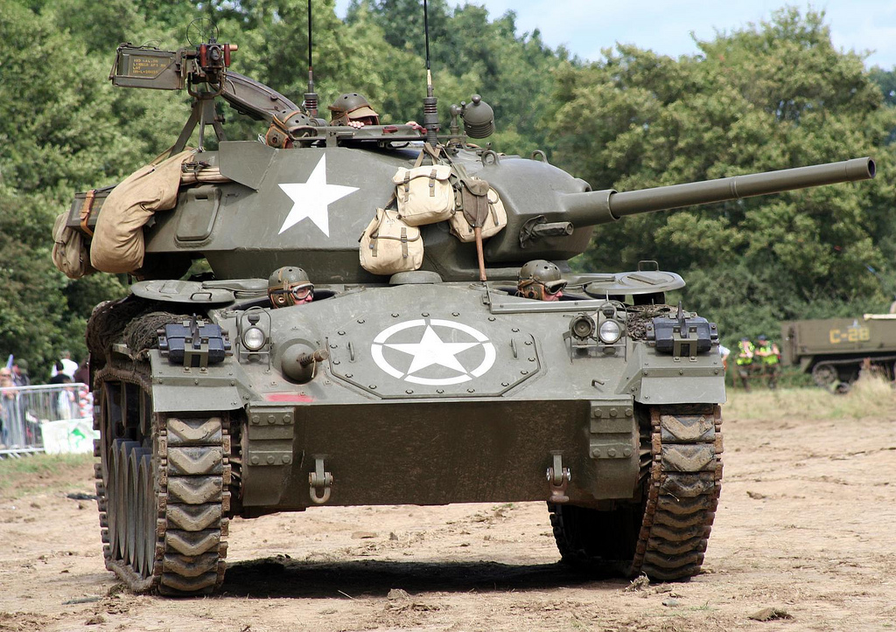
Belli = war, fight.
by gluemoon

Slide 13
Verbicide
She used to have a boyfriend with a wooden leg, but he broke it off.
The butcher backed up into the meat grinder and got a little behind in his work.
I wondered why the baseball was getting bigger. Then it hit me!
Two silk worms had a race. They ended up in a tie
A three legged dog walks into a saloon in the Old West. He slides up to the bar and announces: “I’m looking for the man who shot my paw
by AvidlyAbide
by Vic

Slide 14
Decide
by hang_in_there

Slide 15
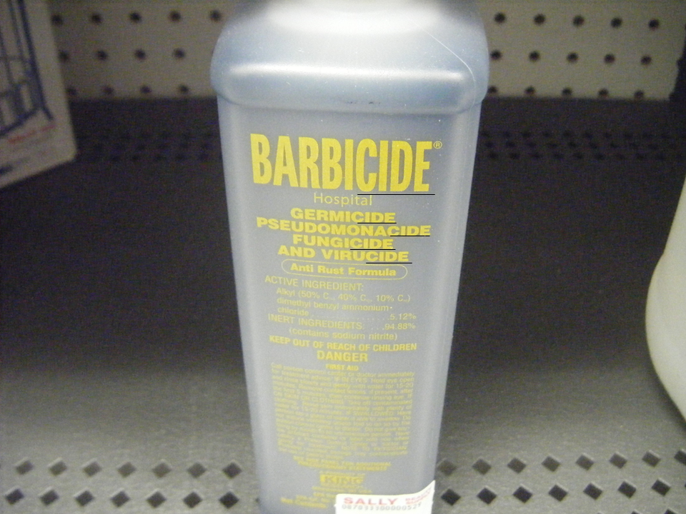
-cide
by bradleygee

Slide 16
-cide = to kill.

