Slide 1
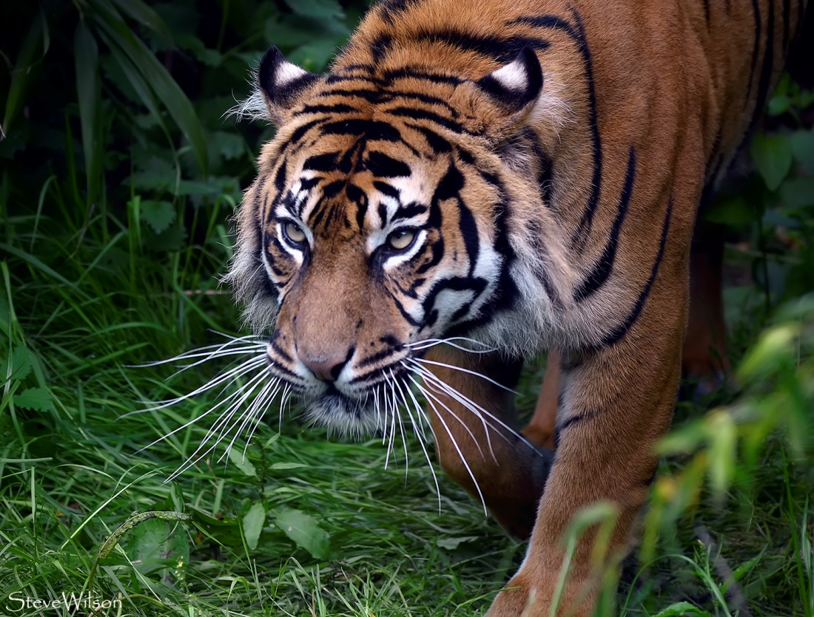
Furtive
by Vic

Slide 2
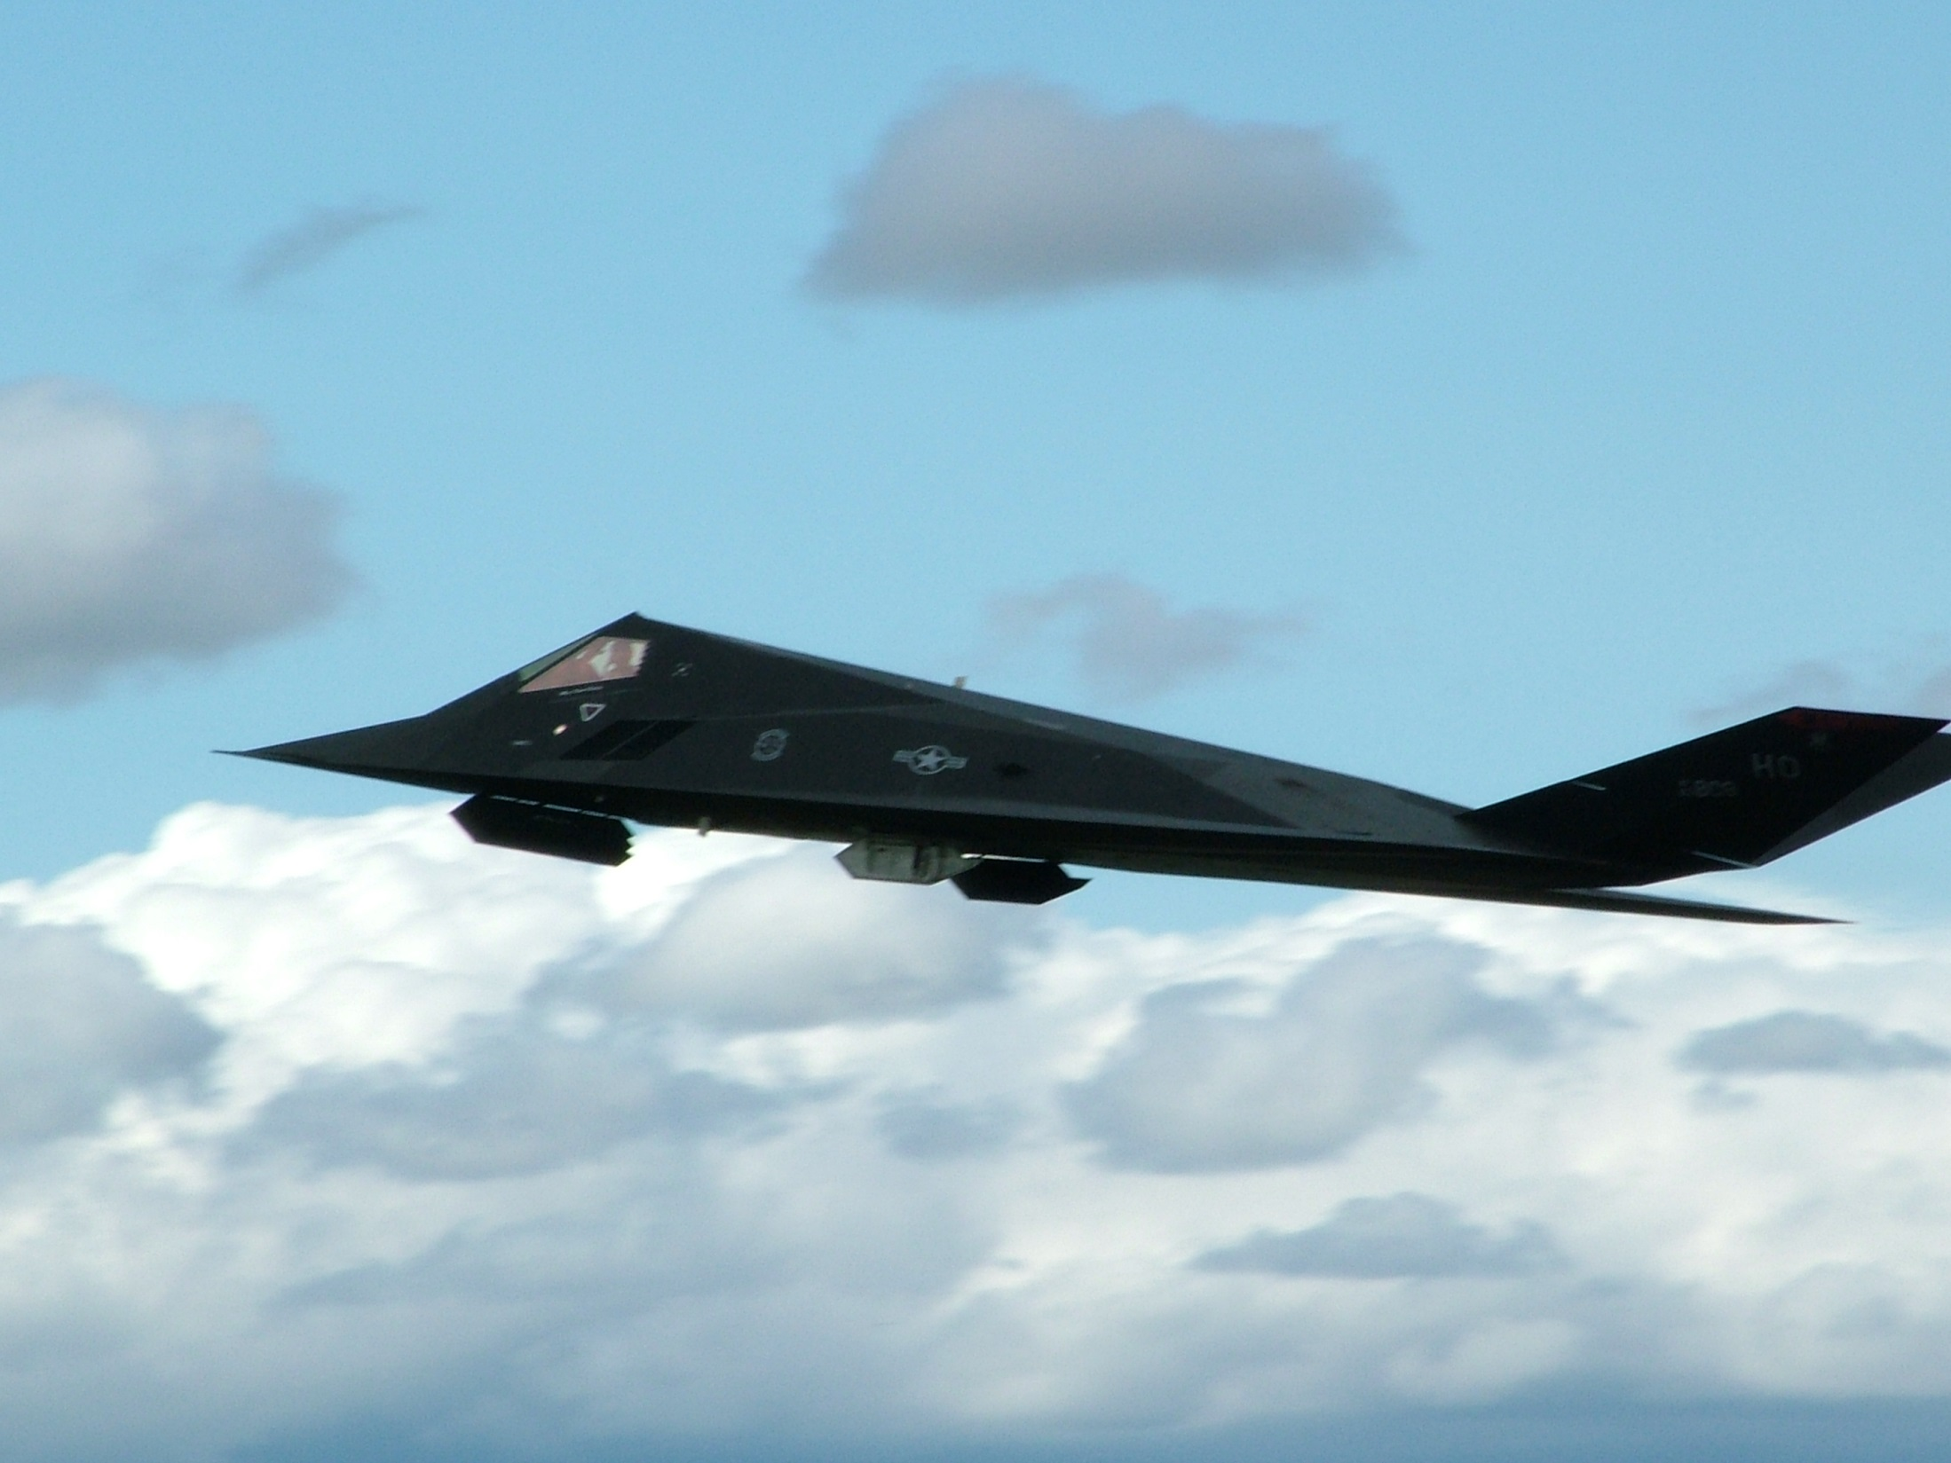
Furtive
by 12me

Slide 3
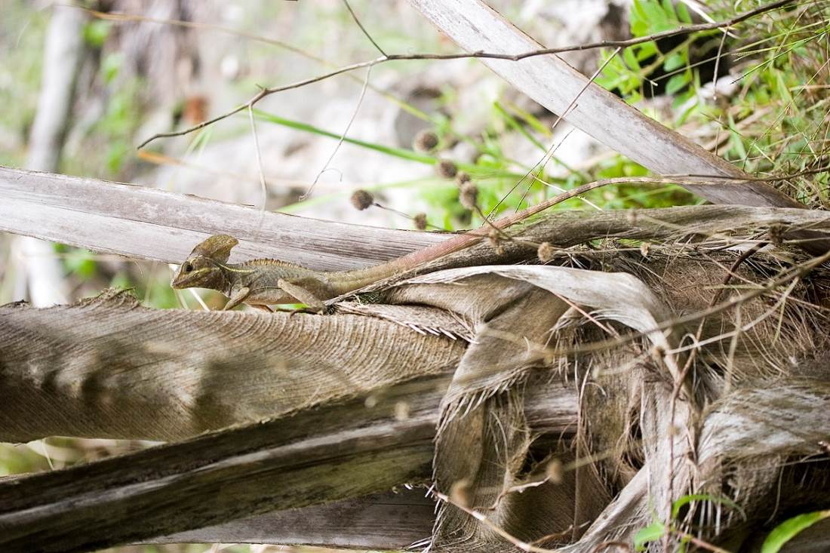
Furtive
by jimmyweee

Slide 4
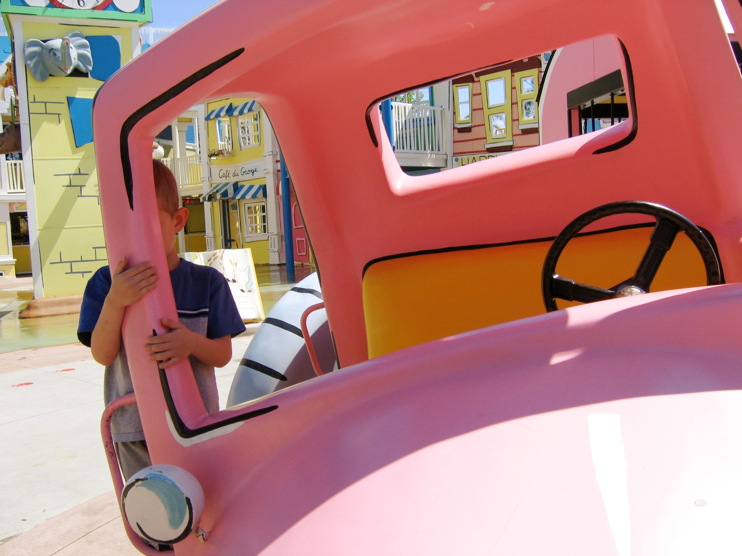
Furtive - (adj) [fur-tiv] stealthy or sneaky
by limaoscarjuliet

Slide 5
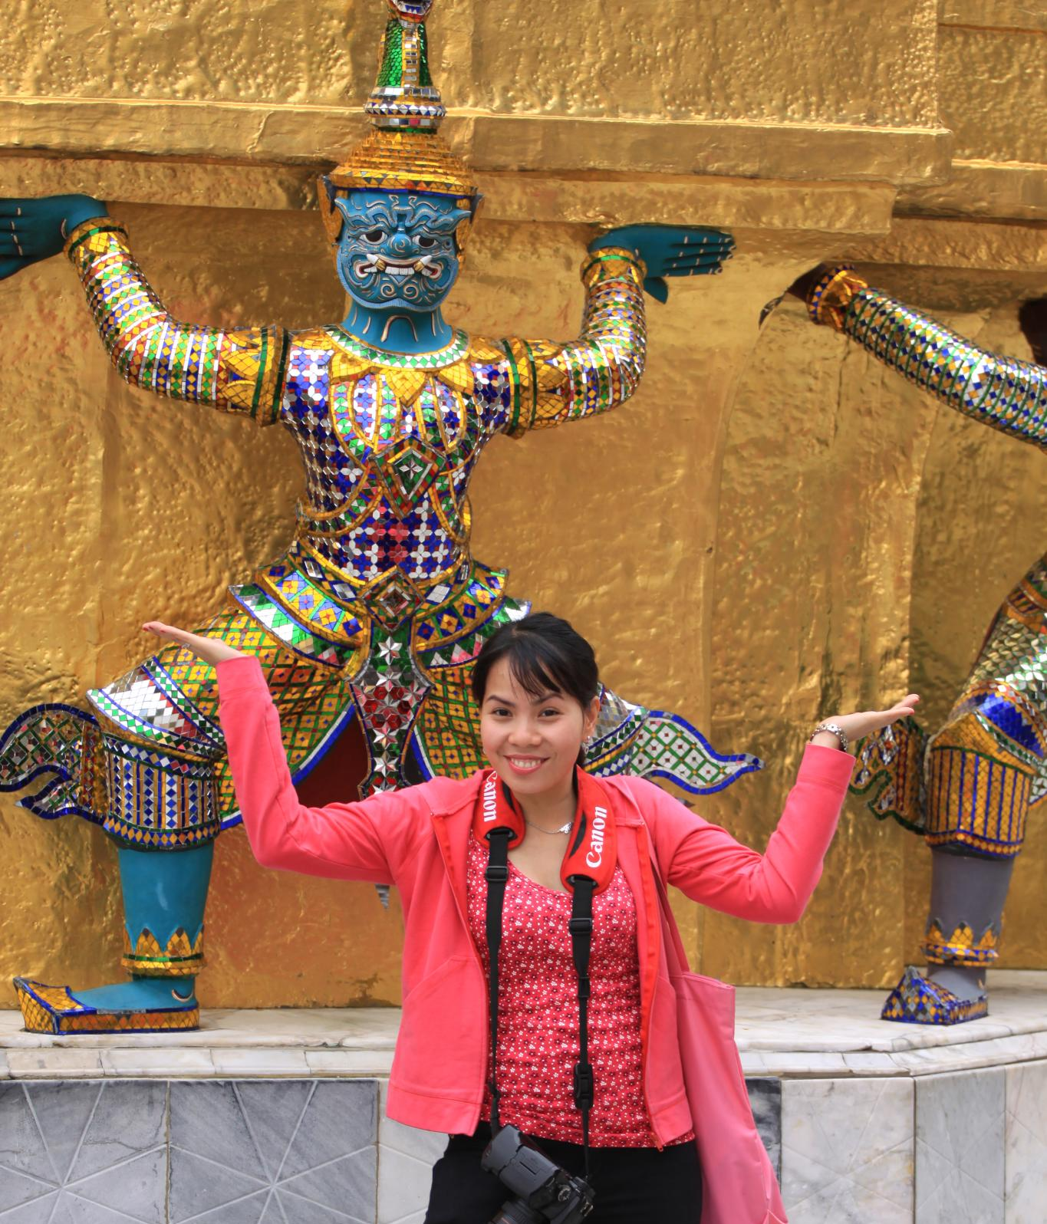
Emulate
by GianCayetano

Slide 6
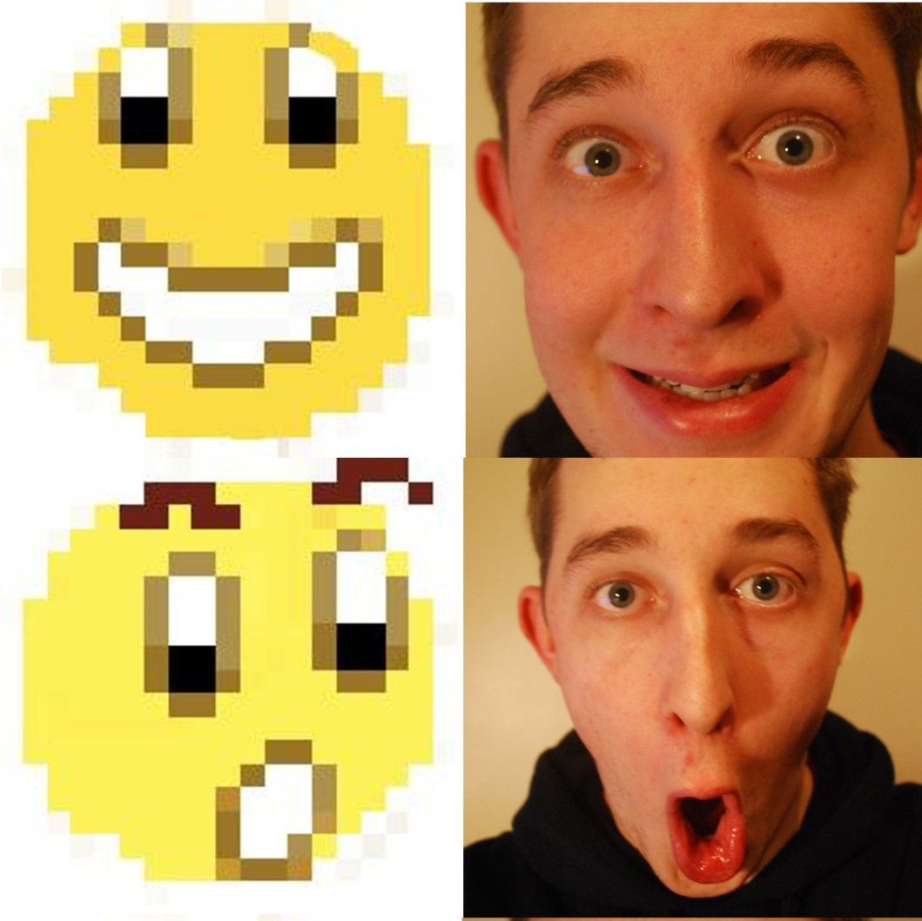
Emulate
by stuartpilbrow

Slide 7
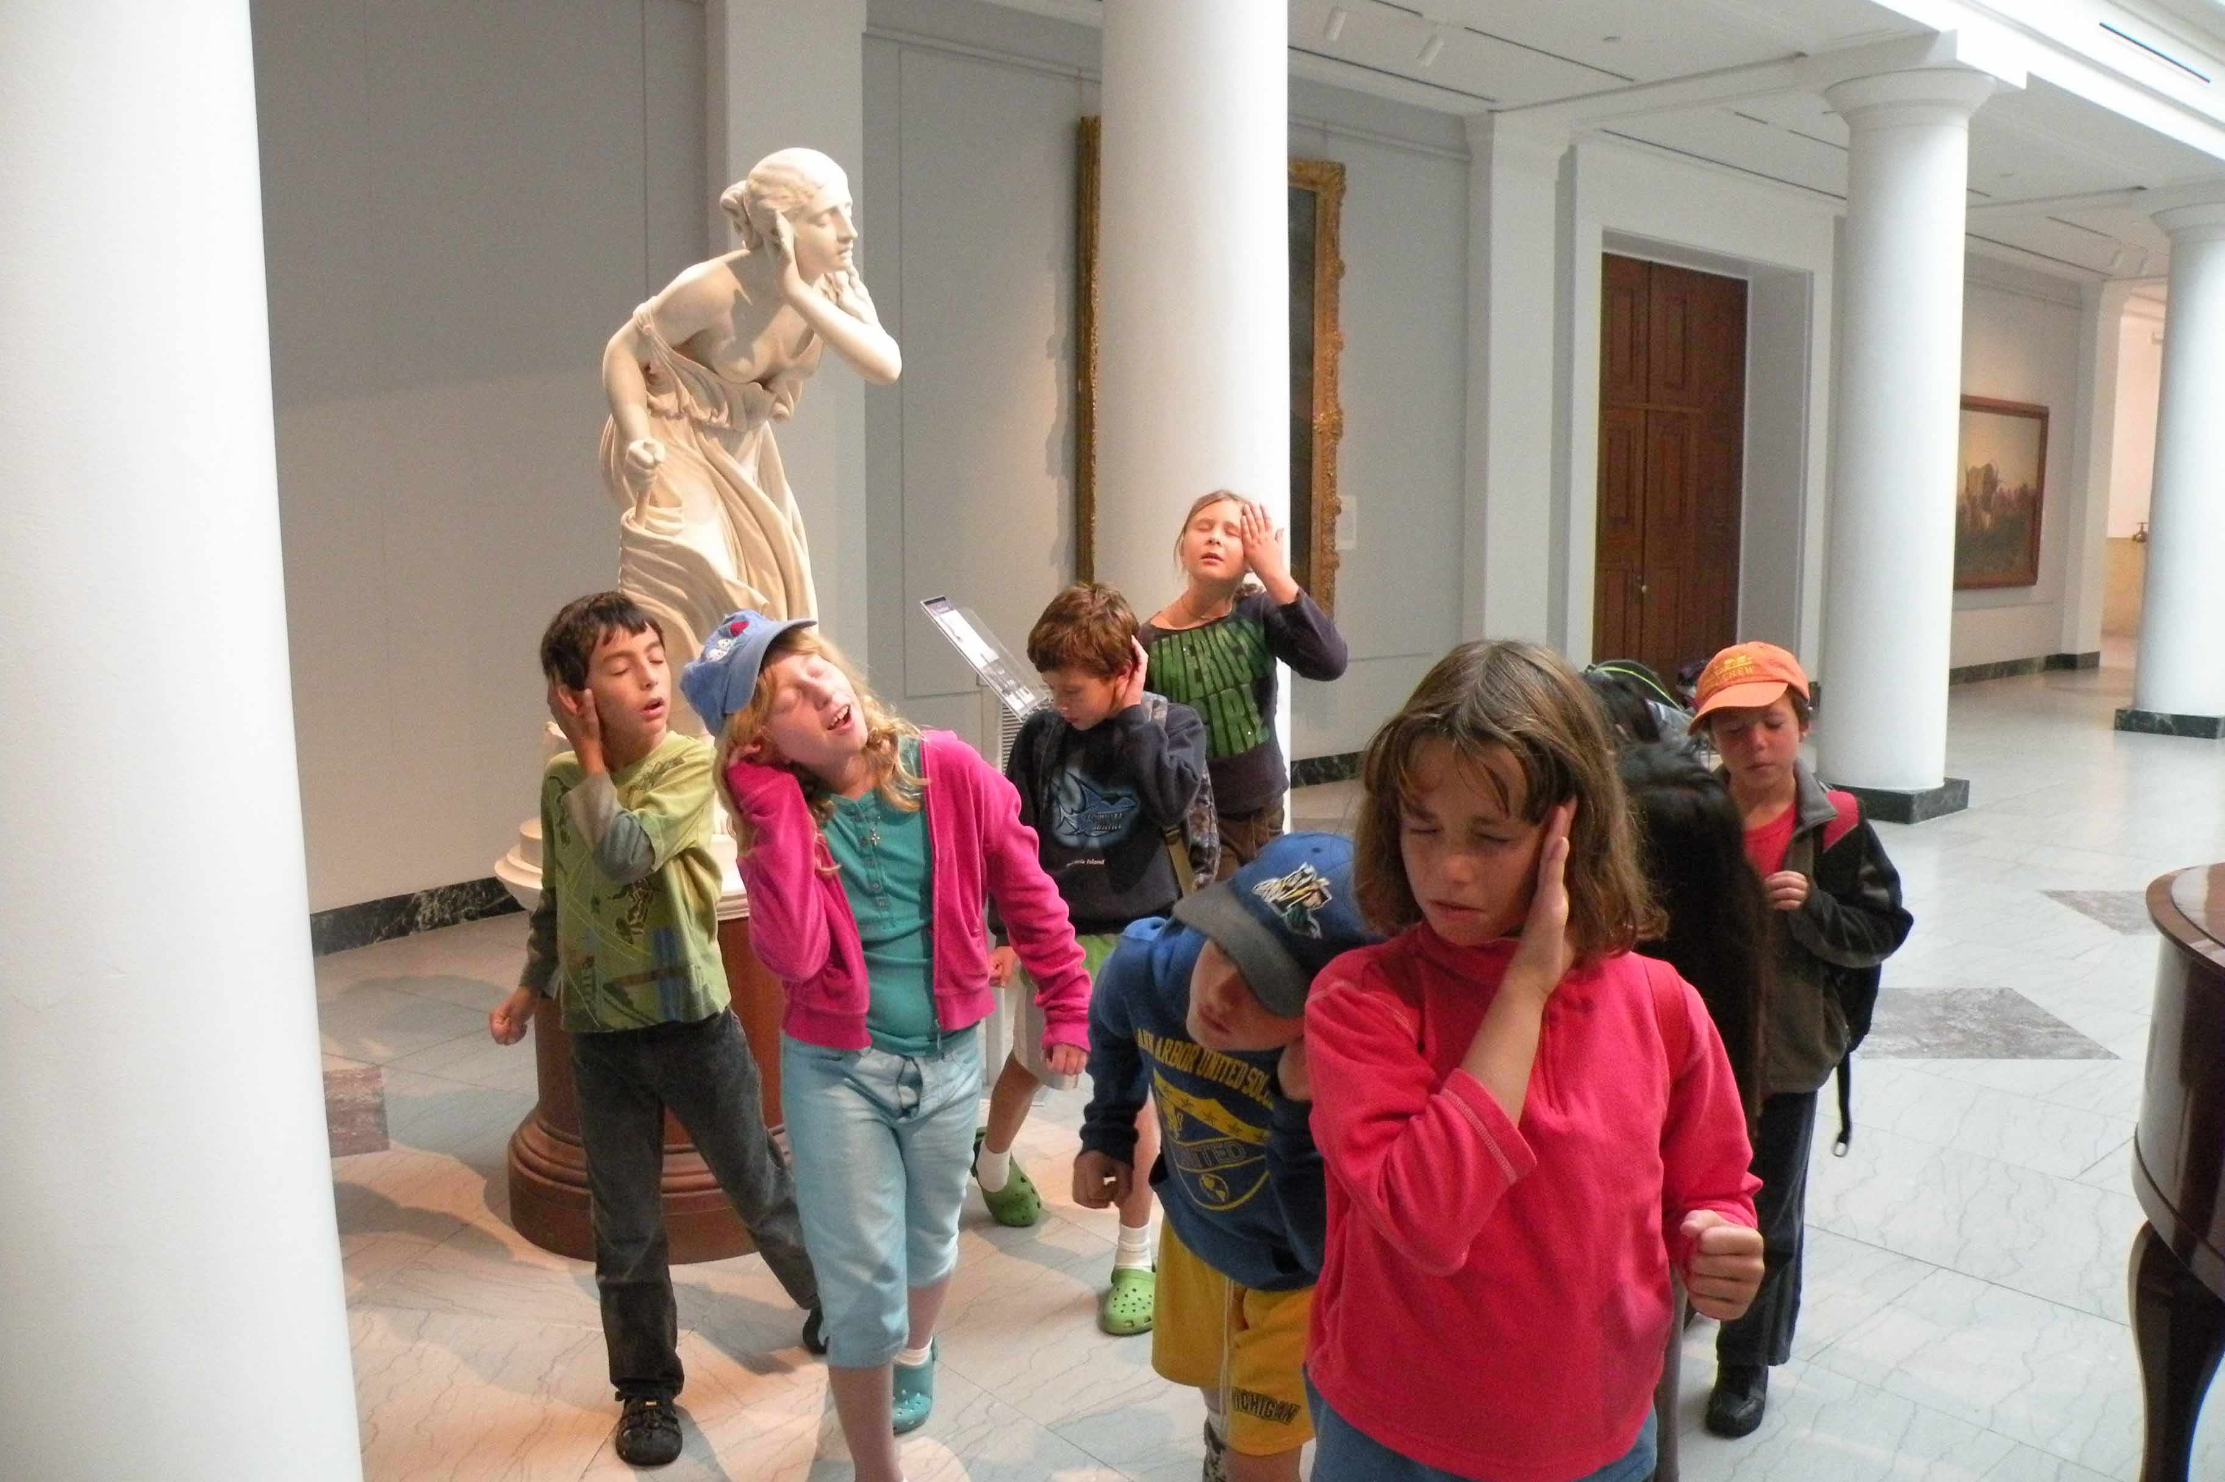
Emulate
by Leslie Science & Nature Center

Slide 8
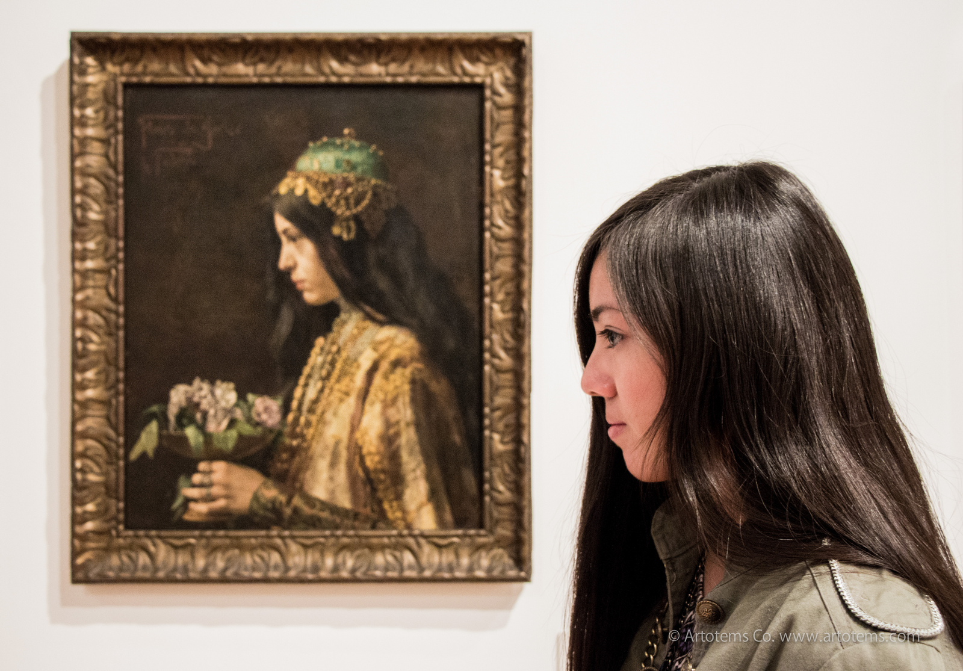
Emulate – (v) [em-yuh-leyt] imitate; rival

Slide 9
Idiosyncrasy
by inkknife_2000

Slide 10
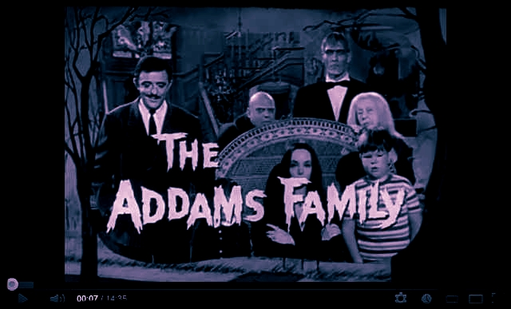
Idiosyncrasy
by artist in doing nothing

Slide 11
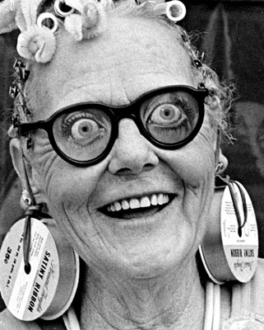
Idiosyncrasy
by Orin Zebest

Slide 12
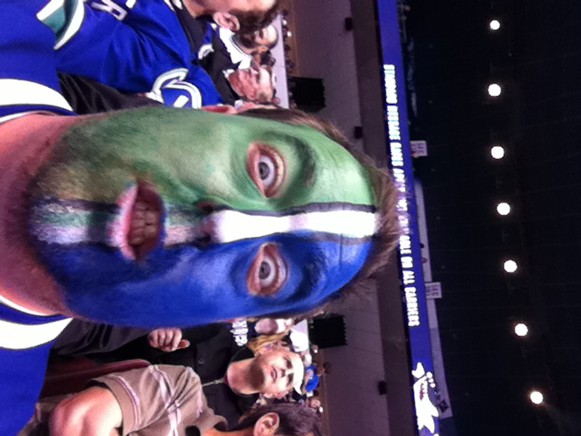
Idiosyncrasy – (n)
[id-ee-uh-sing-kruh-see] individual trait, usually odd in nature, eccentricity
by Chris Breikss

Slide 13
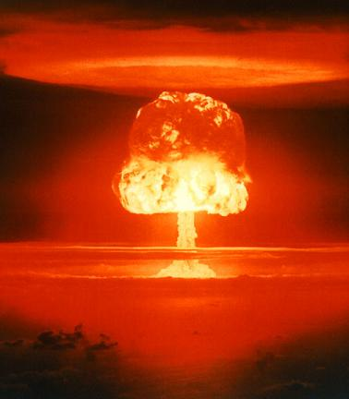
Obliterate
by r0ckchuck

Slide 14
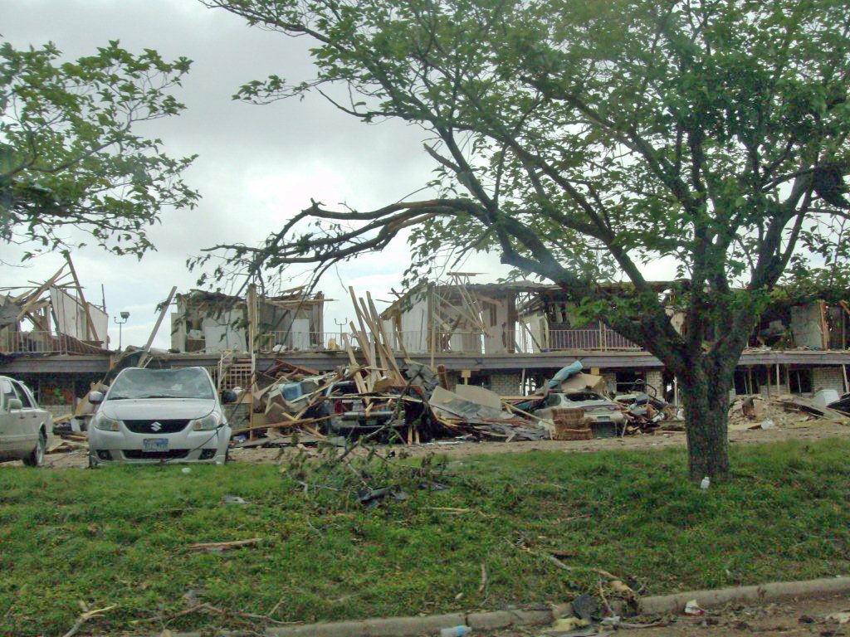
Obliterate
by State Farm

Slide 15
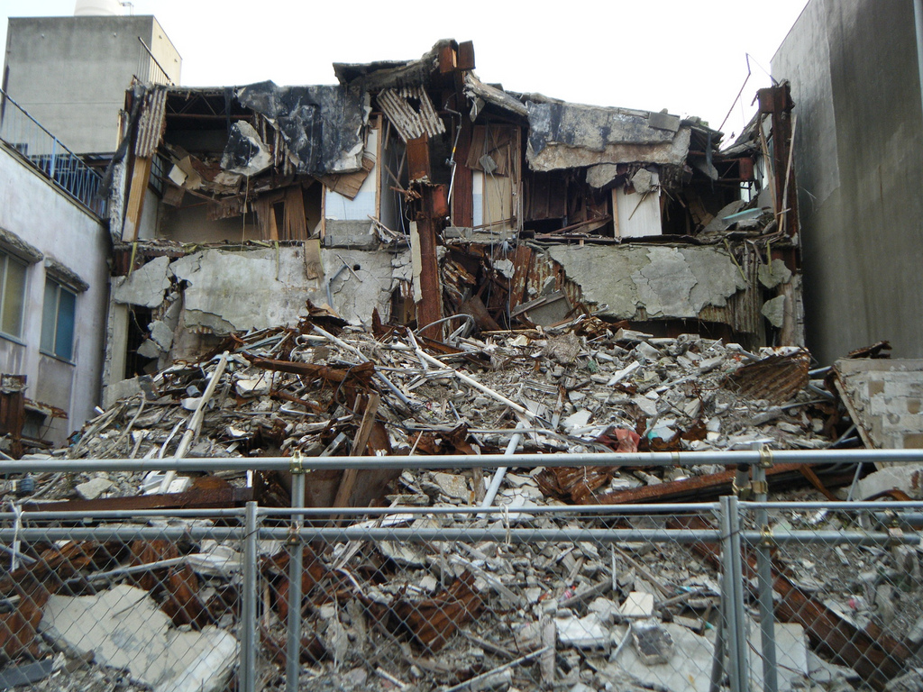
Obliterate
by Garycycles4

Slide 16
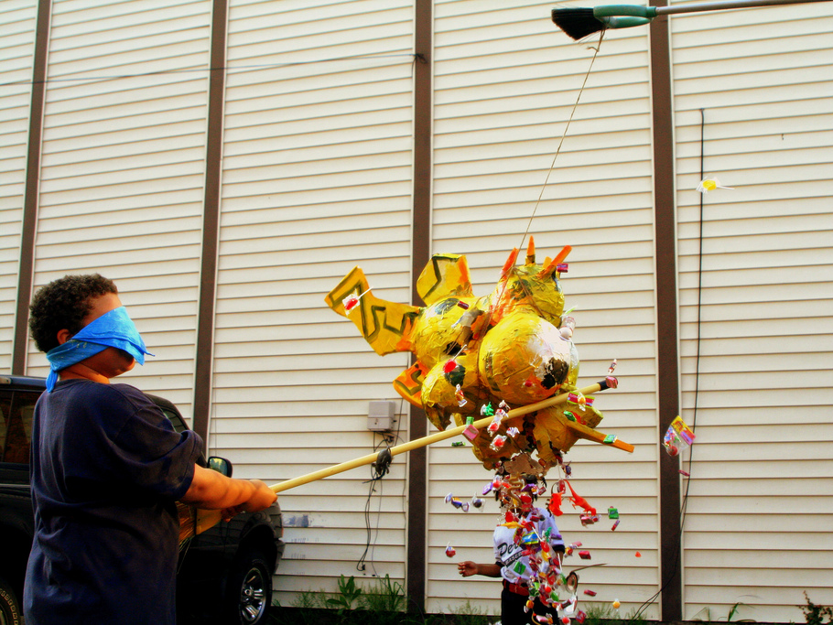
Obliterate - (v) [uh-blit-uh-reyt]
destroy completely
by ndanger

