Slide 1
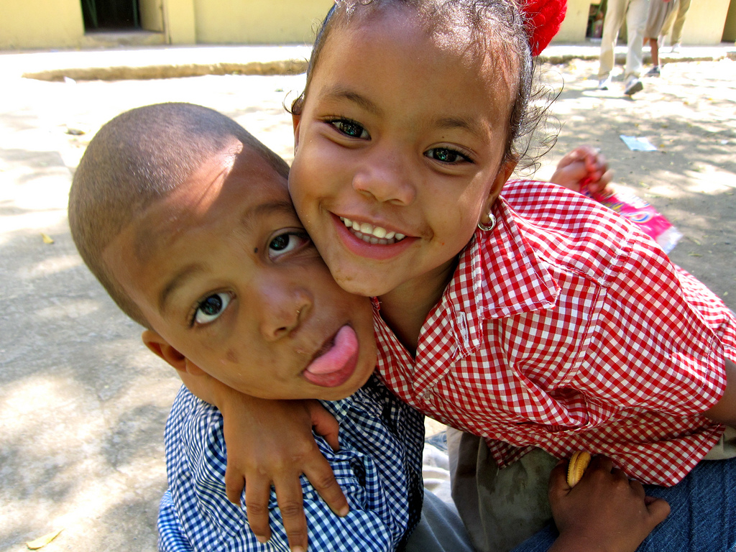
Affable
by KR1212

Slide 2
Affable

Slide 3
Affable

Slide 4
Affable - (adj) [af-uh-buh] easily
approachable; warm, friendly

Slide 5
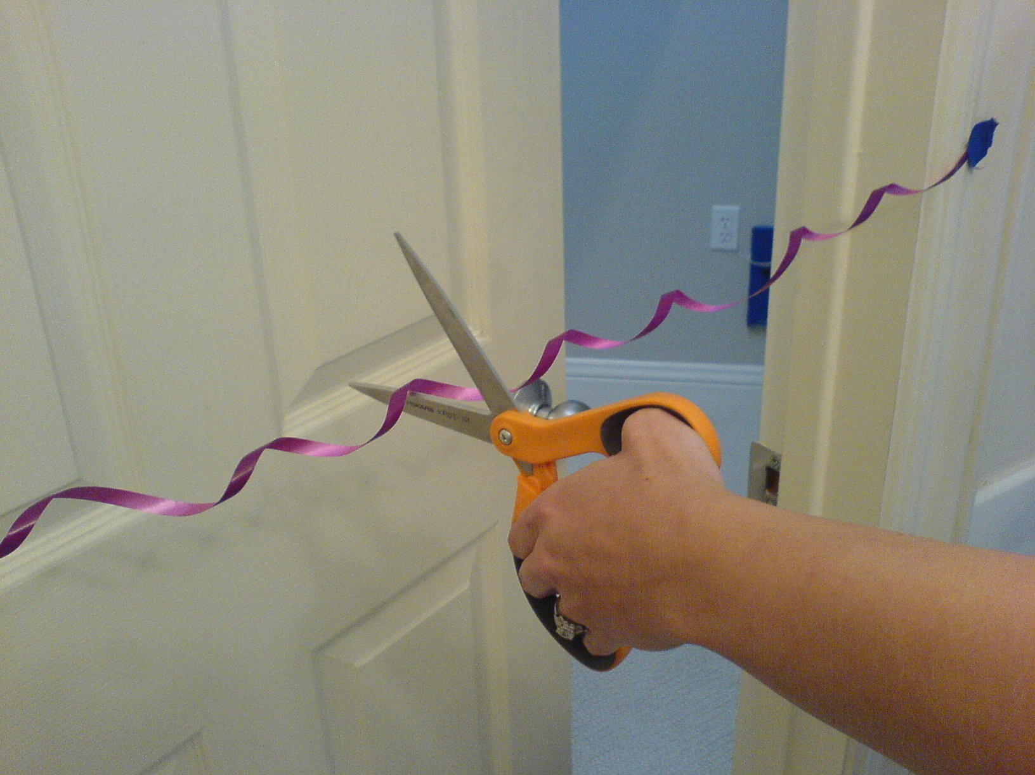
Curtail
by bschmove

Slide 6
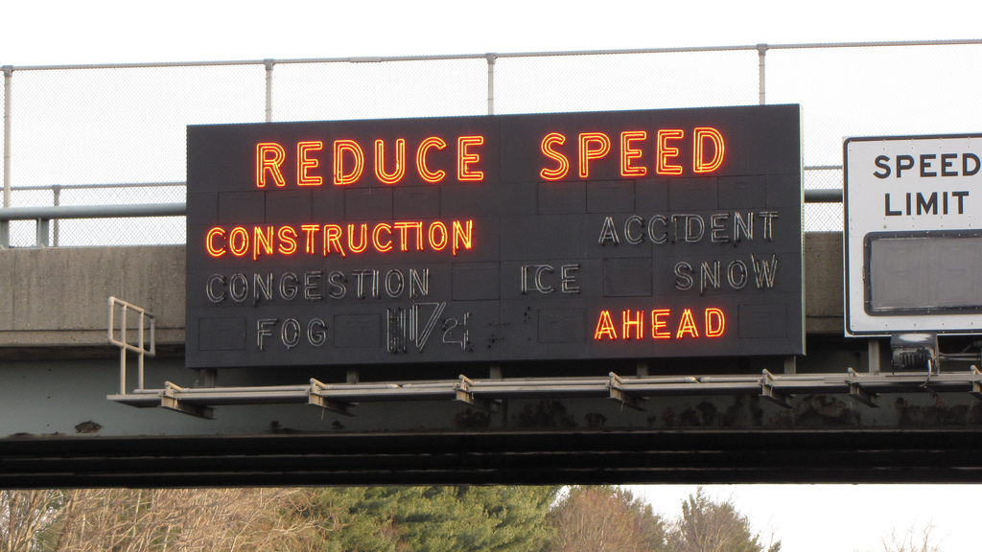
Curtail
by SchuminWeb

Slide 7
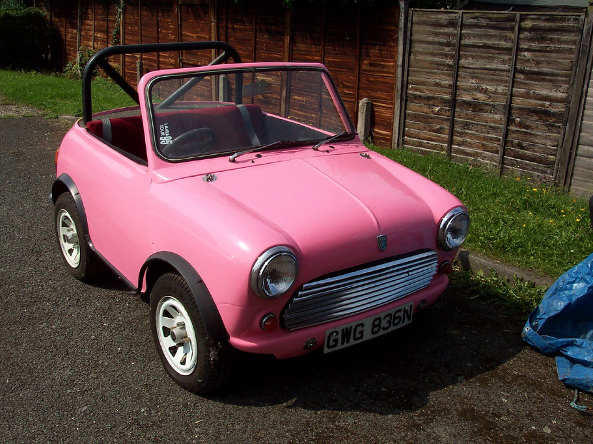
Curtail
by philcampbell

Slide 8
Curtail – (v) [ker-teyl] shorten; reduce
by Karmadude

Slide 9
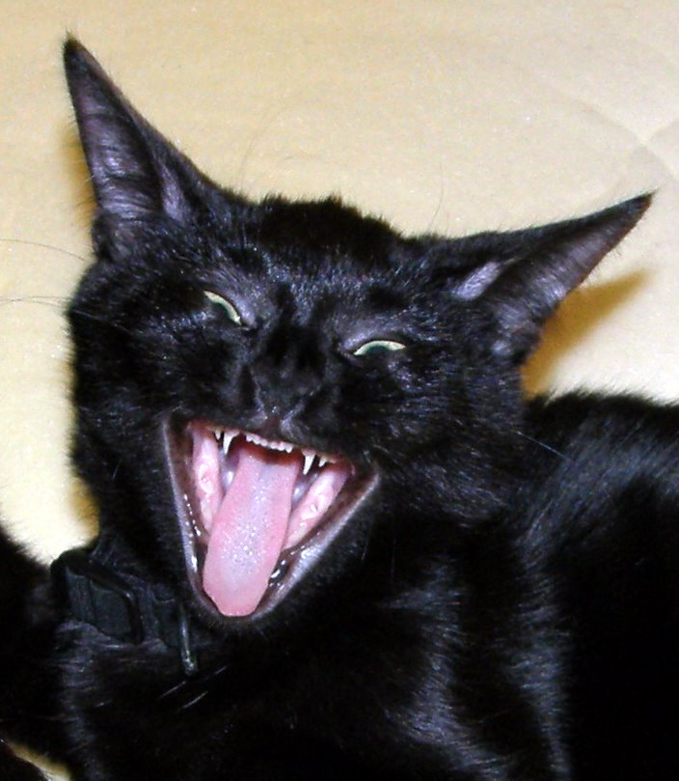
Nefarious
by Dan4th

Slide 10
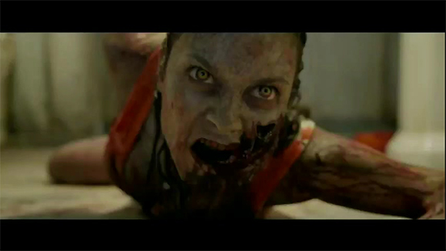
Nefarious
by FilmsInBound

Slide 11
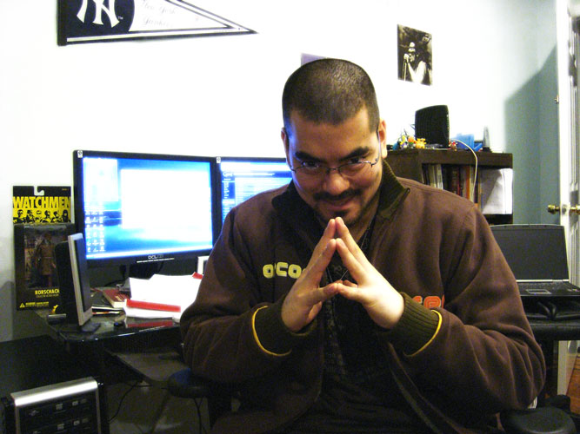
Nefarious
by jaykimdotnet

Slide 12
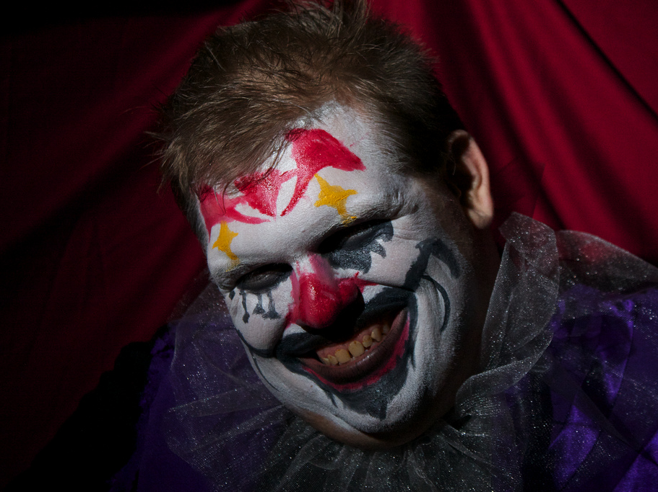
Nefarious – (adj) [ni-fair-ee-uh] evil, utterly immoral or wicked
by AvidlyAbide
by Vic
by Silver Tusk

Slide 13
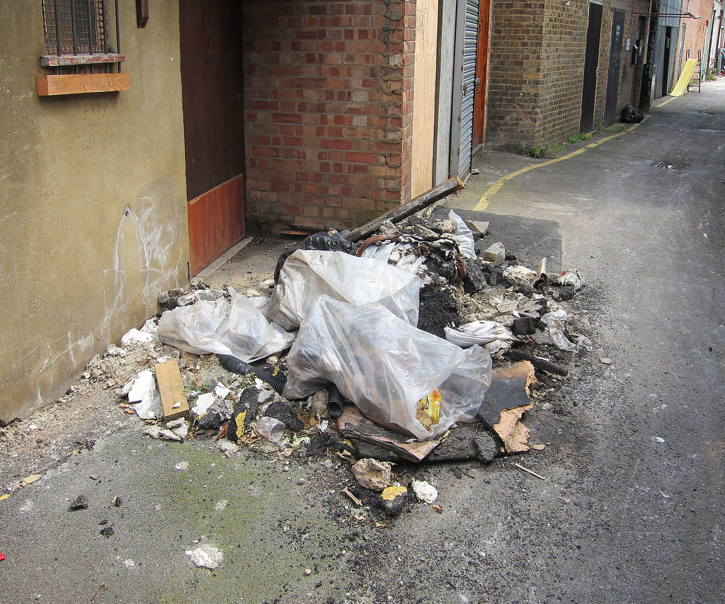
Prodigal
by Alan Stanton

Slide 14
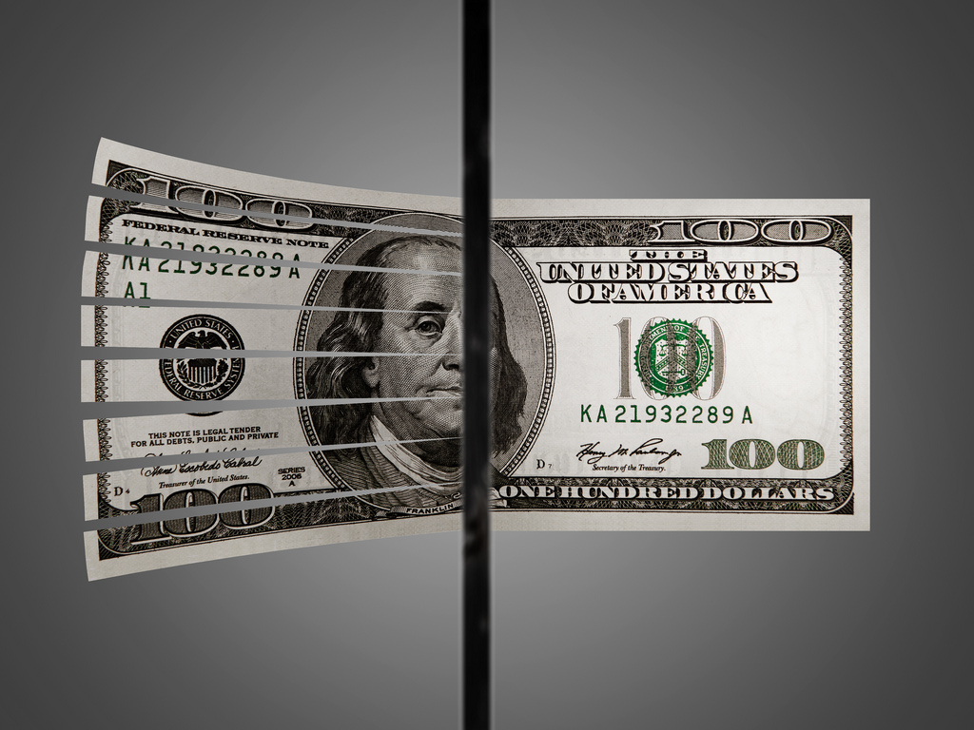
Prodigal
by Tax Credits

Slide 15
Prodigal
by epSos.de

Slide 16
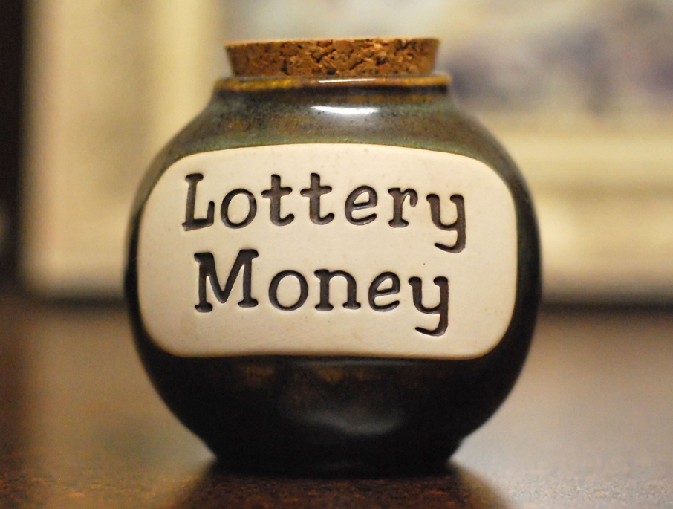
Prodigal - (adj) l[prod-i-guh] wasteful;
reckless with money
by Lisa Brewster

