Slide 1
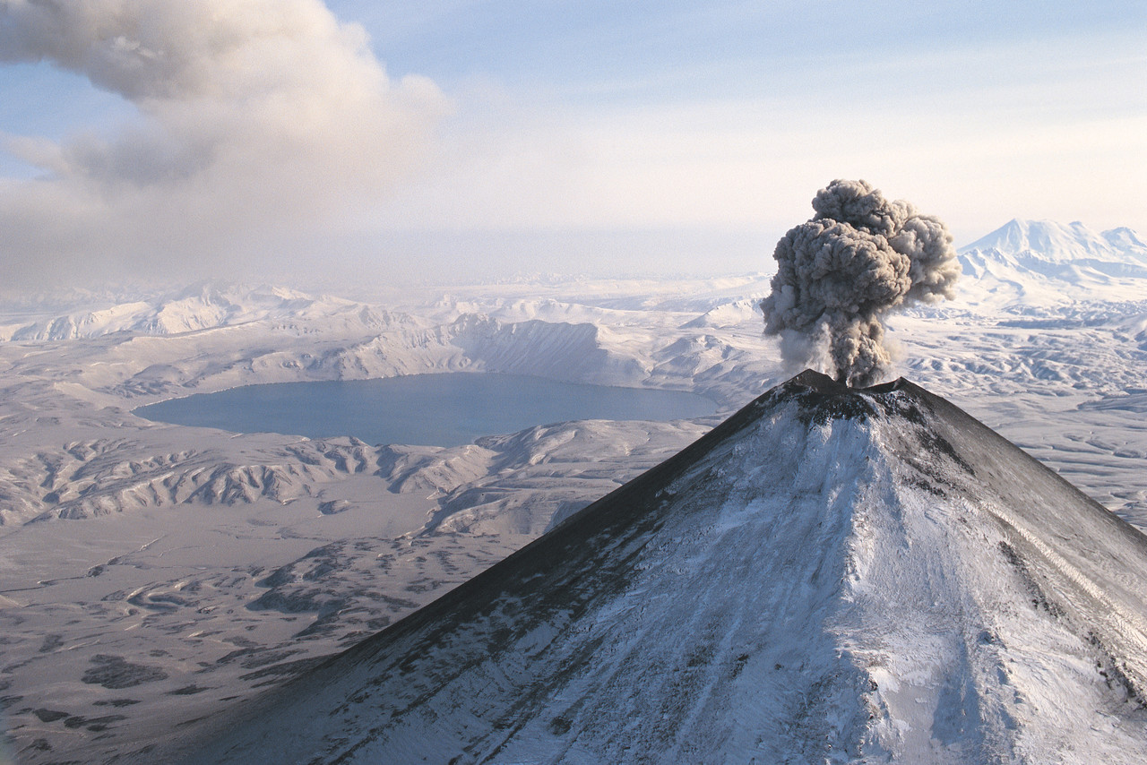
Altitude

Slide 2
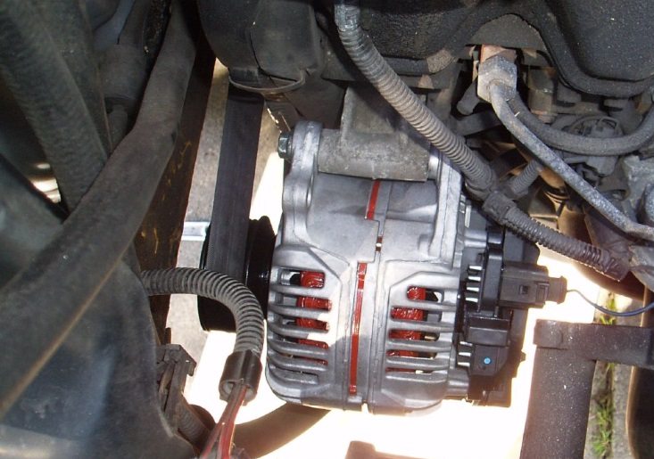
Alternator
by SandMonster

Slide 3
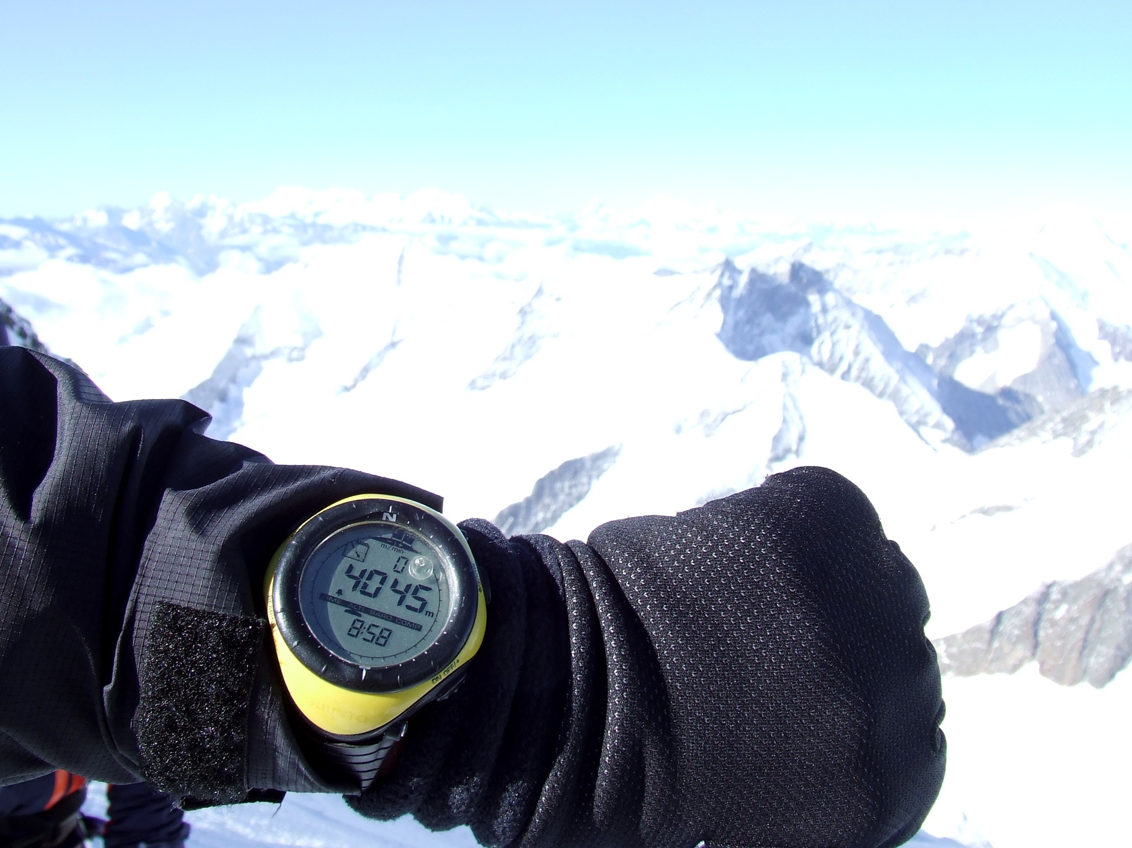
Altimeter
by Jo Simon

Slide 4
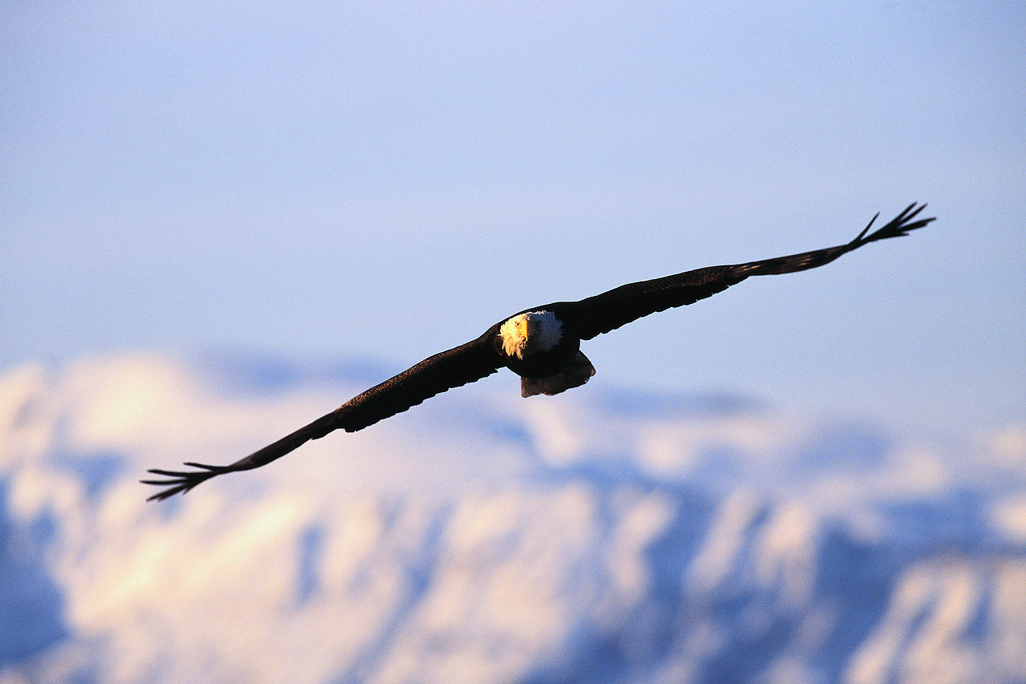
Alt- = high or deep

Slide 5
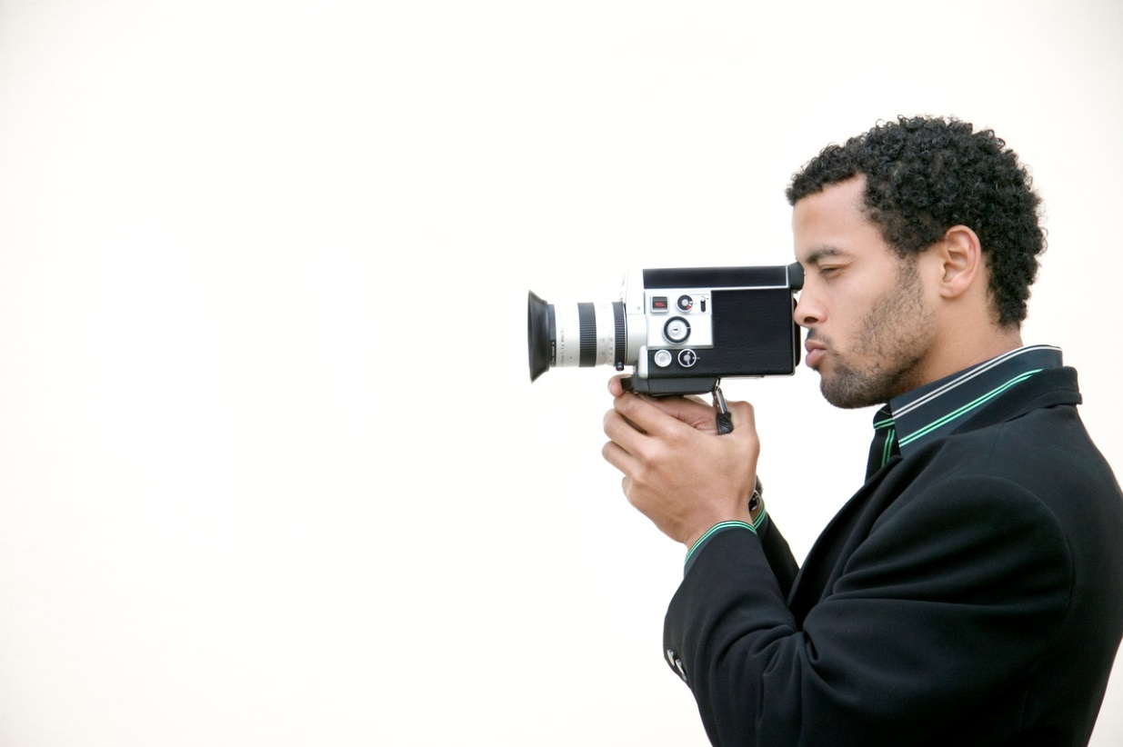
Picture

Slide 6
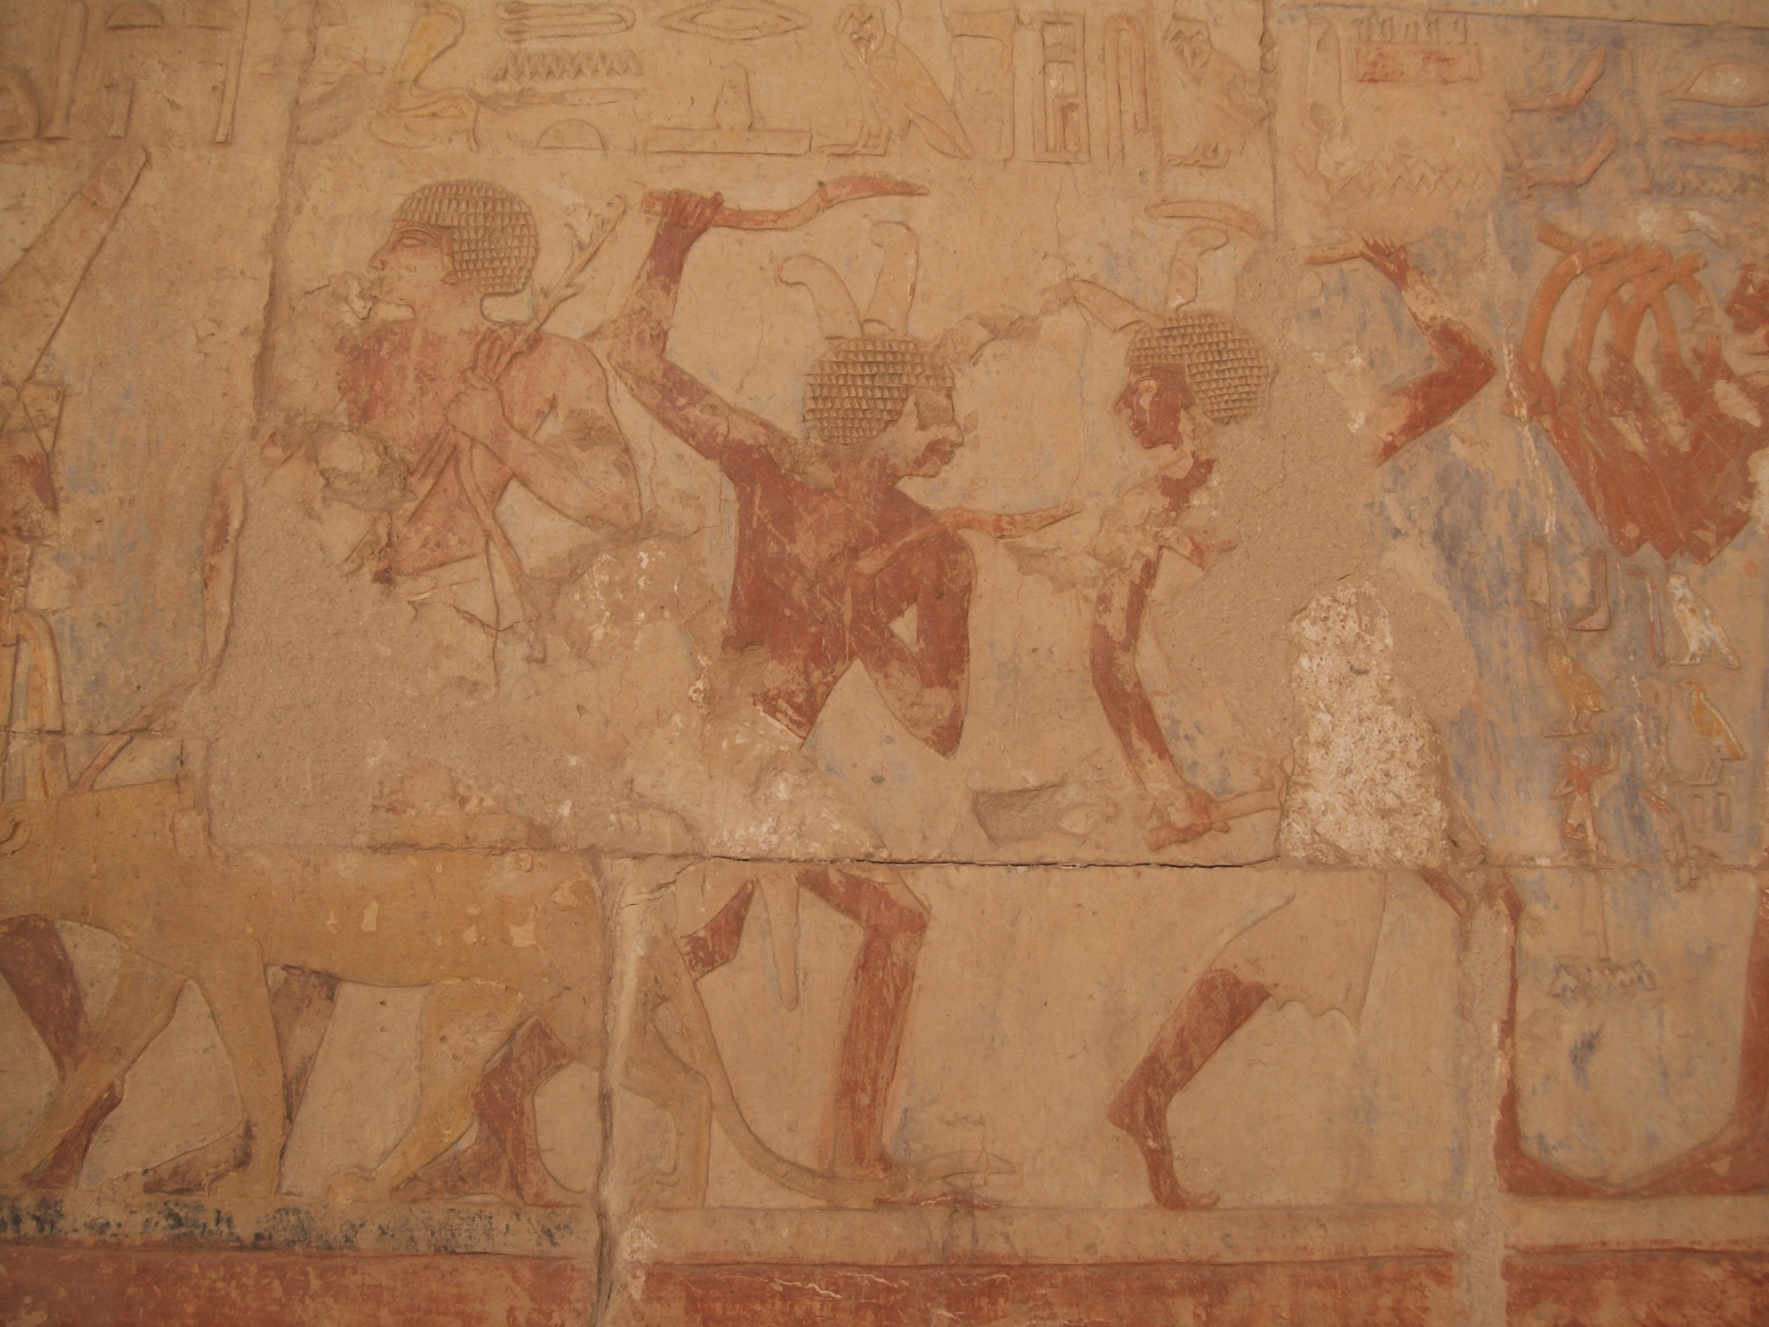
Depict
by isawnyu

Slide 7
Pictogram
by colindunn

Slide 8
Pict- = paint, show, draw.

Slide 9
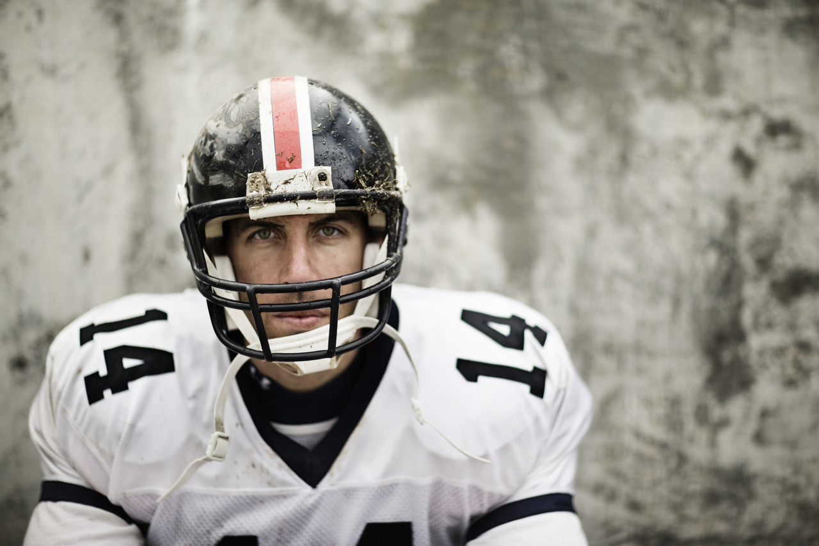
Protect

Slide 10
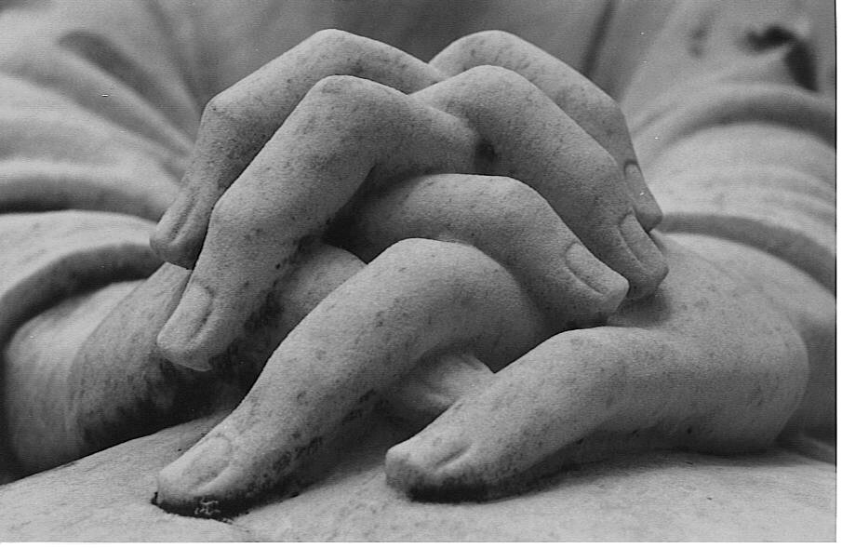
Integrate
by king of the wild frontier

Slide 11
Detector
by idleformat

Slide 12
tect, teg = cover

Slide 13
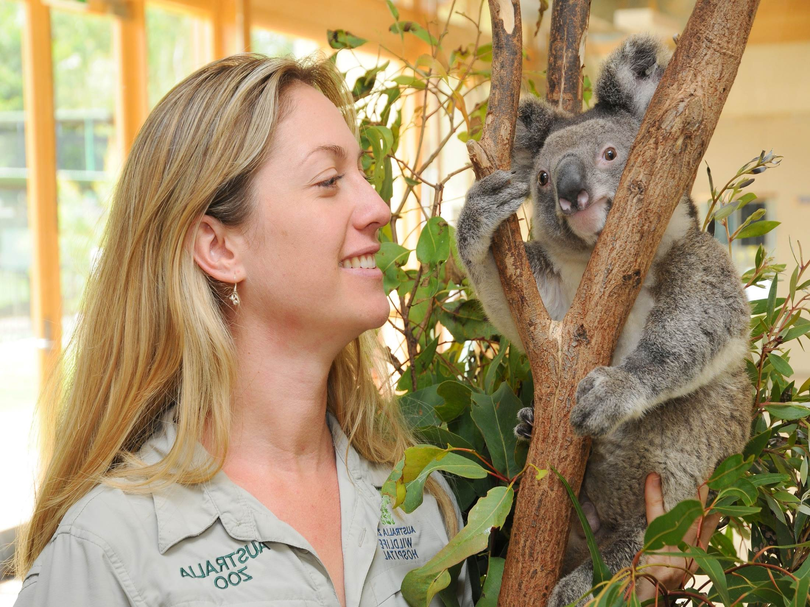
Zoologist
by lwpkommunikacio

Slide 14
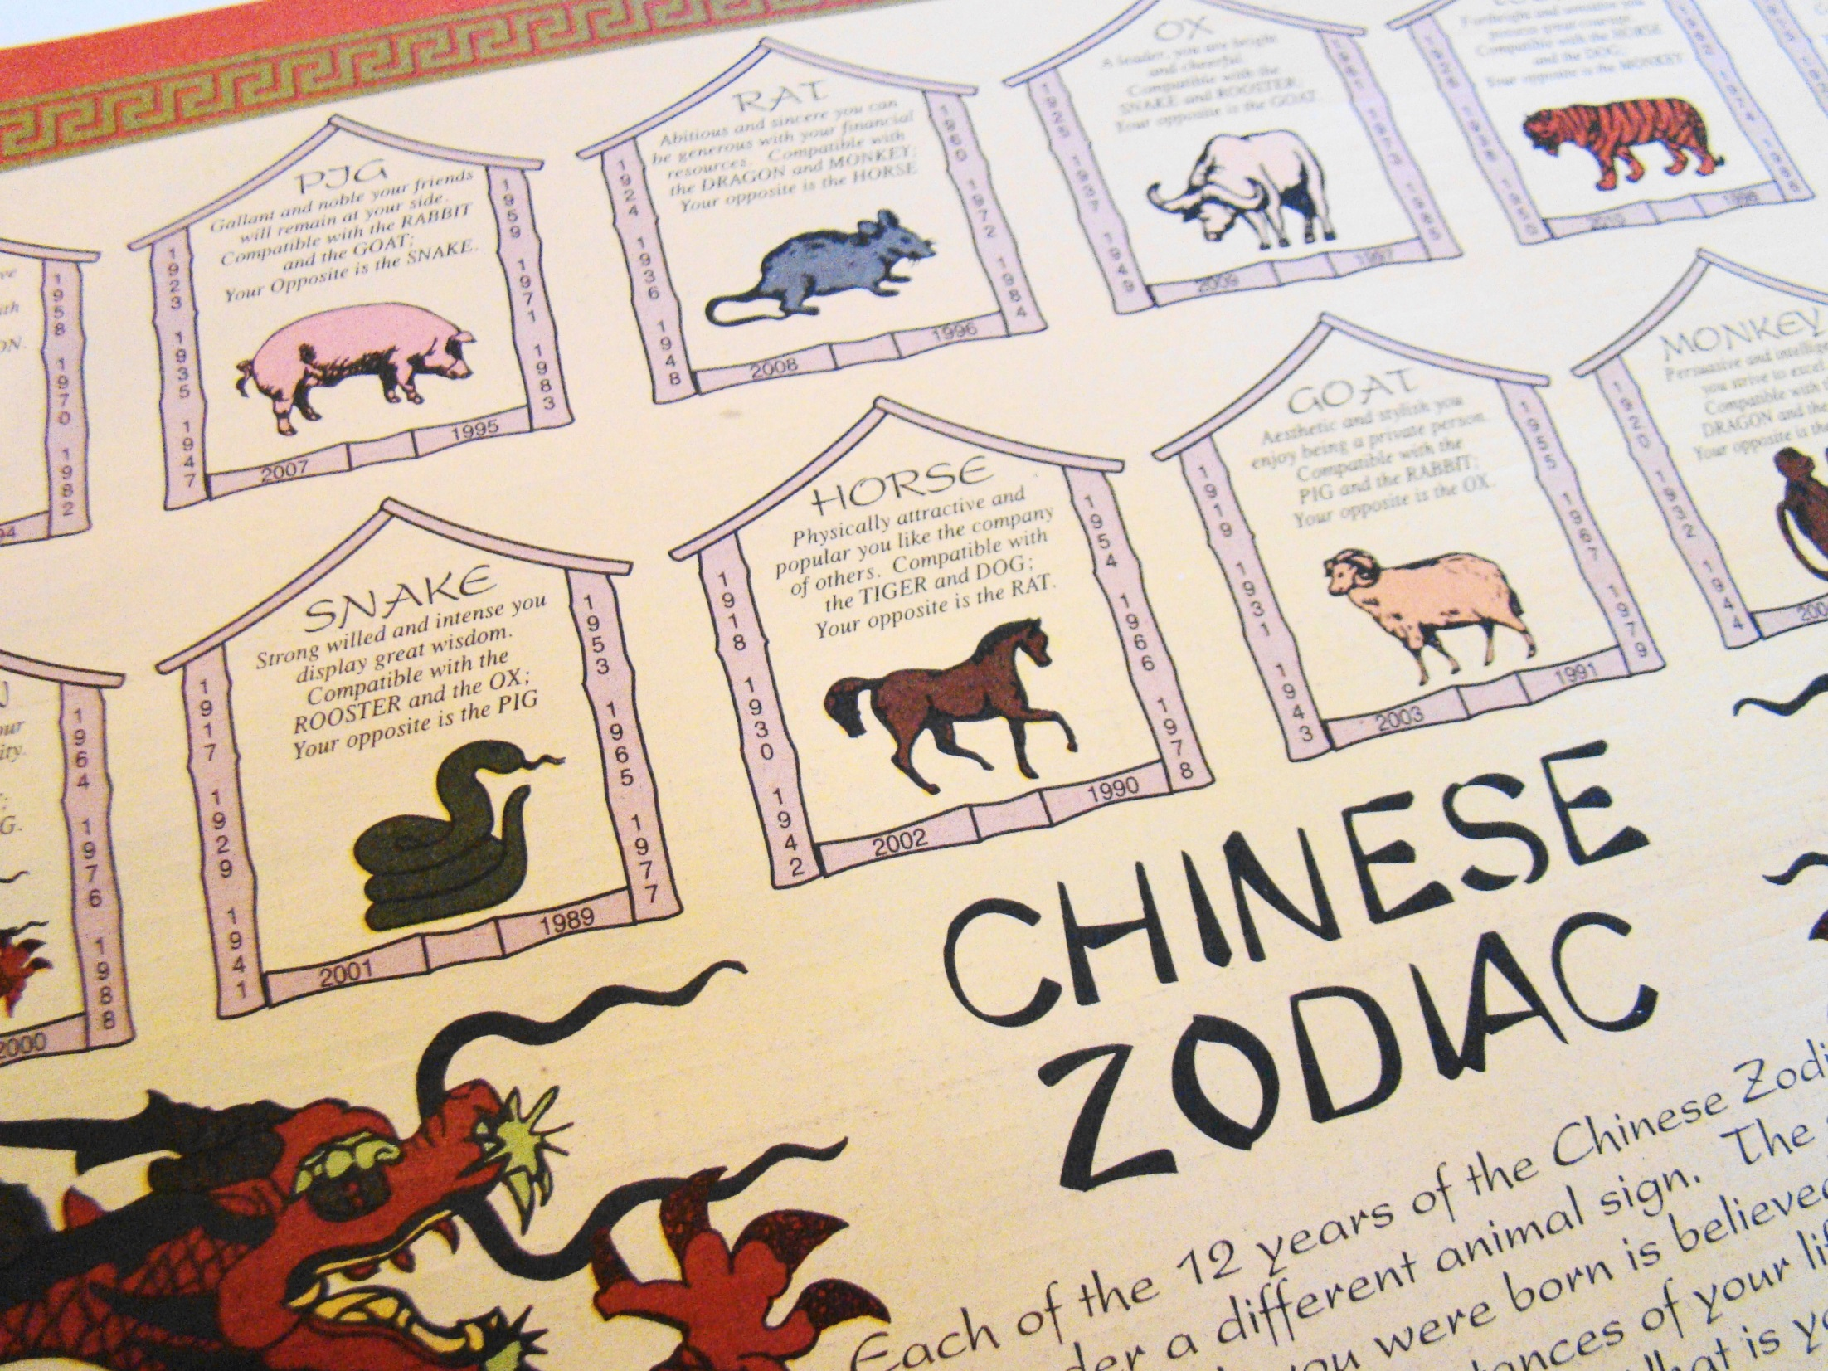
Zodiac
by Vegan Feast Catering.

Slide 15
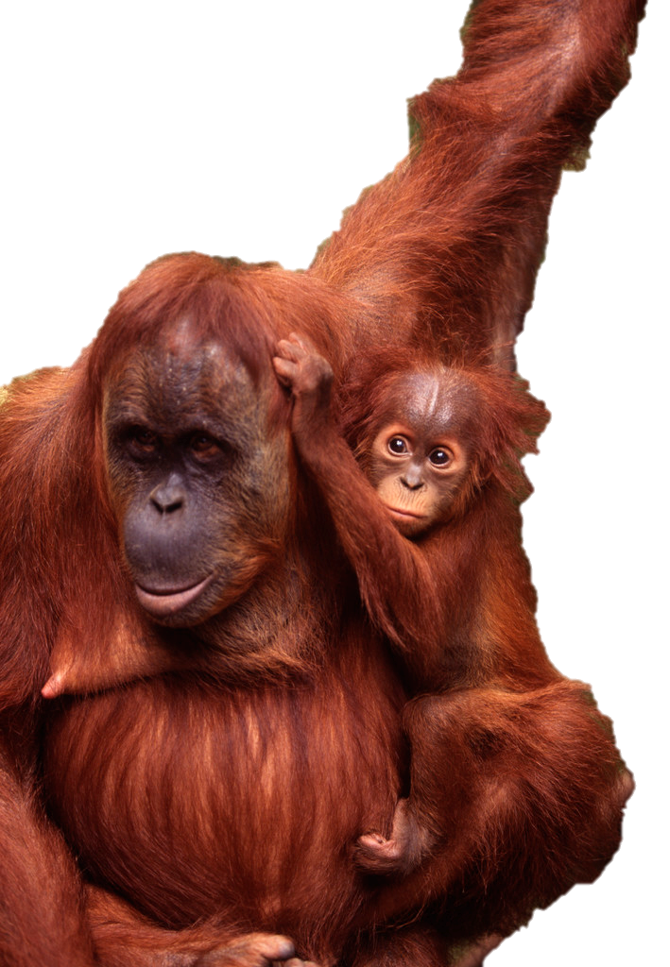
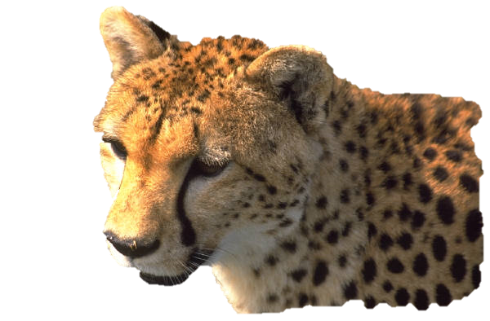
Zoo

Slide 16
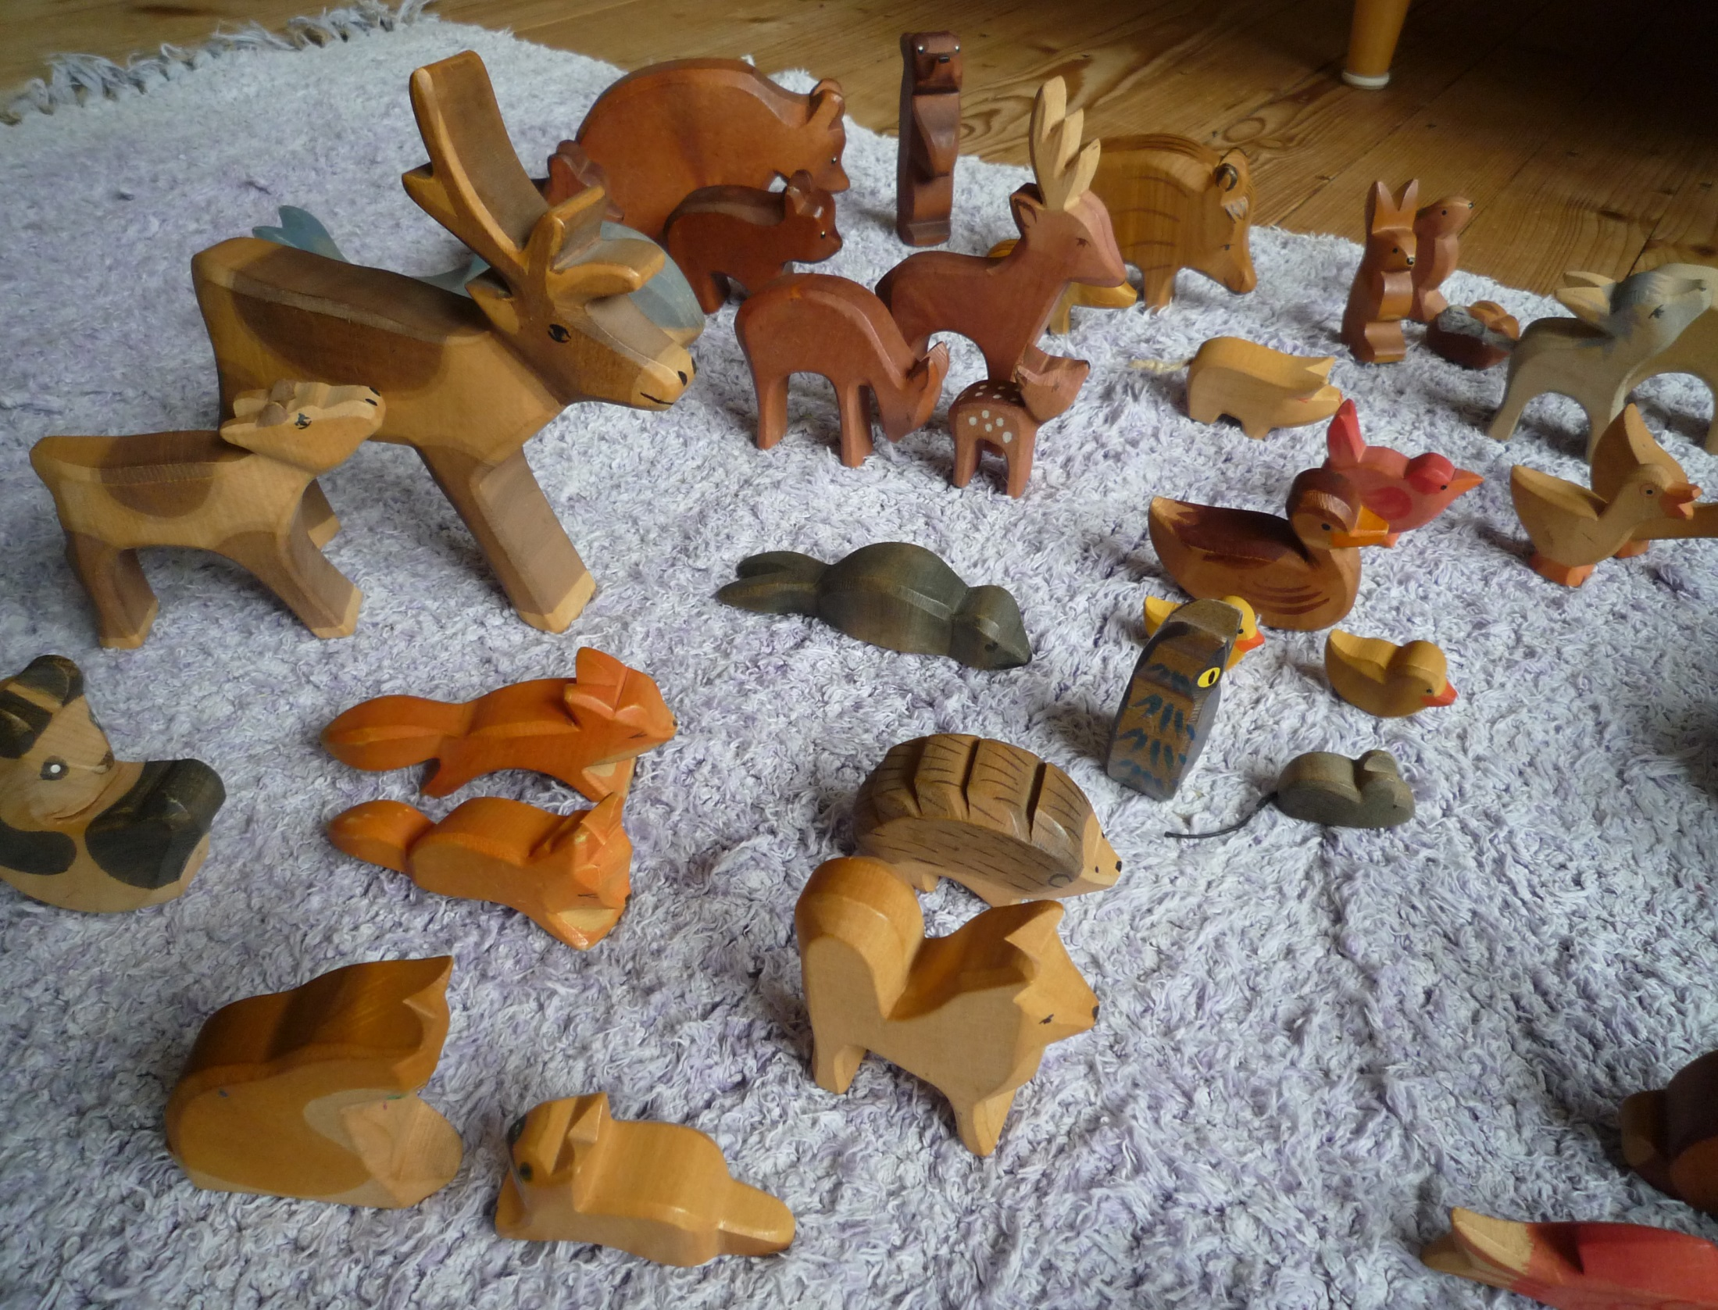
Zo- = animal
by storebukkebruse
by Vic

