Slide 1
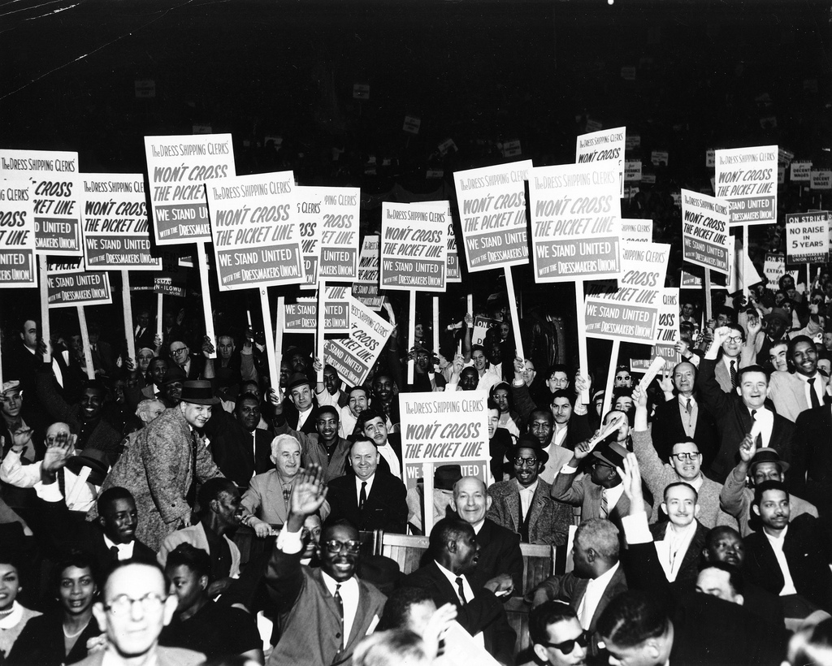


Advocate
by Kheel Center, Cornell University

Slide 2
Advocate

Slide 4
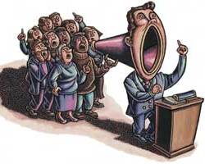
Advocate
  Advocate – (v) / [ad-vuh-keyt] urge; plead for.
by Oldmaison

Slide 5

Lethargic
by wwarby

Slide 6

Lethargic

Slide 7

Lethargic

Slide 8

  Lethargic – (adj) / [luh-thahr-jik] drowsy; dull

Slide 9
Scrutinize

Slide 10

Scrutinize

Slide 11
Scrutinize

Slide 12

  Scrutinize – (v) / [skroot-n-ahyz] examine closely and critically.

Slide 13
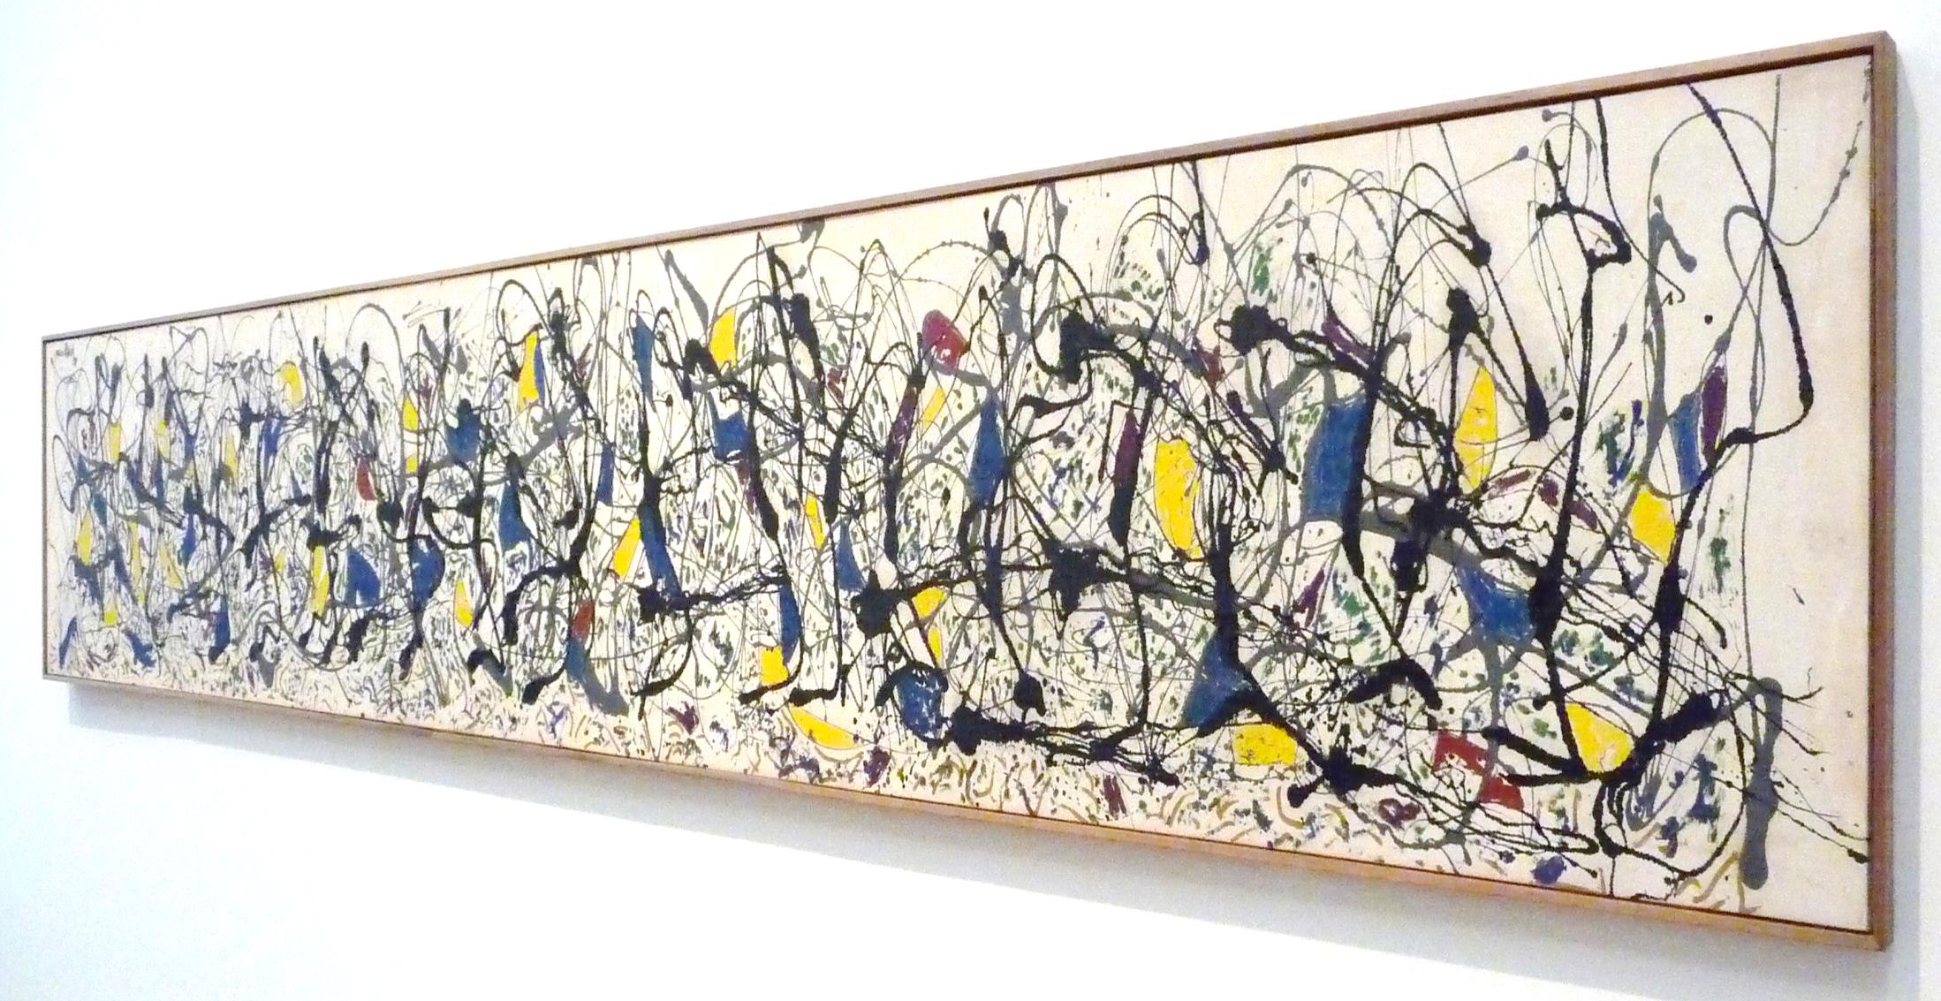
Sporadic
by simononly

Slide 14
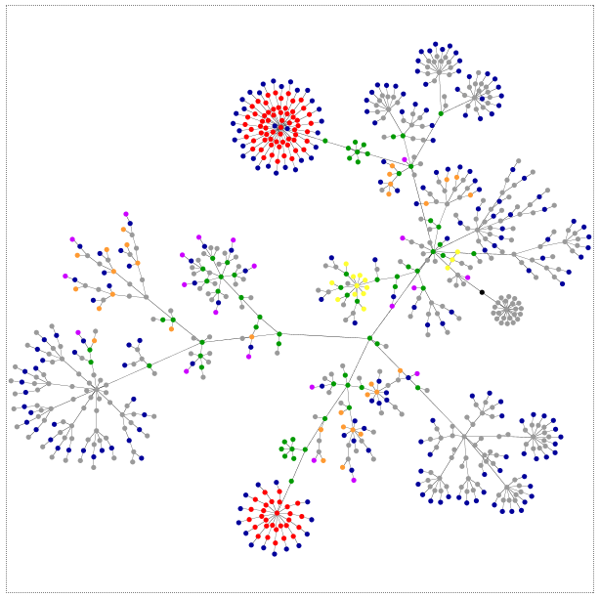
Sporadic
by Noah Sussman

Slide 15

Sporadic
by cdsessums

Slide 16

  Sporadic – (adj) / [spuh-rad-ik] occurring irregularly.
by danbuck57313

