Slide 1



Enigma
by joncandy

Slide 2

Enigma

Slide 3

Enigma
by CollegeDegrees360

Slide 4

  Enigma – (n) / [uh-nig-muh] puzzle; mystery.

Slide 5

Lament
by Andrew Choy

Slide 6
Lament

Slide 7
Lament

Slide 8

  Lament – (v) [luh-ment] grieve; express sorrow.

Slide 9
Ominous

Slide 10
Ominous

Slide 11

Ominous
by mtarlock

Slide 12

  Ominous – (adj) / [om-uh-nuhs] threatening.

Slide 13
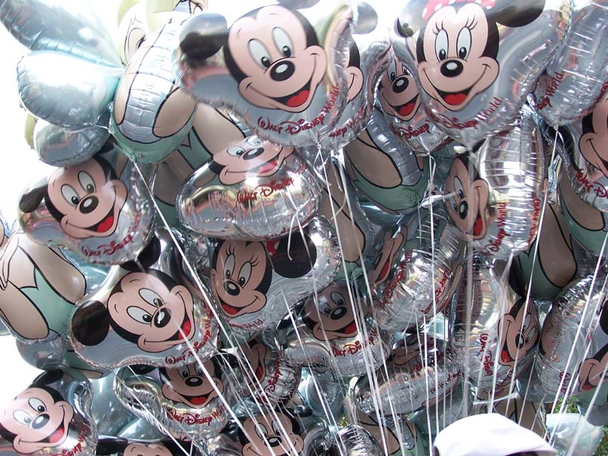

Superfluous
by Ken Kindoku 菌毒
by Vic

Slide 14

Superfluous

Slide 15

Superfluous

Slide 16

  Superfluous – (adj) [soo-pur-floo-uhs] unnecessary; excessive; overabundant.
by carlbob

