Slide 1
Concur

Slide 2
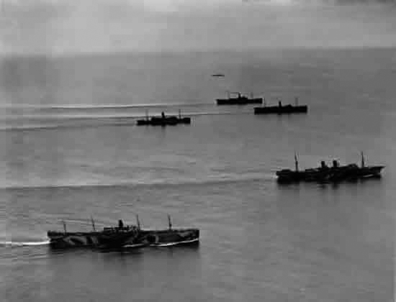

Convoy
by Marion Doss

Slide 3

Conference

Slide 4

  Con = with, jointly.

Slide 5
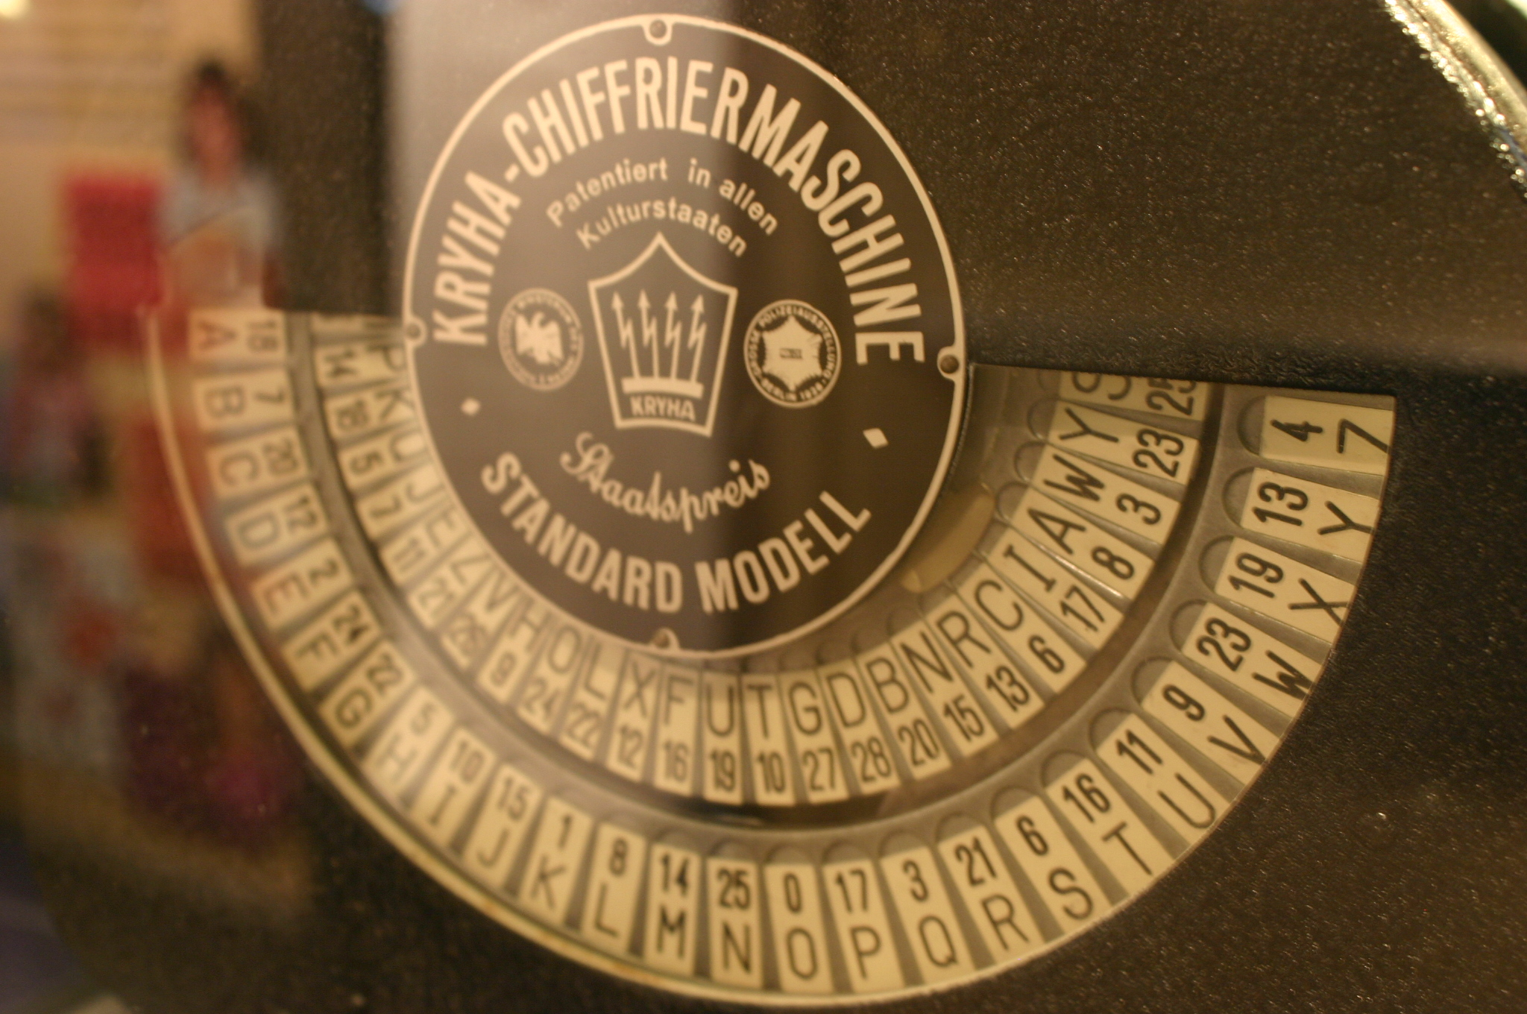
Cryptography
by Ryan Somma

Slide 6
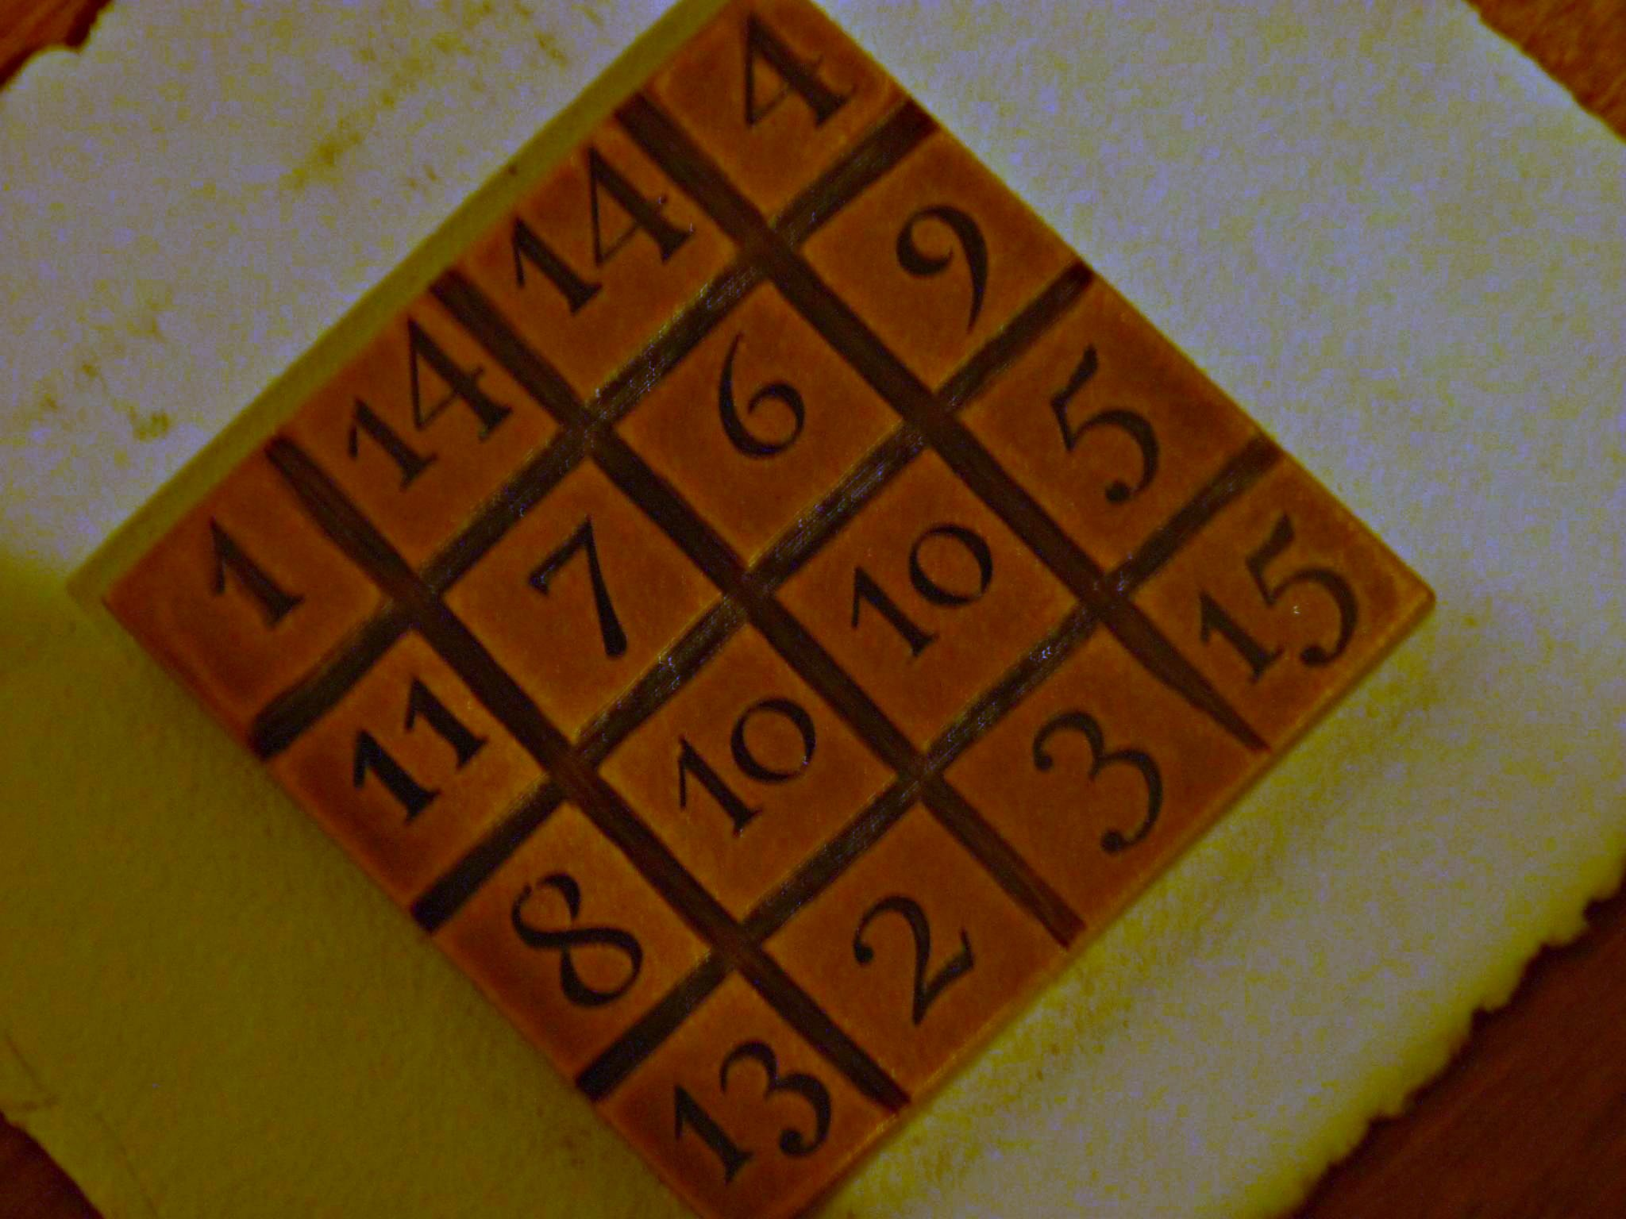
Cryptogram
by austinevan

Slide 7
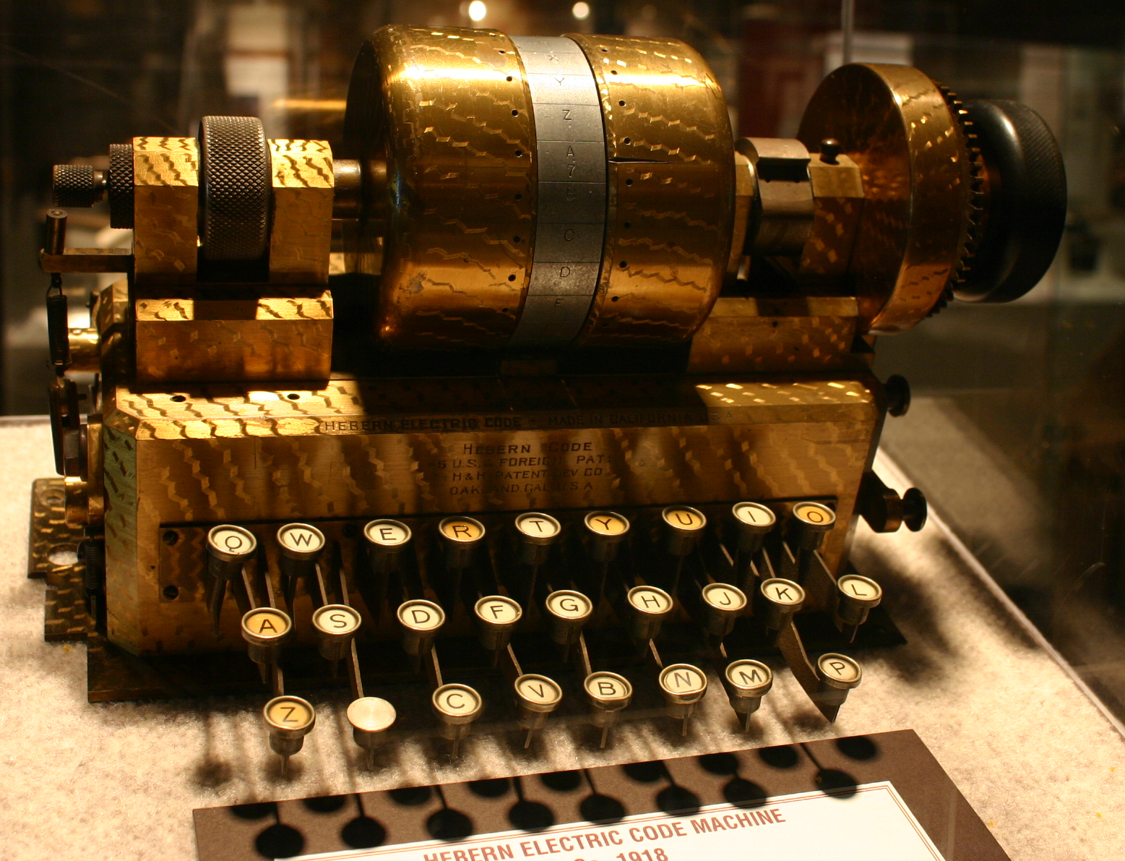
Cryptologic
by Ryan Somma

Slide 8
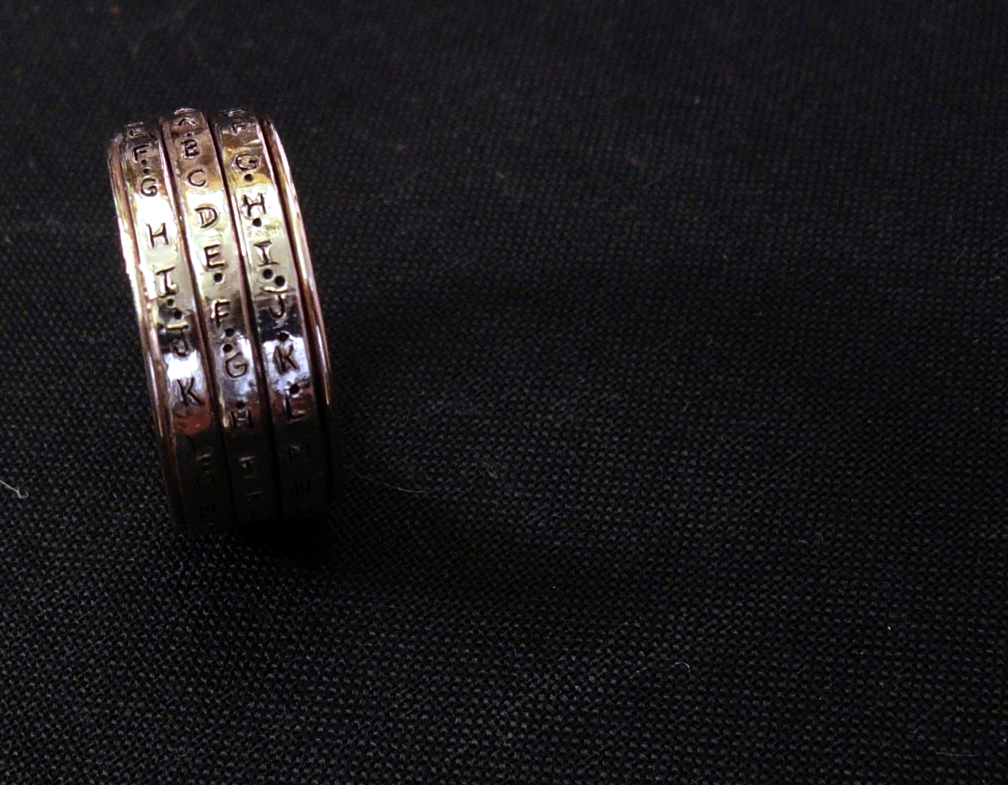
  Crypto = hidden, secret.
by gruntzooki

Slide 9
Empathy

Slide 10
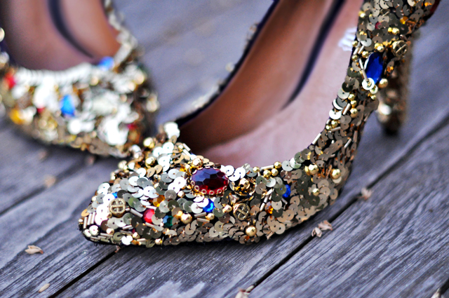
Embellish
by ...love Maegan

Slide 11
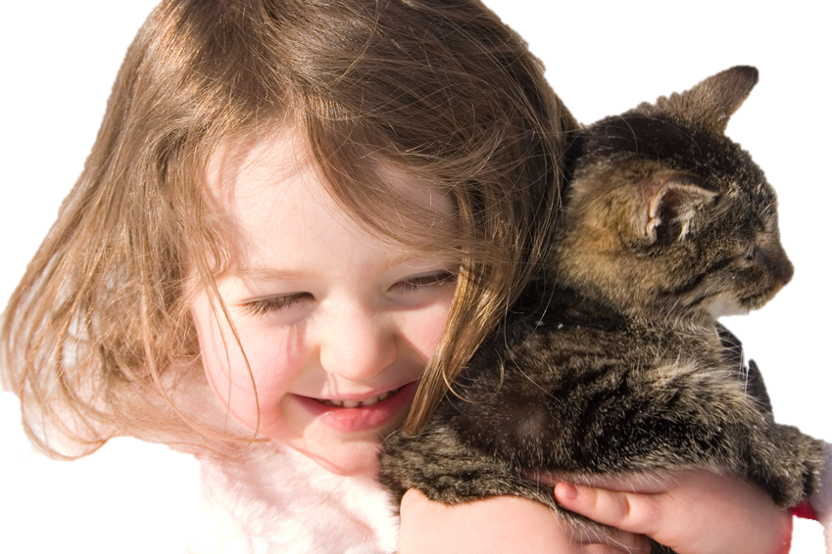
Embrace

Slide 12
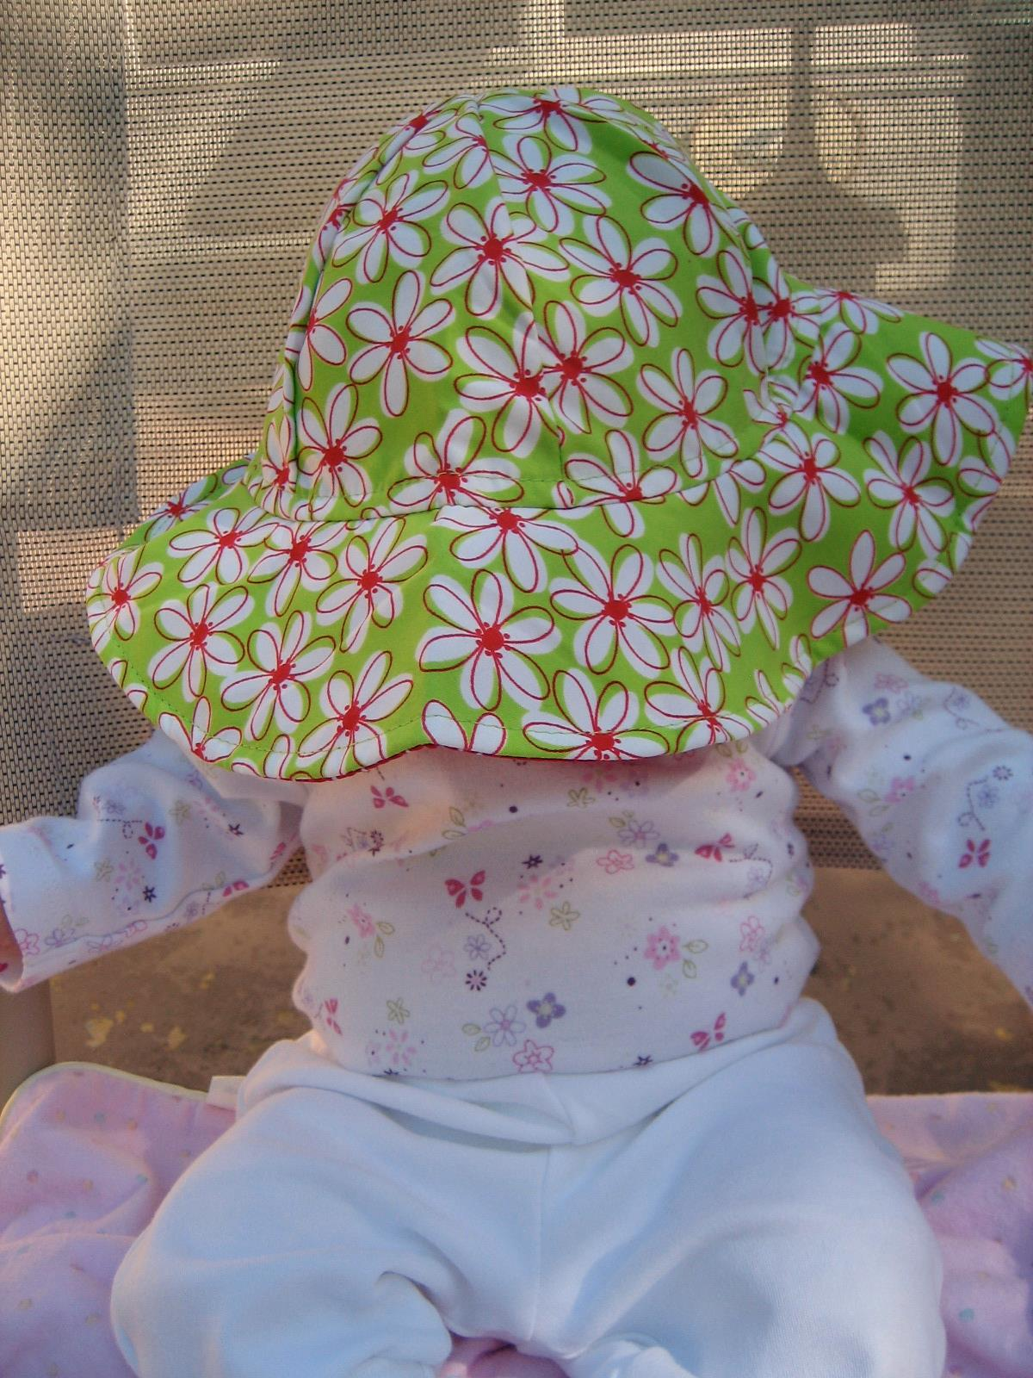

  Em = into, cover with, cause
by boulter

Slide 13
Obscure

Slide 14
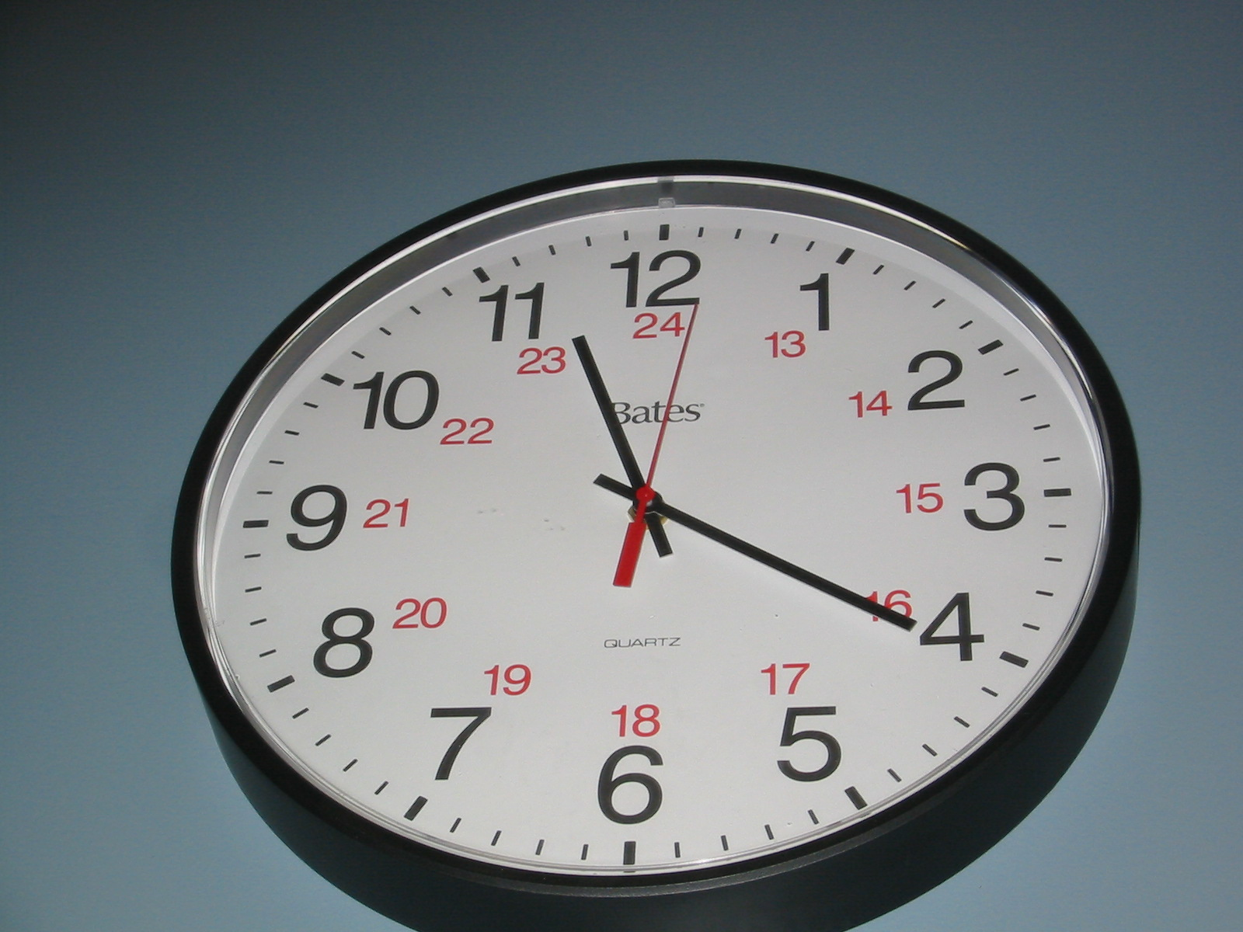
Obtuse
by huzzah16

Slide 15
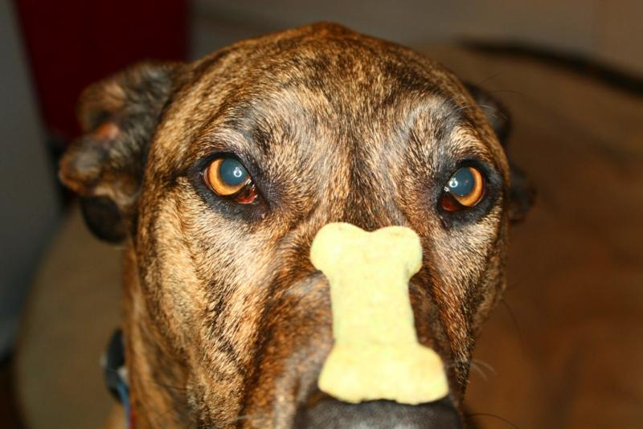
Obedient
by trazomfreak

Slide 16


Ob = in the way, against
by hang in there

