Slide 1
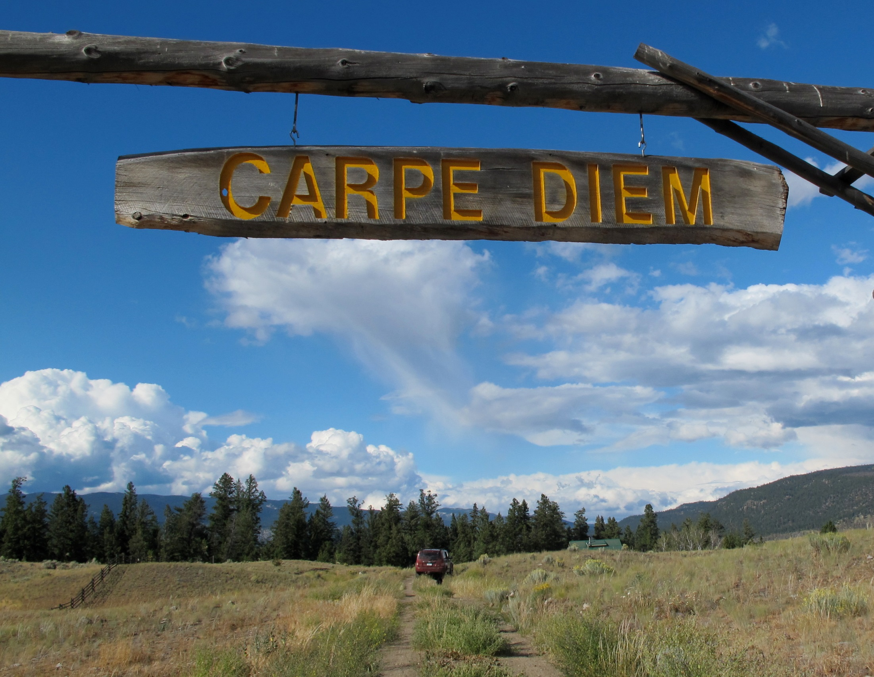
Usurp
by m.gifford

Slide 2
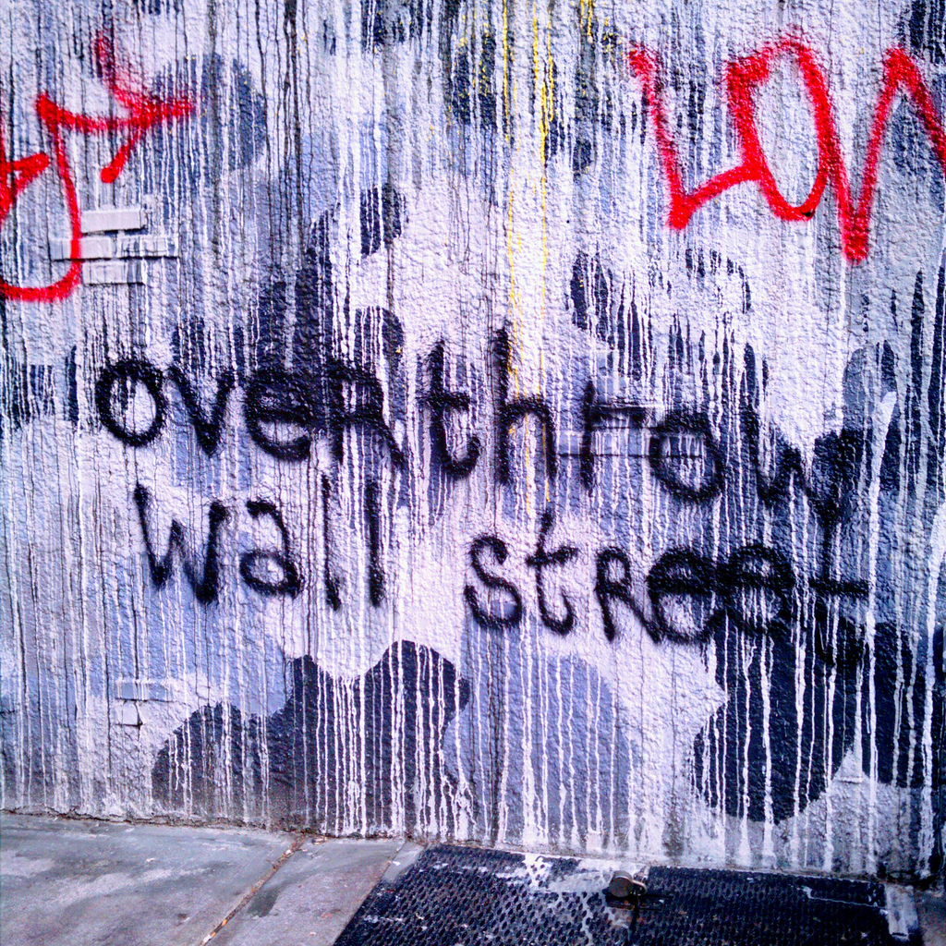
Usurp
by WarmSleepy

Slide 3
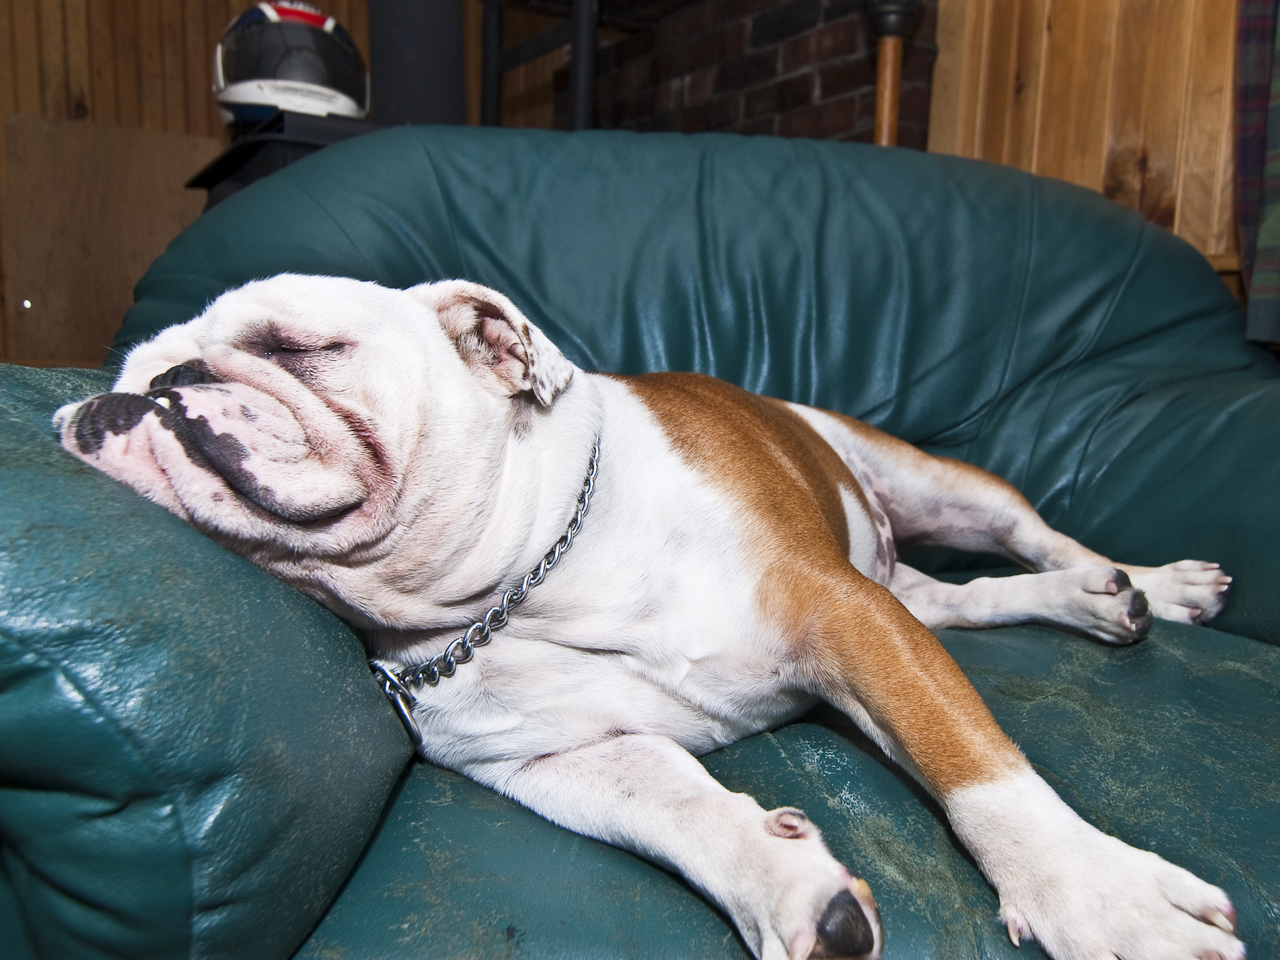
Usurp
by pennuja

Slide 4
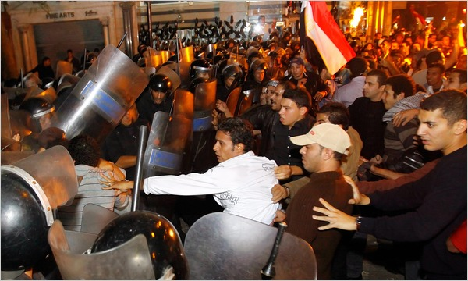
Usurp - (v) [yoo-surp] seize another’s
power or rank
by Globaltechfirm

Slide 5
Rancor

Slide 6
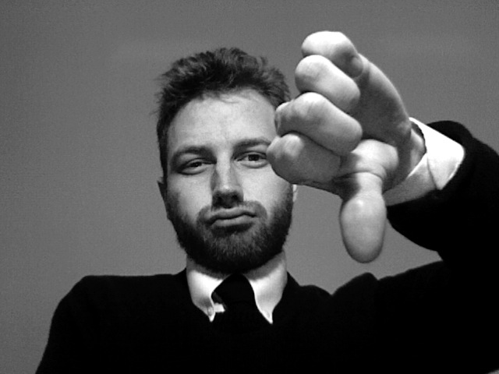
Rancor
by striatic

Slide 7
Rancor

Slide 8
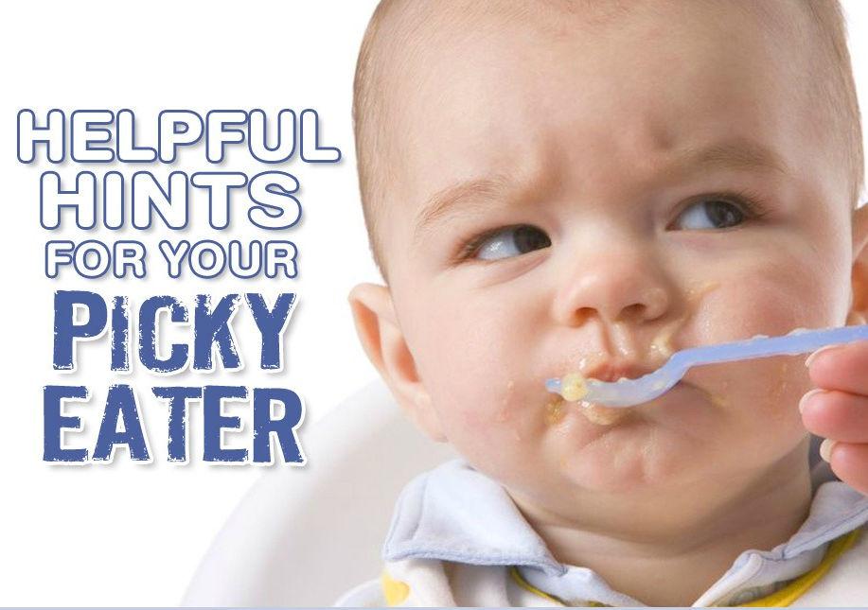
Rancor – (n) [rang-ker] bitterness; hatred
by cheeseslave

Slide 9
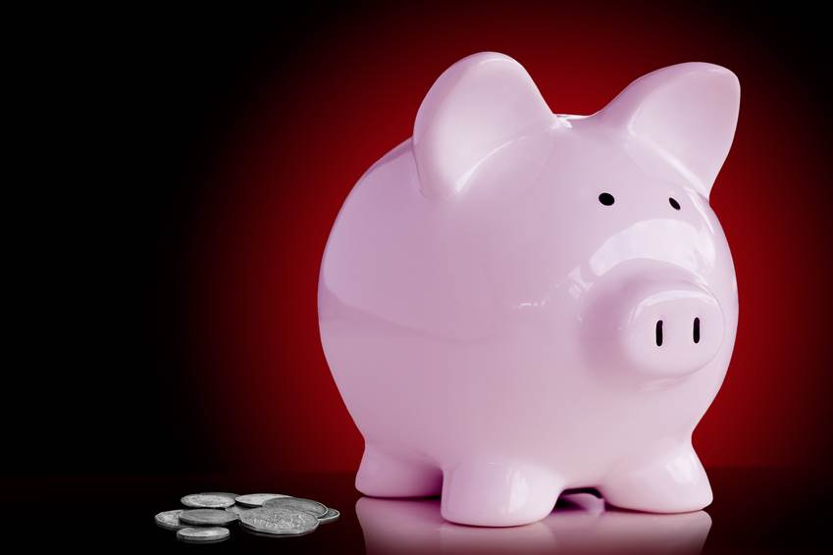
Parsimony

Slide 10
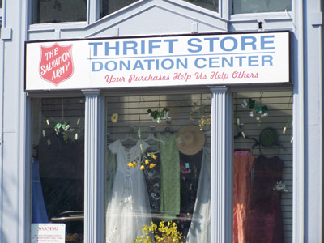
Parsimony
by adiything
by Vic

Slide 11
Parsimony

Slide 12
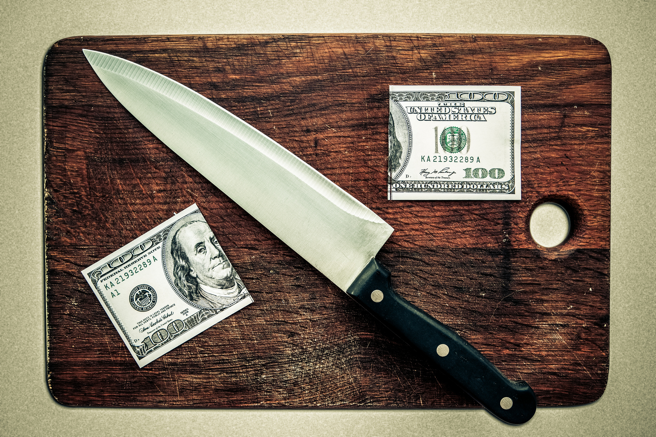
Parsimony – (n) [pahr-suh-moh-nee] stinginess; excessive frugality
by Tax Credits

Slide 13
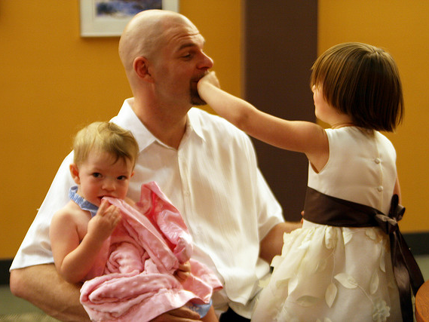
Garrulous
by quinn.anya
by Vic

Slide 14
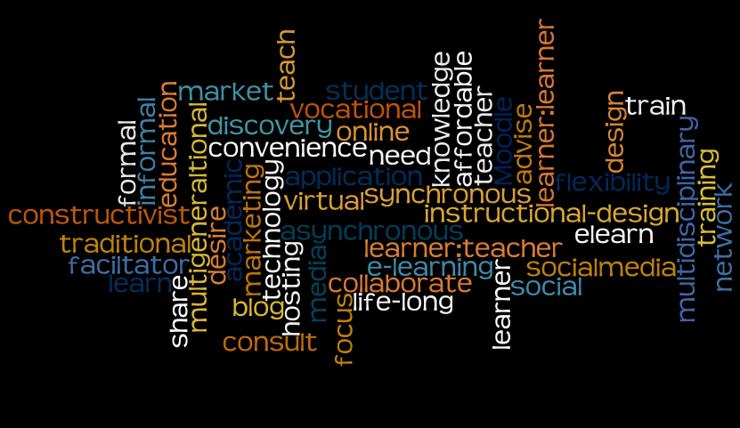
Garrulous
by couchlearner

Slide 15
Garrulous
by Claudio Gennari ..."Cogli l'attimo ferma il tempo"

Slide 16
Garrulous - (adj) s[gar-uh-luh] loquacious; wordy; talkative

