Slide 1
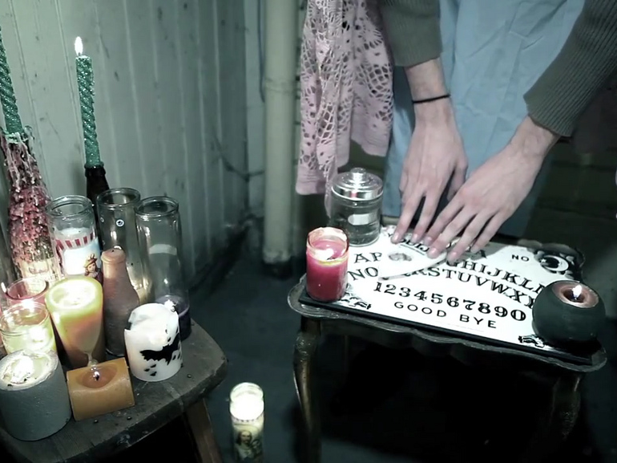
Heresy
by chantel beam photography

Slide 2
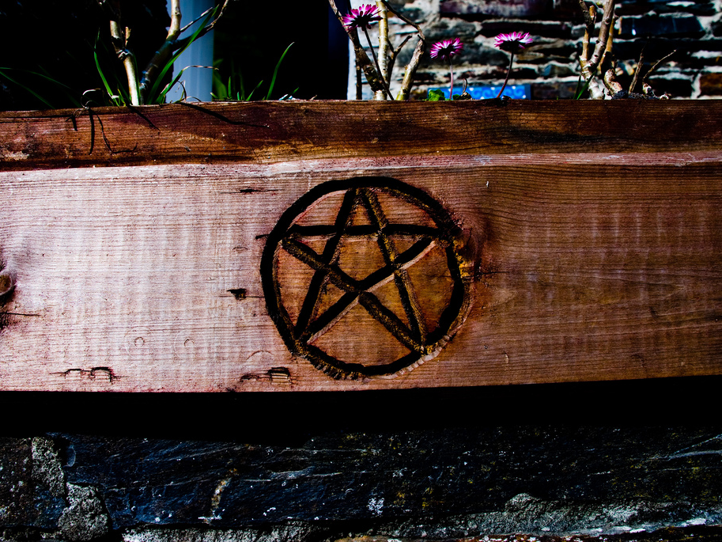
Heresy
by Conor Lawless

Slide 3
Heresy
by quinn.anya

Slide 4
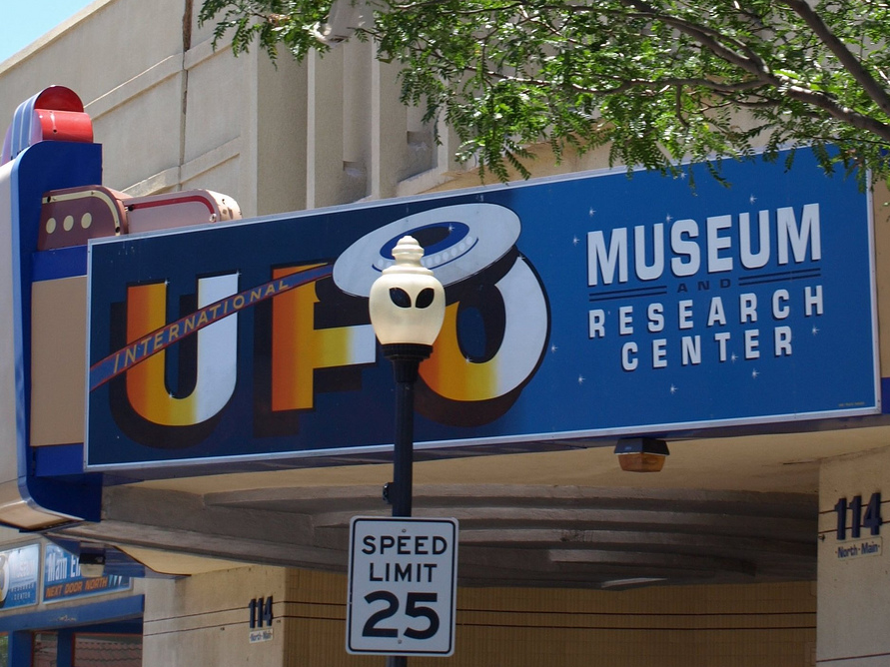
Heresy - (n) [her-uh-see] opinion contrary
to popular belief; opinion contrary to
accepted religion
by Beatnik Photos

Slide 5
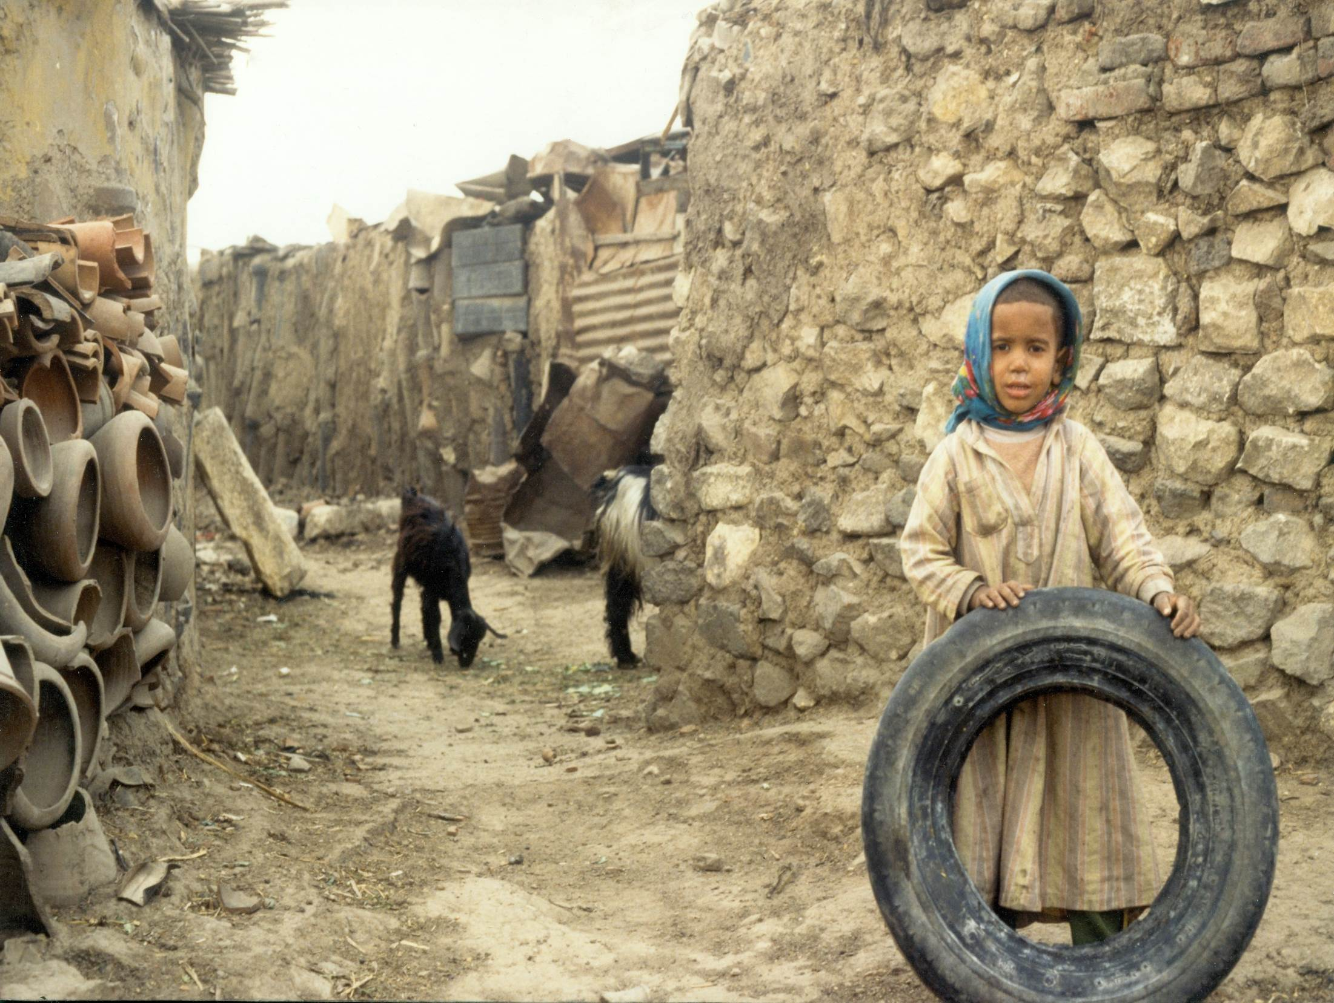
Penury
by Adam Jones, Ph.D. - Global Photo Archive

Slide 6
Penury
by Pepa Barril

Slide 7
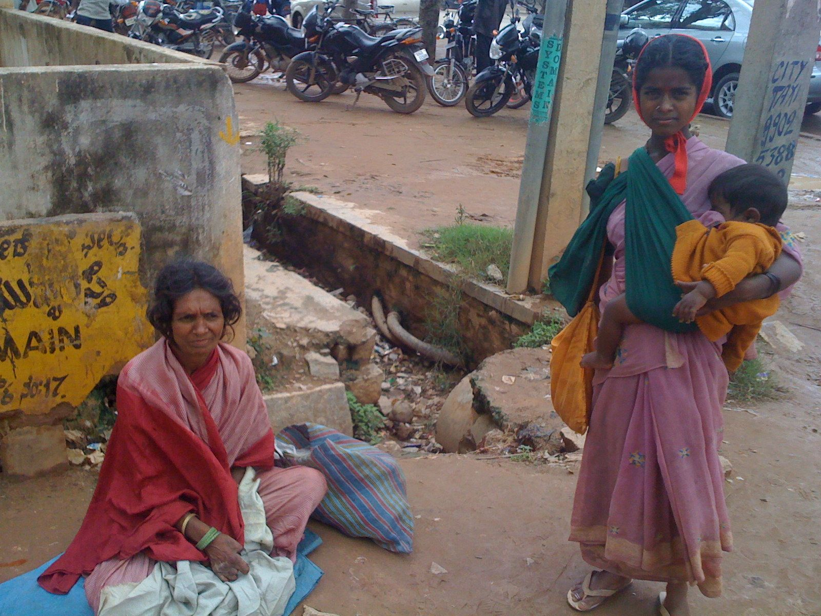
Penury
by bandarji
by Vic

Slide 8
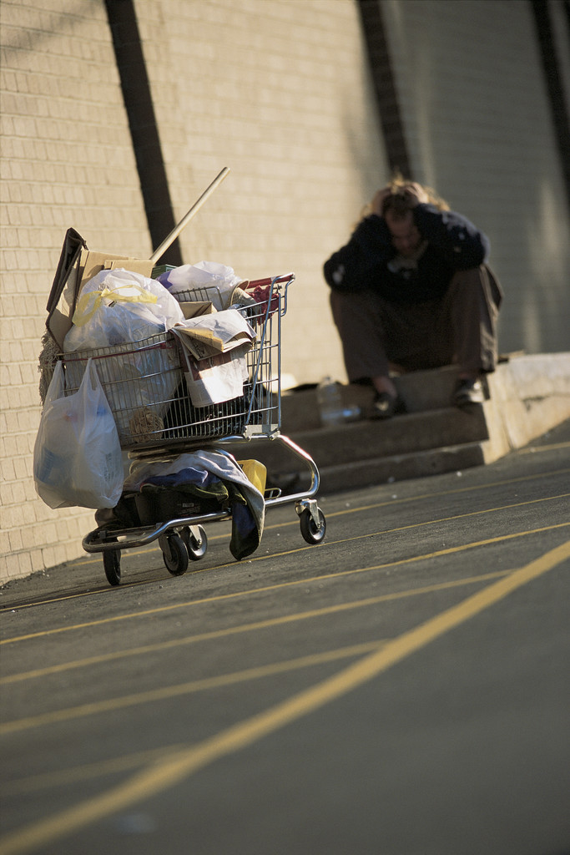
Penury – (noun)
[pen-yuh-ree] severe
poverty; stinginess

Slide 9
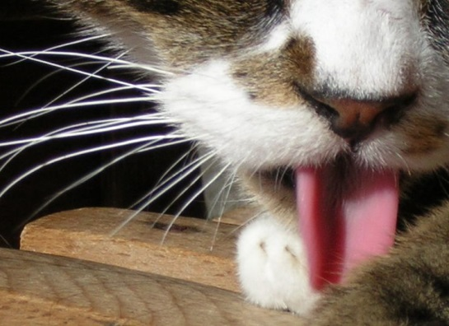
Scrupulous
by zenera
by Vic

Slide 10
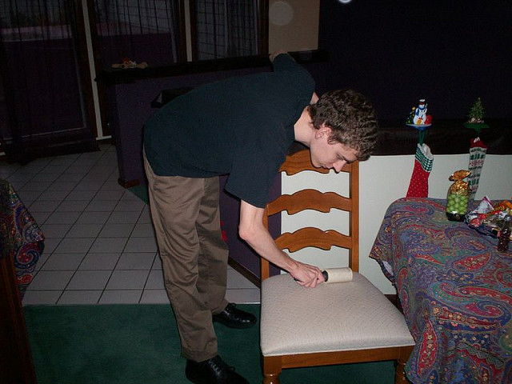
Scrupulous
by tps 12

Slide 11
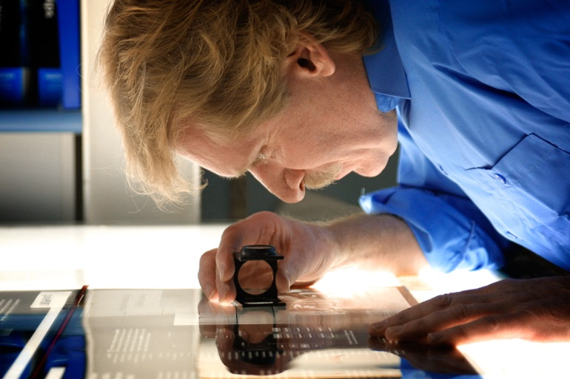
Scrupulous
by Ravenshoe Group

Slide 12
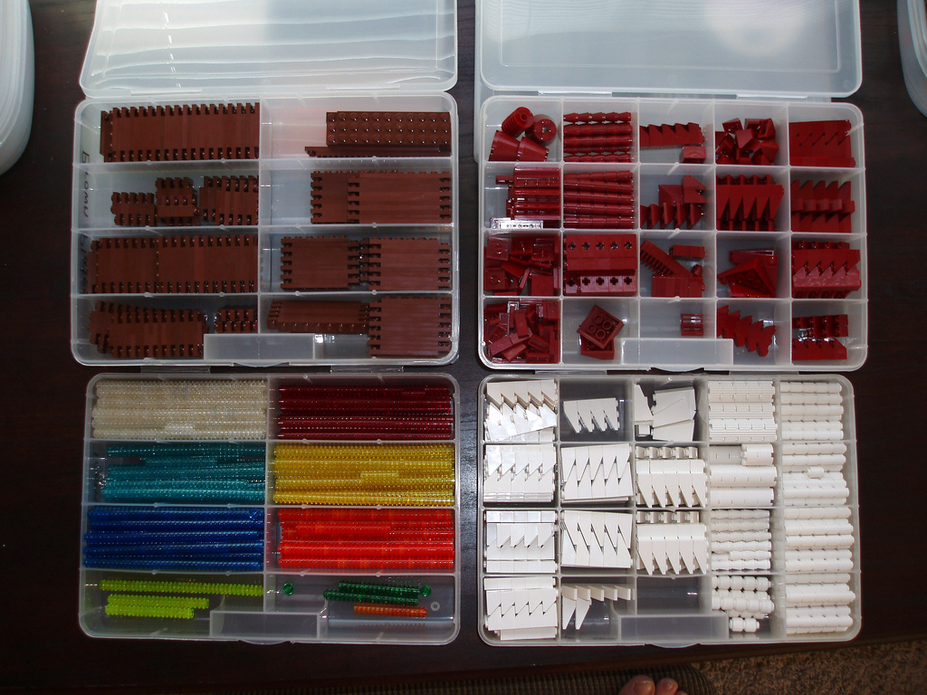
Scrupulous – (adj) s[skroo-pyuh-luh] conscientious; extremely thorough
by eilonwy77

Slide 13
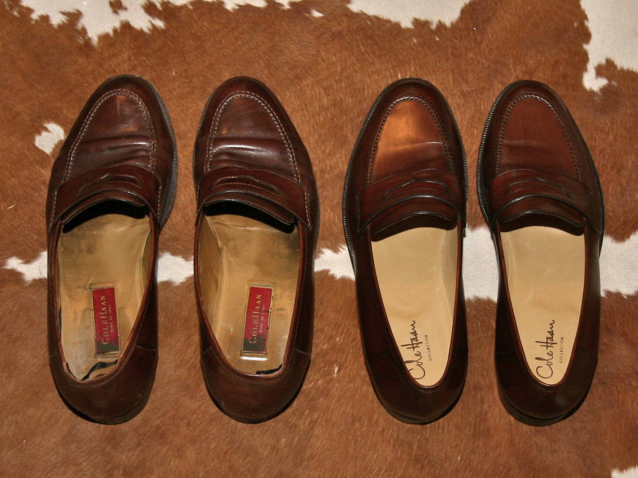
Trite
by eschipul

Slide 14
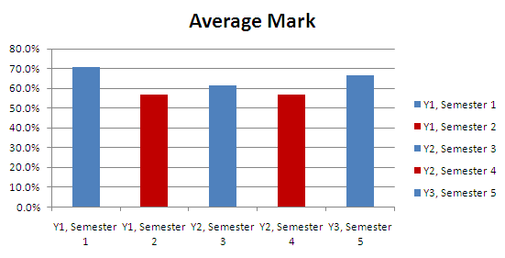
Trite
by Sean MacEntee

Slide 15
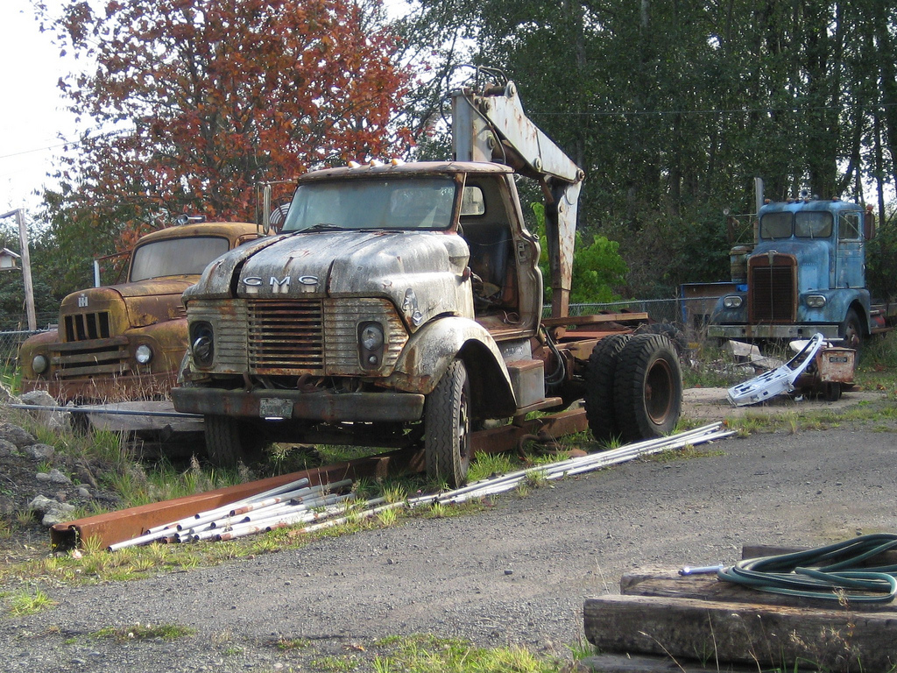
Trite
by Hugo
by Vic

Slide 16
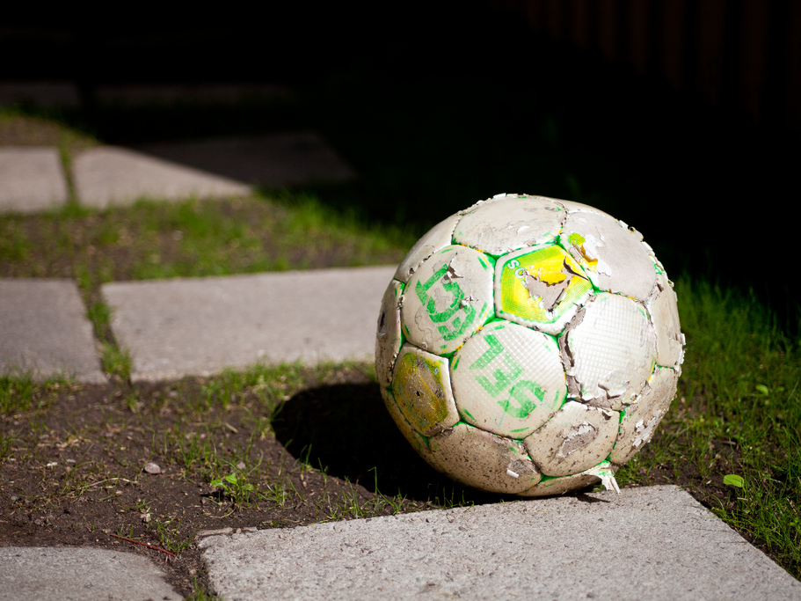
Trite - (adj) [trahyt] hackneyed; commonplace
by Hakan Dahlstrom

